Slide 1

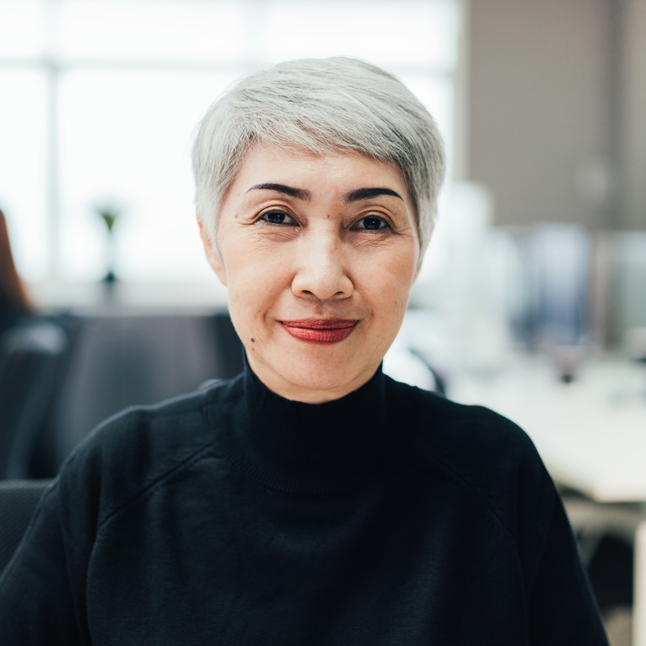
Elevating Your Ethical Awareness
February 7-8, 2023
8am-5pm (PST)
Los Angeles, CA
Course 102
To elevate ethical awareness in our industry to ensure we serve our clients and the profession to the highest standard To provide a clear understanding and clarity of our Code of Ethics, Ethical Rules and Standards To be educated on the risks associated with non-ethical behavior To cultivate an active presence of ethical awareness in daily work and life To nurture an understanding of Ethics as a concept and social construct
Jane Doe, SR/WA, Instructor

