Slide 1
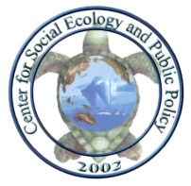
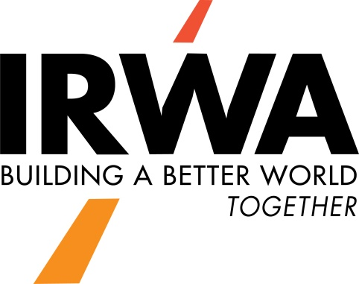
“A Citizen Issue Management Seminar”
Moderator: Lesley T. Cusick, RSI EnTech LLC
The Center for Social Ecology and Public Policy (CSEPP), Inc.
Kevin Preister, Ph.D.
James A. Kent, J.D.
International Right of Way Annual Conference
Portland, Oregon
June 10, 2019
8:00 – 9:30 am

Slide 2
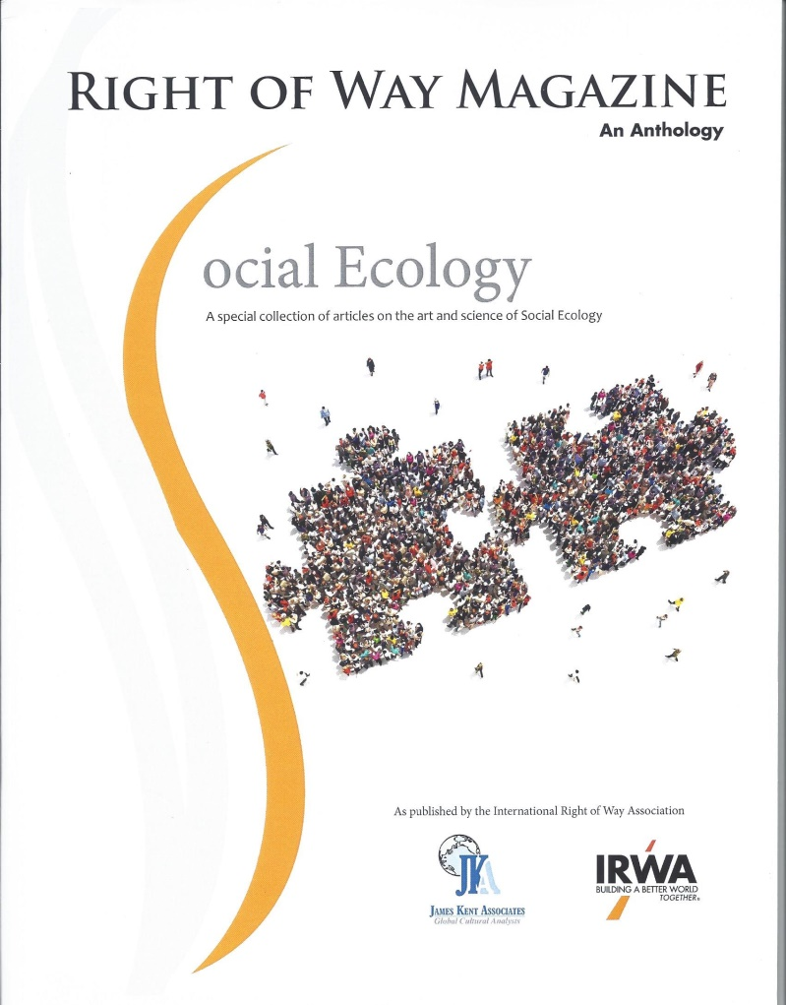
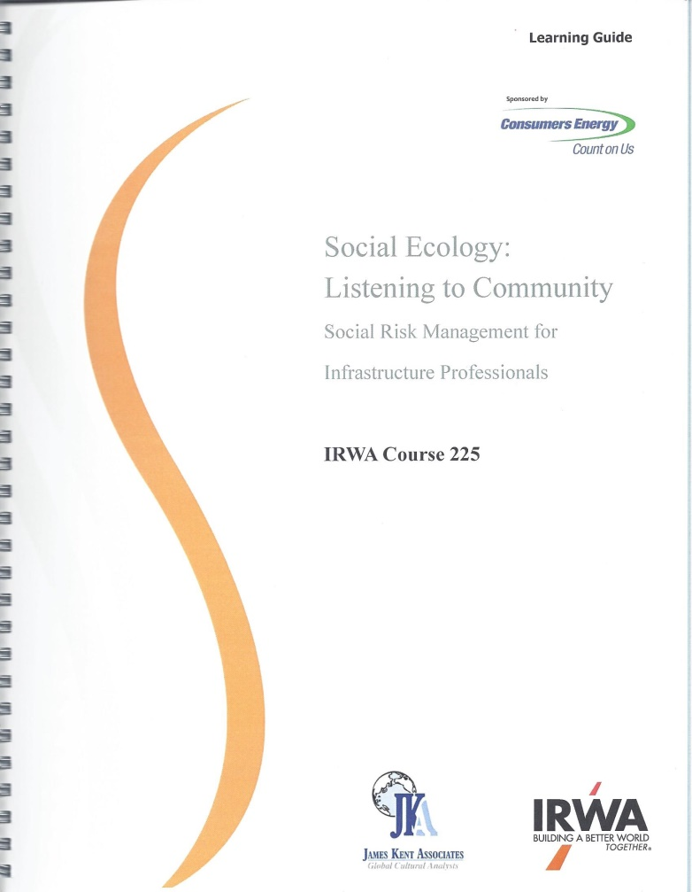
Social Ecology Articles and IRWA Course 225 Learning Guide

Slide 3
Course 225: Social Ecology: Listening to Community
Pablo, Montana, 2013
Caro, Michigan, 2014
Los Angeles, California, 2015
Oakland, California, 2017
Niagara Falls, Ontario, 2017
Phoenix, Arizona, 2017
Concord, New Hampshire, 2017
Denver, Colorado, 2018
Hunt Valley, Maryland, 2018
Lethbridge, Alberta, 2018
Sacramento, California, 2018
San Antonio, Texas, 2018
Portland, Oregon, 2019

Slide 4
Social Ecology:
Art
The Discovery Process™
“What’s out there?”
Science
Human Geographic Issue Management System™
“What do I do with it?”
Social Ecology is the Art and Science of understanding how individuals interact with and influence their physical, biological, social and cultural environments. Social Ecology is an action theory that enhances the ability of the individual to predict, participate in and control their environments in a manner that improves their well being while not oppressing others.

Slide 5
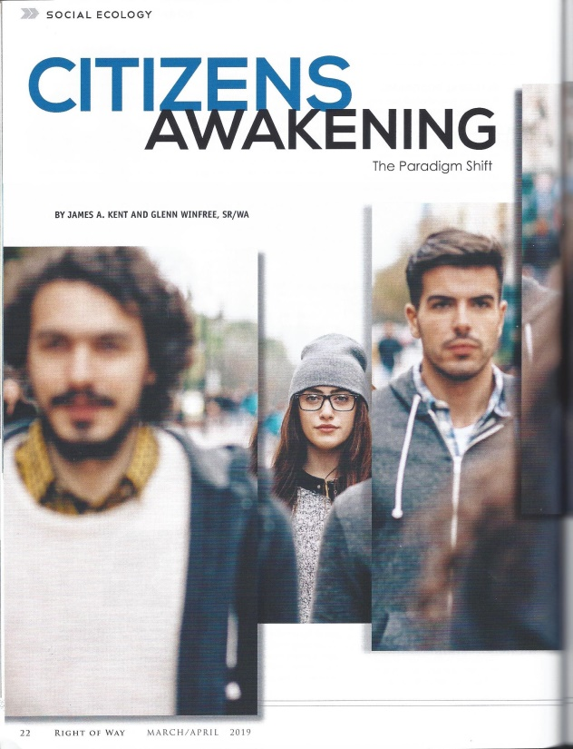
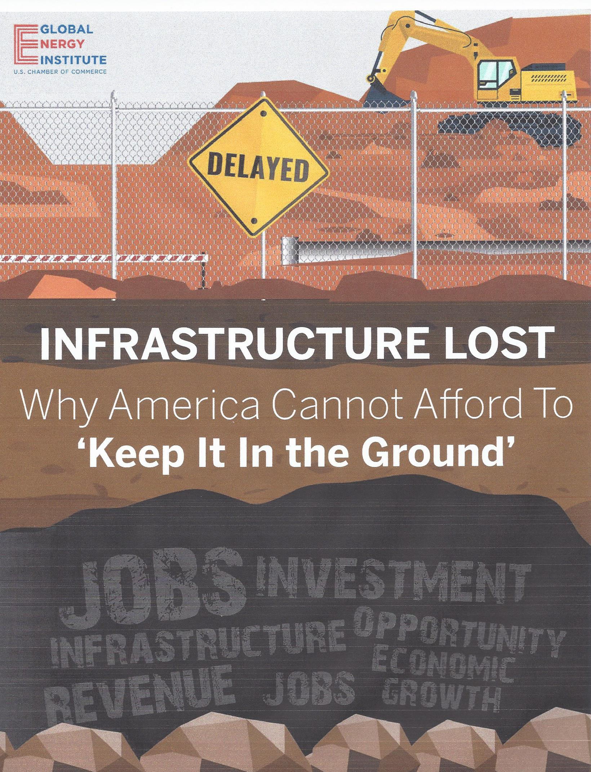
March/April, 2019, Right of Way Magazine

Slide 6
The losses were calculated in the time period between January of 2010 and August 2018:
• Costs of Projects Lost: $57.9 billion
• Gross Domestic Product Lost: $91.9 billion
• Tax Revenue to Local and State Governments Lost: $20.3 billion

Slide 7
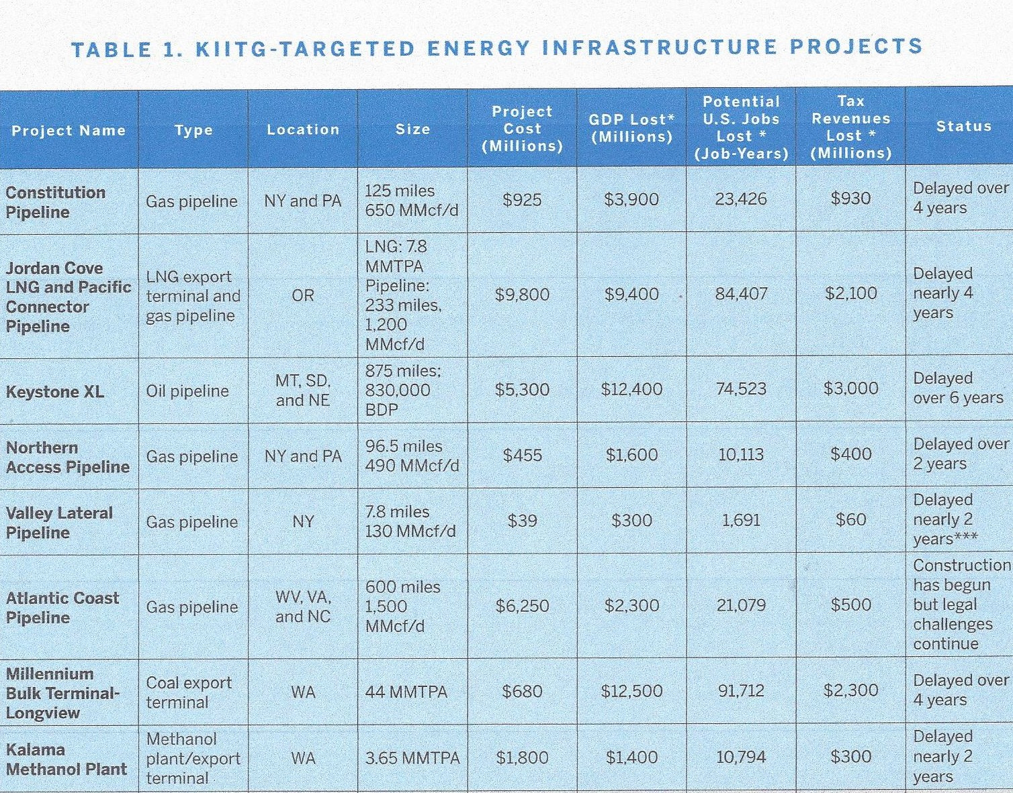

Slide 8
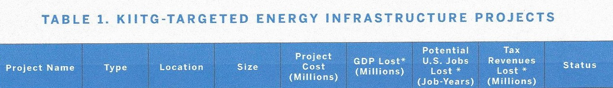
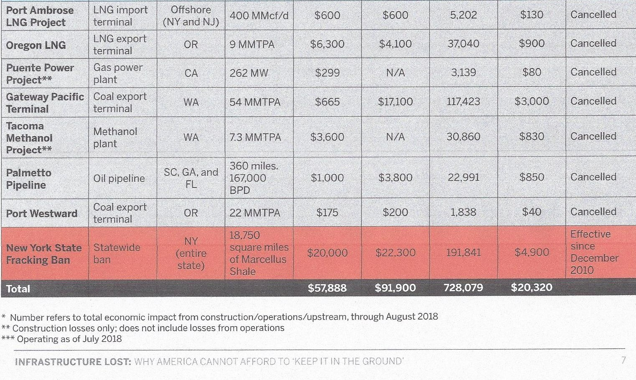

Slide 9
1. Project uses public relations to convince the public that the project is necessary and good for them.
Why this no longer works:
2. They mobilize lawyers to interpret the laws in their favor and prepare for litigation.
Why this no longer works:
3. Projects hire lobbyists to persuade governments that their corporate model is still what’s best for everyone.
Why this no longer works:
4. They employ eminent domain whenever there are delays or challenges.
Why this no longer works:
5. They expect the PUCs to favor project proponents as a final authority.
Why this no longer works:
March/April, 2019, Right of Way Magazine

Slide 10
OLD MODEL--Ineffective
Formal Impact Model
Traditional Approach
Design
Propose
Defend
Community boundary
Project Intrusion
Community Culture
© CSEPP, 2019

Slide 11
NEW MODEL--Effective
Informal Absorption Model
Social Ecology Approach
Learn
Engage
Benefit
Community boundary
“Our”
Community Culture
“Our Project”
© CSEPP, 2019

Slide 12
Four Essential Concepts in Social Risk Management that will Positively Change Project Outcomes
Informal Networks and Local Routines
Gathering Places
Human Geography
Citizen Issues—Emerging, Existing and Disruptive

Slide 13
Concept #1: Informal Networks and Local Routines
CITIZEN NETWORKS
HORIZONTAL
VERTICAL
STRUCTURE
FUNCTION
Caretaking
Survival
Cultural
Political
Economic
Ideological
CHARACTERISTICS
Respected leaders
Flexible goals
Internal recognition of members
Informal communication
Gathering places and natural routines
Elected/appointed leaders
Organizational goals
Membership list
Formal communication
Meeting locations and scheduled times

Slide 14
Examples of How Networks Work
“The County is trying to upgrade this road into a freeway.”
Medford, Oregon
“Are you shushing me?”
Missoula, Montana

Slide 15
Eight Informal Network Archetypes
Caretaker
Trusted by others
Utilized in time of stress
“Let us talk over the idea.”
Communicator
“Did you know...?”
“I heard that...”
Gatekeeper
Narrows entry
“I can hook you up.”
Bridger
Two cultures
Two languages
“I know somebody from...”
“This is what they’re saying...”
Authenticator
Knowledge and wisdom from the culture Provides cultural interpretations to technical data and information
“This is how we do it here.”
Storyteller
“In the past...”
“We used to do it this way...”
Opportunist
Use of public setting for personal gain
“We in the community...”
“My people....”
Historian
History of their geographic place, carriers of the events that have happened over the lifetime of the community. They know critical information.

Slide 16
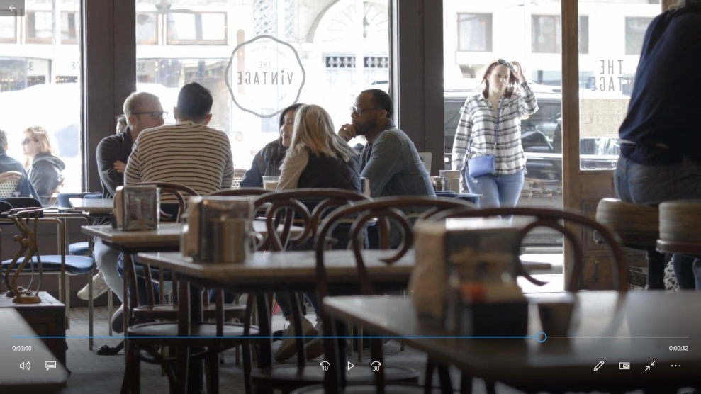
Concept #2: Gathering Places

Slide 17
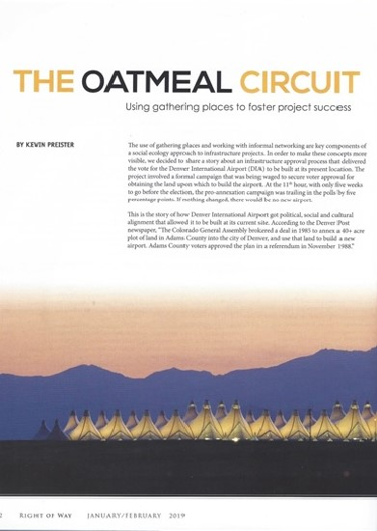
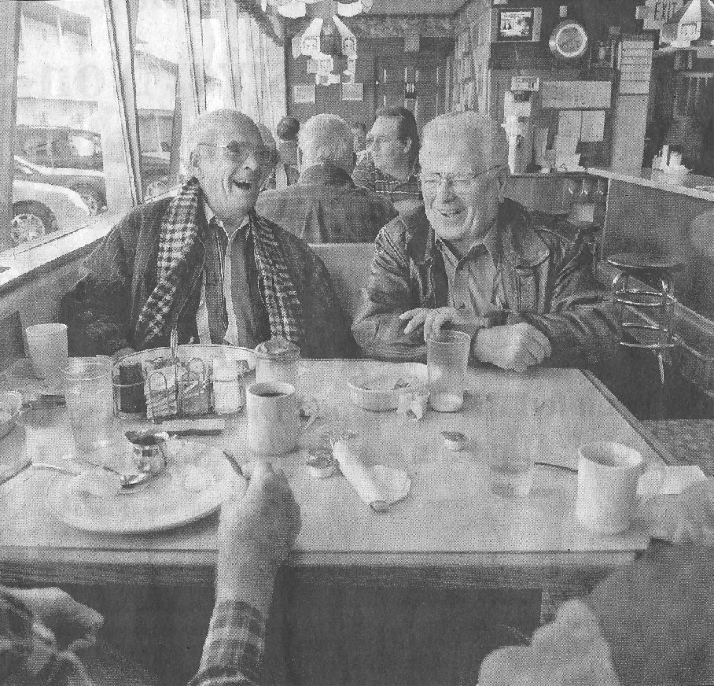
Jan/Feb, 2019, Right of Way Magazine

Slide 18
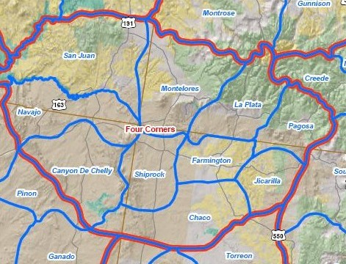
Concept #3: Human Geography

Slide 19
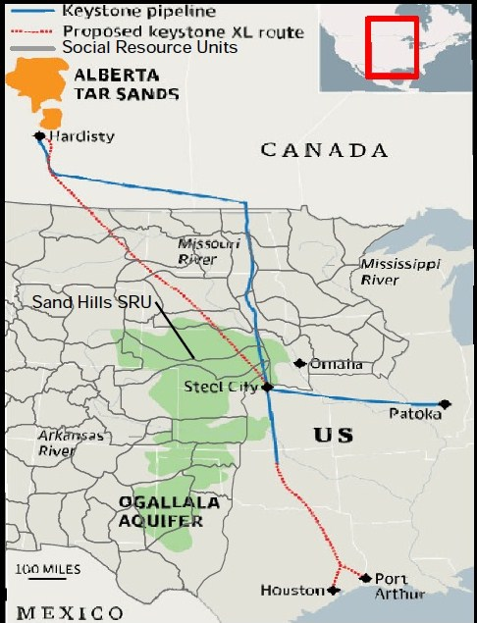
From Right of Way Magazine, IRWA: ”The Promise and Peril of Corridor Expansion” By James A.
Kent, Social Ecology Columnist, Jan/Feb 2012, pages 26 to 29

Slide 20
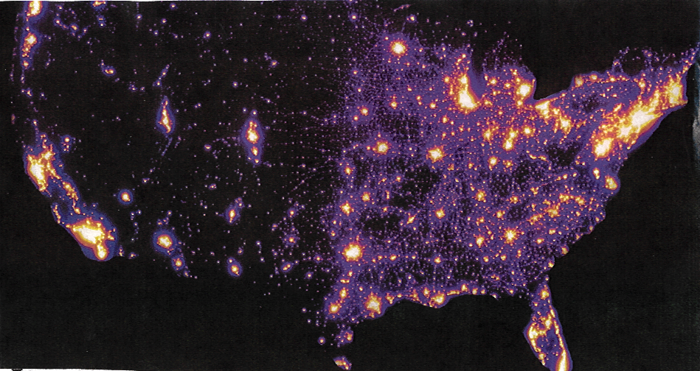

Slide 21
Concept #4: Citizen Issues—Emerging, Existing and Disruptive
Issue Management
is the ability to
recognize,
analyze and
respond
to conditions which
contribute to the development of
citizen issues affecting an organization’s interests.

Slide 22
The Process of Citizen Issue Management to Reduce Social Risk
A means to develop the “moderate middle”
B. Evaluate Solutions
& Make Decisions
A. Gathering & Sorting
Information
C. Implement,
Practice and
Evaluate
TYPICAL MANAGEMENT PROCESS IN COMPANY
Courts
or
Legislature
IMPACT
Company/ Agency
Public
Interests
STAGE 3
Disruptive
Issue
BYPASSES MANAGEMENT CIRCLE AND GOES TO COURTS OR LEGISLATURE
INCORPORATED INTO ORGANIZATIONAL ACTION
STAGE 1
Emerging
Issue
STAGE 2
Existing
Issue

Slide 23
USCC reported $58 billion lost of corporate money.
What if it were possible to get $5 billion of that lost revenue to spend on Right of Way agents to prevent disruption ?
That would mean that $53 billion returns to the company as profit that benefits shareholders.
Question: “What would you do with $5 billion to prevent disruption in your projects?

Slide 24
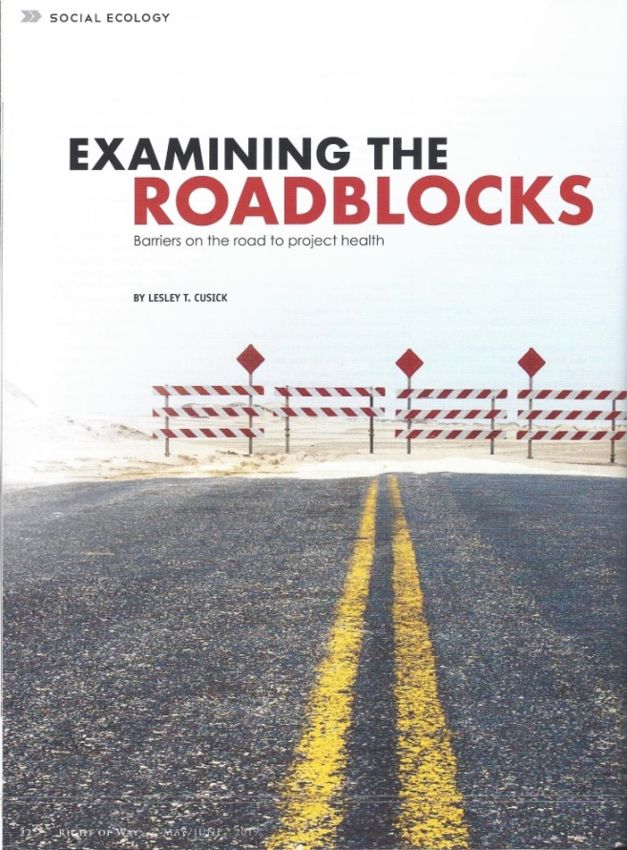
IRWA members who have written Social Ecology columns in the Right of Way magazine
Glenn Winfree, SR/WA
Duke Energy
Chair, International Electric and
Utilities Cmte
Lesley Cusick
RSI EnTech LLC
Public Outreach and Engagement
Glenn was co-author also:
"Managing Project Complexity: The Importance of the Right of Way Professional" , and
"Predict Community Pushback: Using the Social Risk Management Matrix."

