Slide 1
Easement Valuation An Oxymoron?
Can Easements Actually Be Valued,
Or Are We Throwing Darts?
June 9-12, 2019
Brad Kuhn
NOSSAMAN LLP
Rick Friess
ALLEN MATKINS
Kevin Donahue
CUSHMAN & WAKEFIELD

Slide 2



Introductions
Brad Kuhn
Rick Friess
Kevin “Captain Pumpkin” Donahue

Slide 3
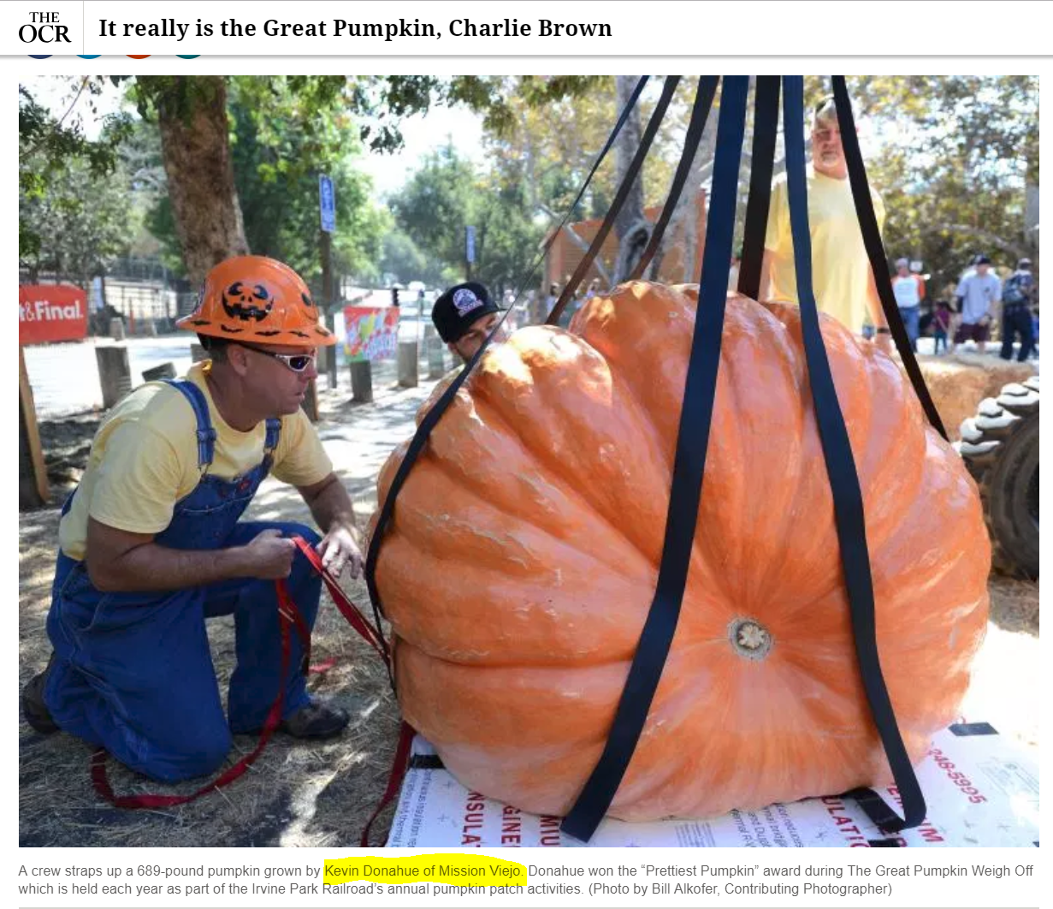
Captain Pumpkin

Slide 4

Captain Pumpkin

Slide 5
What We are Going to Cover
General easement concepts and issues.
  Basic principles.
  Scope/language of the easement.
  Existence of "comps?" How would one find them?
Valuing easements that are being acquired.
Valuing properties already subject to easements.

Slide 6
What is an Easement?
“An easement is an interest in real property that transfers use, but not ownership, of a portion of an owner’s property.”
  The Appraisal of Real Estate, 13th Edition
Fancy way of saying: “the legal right to use another’s property for a specific, limited purpose.”

Slide 7
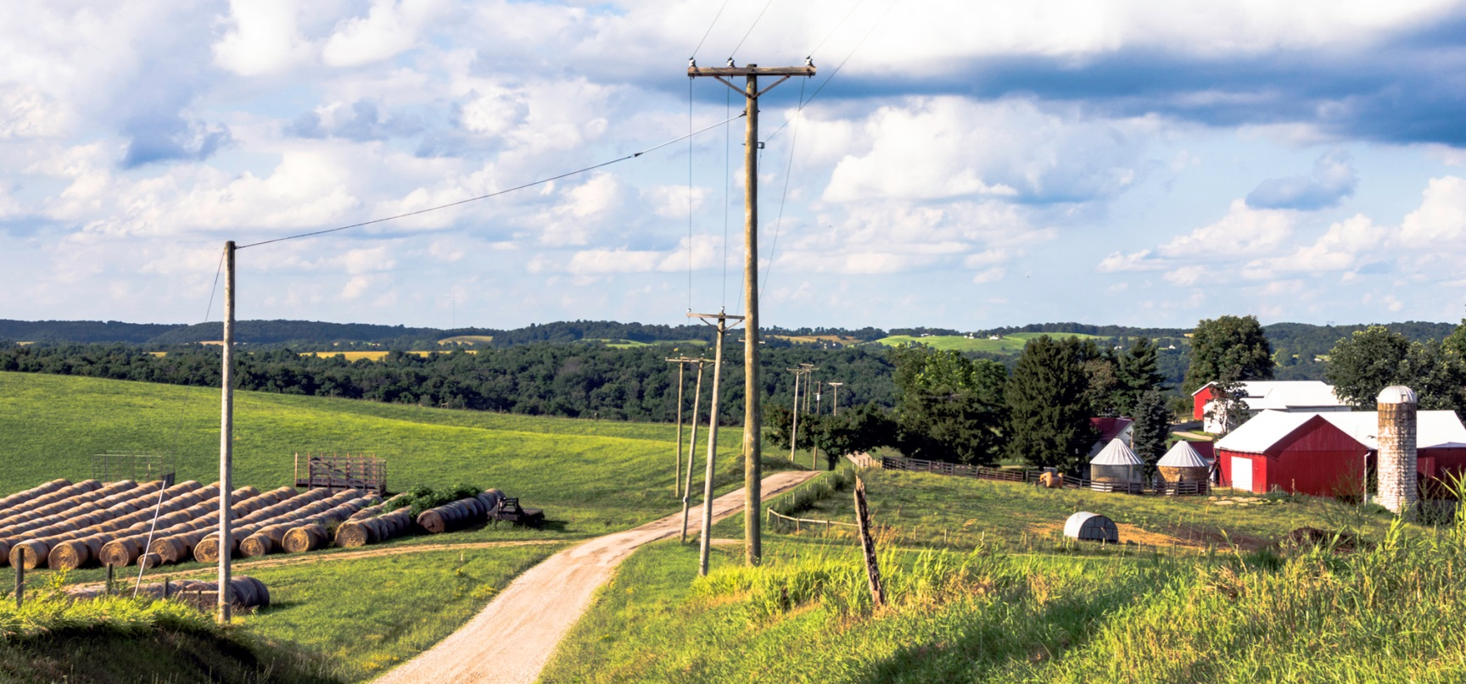
Common Types of Easements
Utilities (overhead and underground)
Access
Streets / Highways
Aerial
Others
Temporary

Slide 8

General Issues and Rules in Valuing Easements
Fair market value/just compensation.
What part of the bundle of rights is being acquired? Scope of the easement and the easement language.
Existence of "comps?" How would one find them. Typically, there is a lack of market data.

Slide 9
Valuing Easements
That are Being Acquired
Scope/language of the easement being acquired.
“Most injurious use.”
Impact of an existing easement on developability of a property, e.g., setbacks, FAR, etc. (e.g., the City of Del Mar excludes some easement areas when calculating FAR.
Severance damages vs. easement value.

Slide 10

Consider the Easement Terms
The appraiser needs to review the easement deed prior to commencing the appraisal process.
USPAP Std. Rule 1-2(e) requires a definition of the rights being appraised.
What does the appraiser do when the easement language is not available?

Slide 11
An Example of an Extreme Easement Provision: Hold Harmless
11. HOLD HARMLESS: GRANTOR shall hold harmless, indemnify, and defend GRANTEE and its members, directors, officers, employees, agents, and contractors and the heirs, personal representatives, successors, assigns of each of them, and the Department (collectively "Indemnified Parties") from and against all liabilities, penalties, costs, losses, damages, expenses, causes of action, claims, demands, or judgment, including, without limitation, reasonable attorneys' fees, arising from or in any way connected with injury to or the death of any person, or physical damage to any Easement Area, resulting from any act, omission, condition, or other matter related to or occurring on or about the Easement Area, regardless of cause, unless due solely to the negligence of any of the Indemnified Parties.

Slide 12
Easement Valuation Matrix
Percentage of Fee | Comments | Potential Types of Easements
90% - 100% | Severe impact on surface use Conveyance of future uses | Overhead electric Flowage easements Railroad ROW Irrigation canals Access roads
75% - 89% | Major impact on surface use Conveyance of future uses | Pipelines Drainage easements Flowage easements
51% - 74% | Some impact on surface use Conveyance of ingress/egress rights | Pipelines Scenic easements
50% | Balanced use by both owner and easement holder | Water or sewer lines Cable line Telecommunications
26% - 49% | Location along a property line, location across non usable land area | Water or sewer line Cable lines
11% - 25% | Subsurface or air rights that have minimal effect on use and utility Location with a setback | Air rights Water or sewer line
0% - 10% | Nominal effect on use and utility | Small subsurface easement

Slide 13
Most Injurious Use
Courts across the United States have held that the proper consideration in assessing damages is the rights acquired, not what the condemnor intends to do with those rights.
  Condemnor cannot condemn the right to flood one’s land at any time and then escape damages by claiming that floods will occur only every fifty years.
  Condemnor cannot condemn all rights of access to and from a property and then escape payment of damages by claiming that it will allow the property owner to continue to access the property to the extent that doing so does not interfere with the condemnor’s use of the land taken.
See Nichols on Eminent Domain, Ch. G1B, §G1B.01
(Matthew Bender, 3rd ed.).

Slide 14
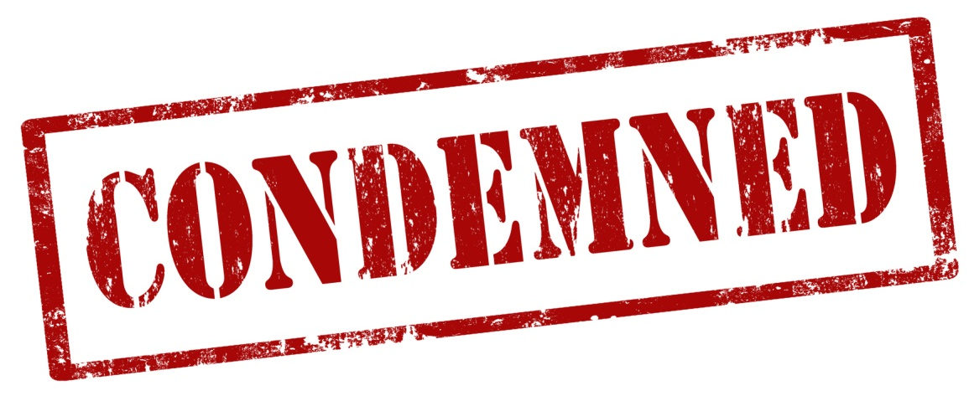
Most Injurious Use – Limitations?
Privileges to use property are not considered in condemnation (permissive and subject to revocation)
Possible future abandonment not considered

Slide 15
Valuing the Impact of Existing Easements in Property Being Acquired
Does the existing easement actually create a burden?
  Could it be a benefit?
The “undivided fee” rule and whether an agency should even get to talk about the impact of an existing easement on value.
  Impact of an owner’s ability to potentially negotiate with an easement holder to relocate or remove an easement.
Impact of an existing easement on developability of a property, e.g., setbacks, FAR, etc. Zones of value?
Existence of “comps?” Again, how would one find them?
Notes:
Artin

Slide 16
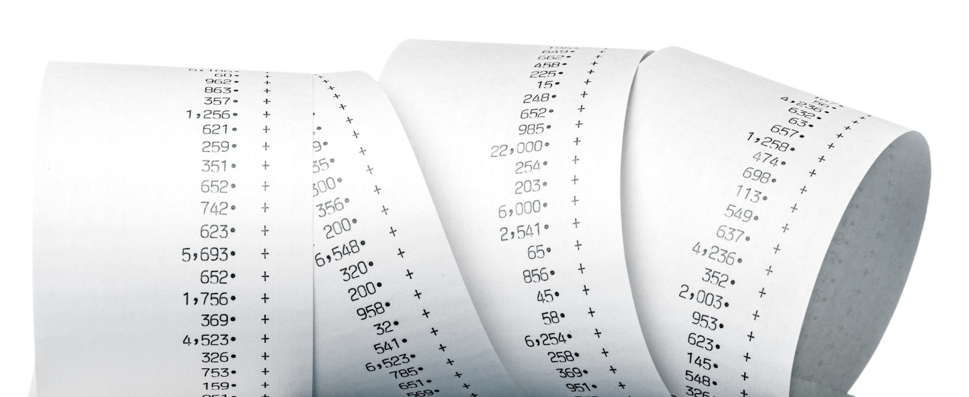
Double Easements –
General Approach
Compensation calculated by determining difference between the value of the fee as burdened by the first easement and the value of the fee as burdened by both easements.
Fee owner may not insist on application of the undivided fee rule.

Slide 17
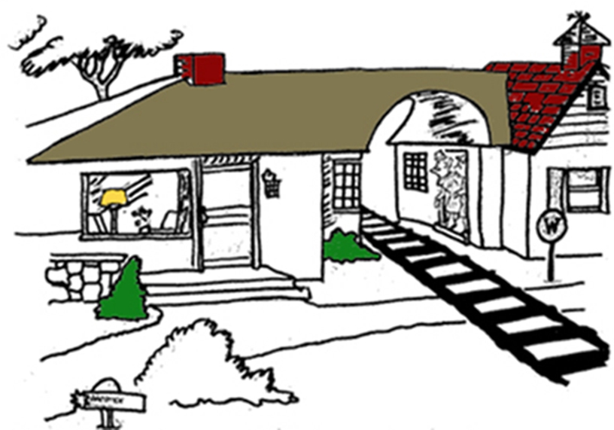
“At the time we bought it, I didn’t know what an ‘easement’ was!”
Notes:
DG

Slide 18
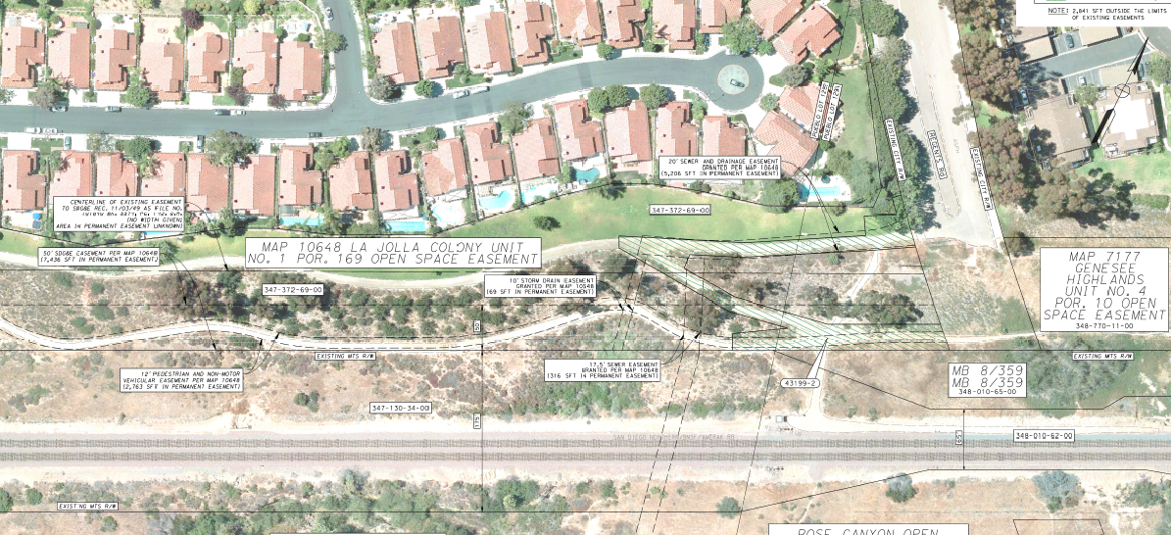
Access Easement Example

Slide 19
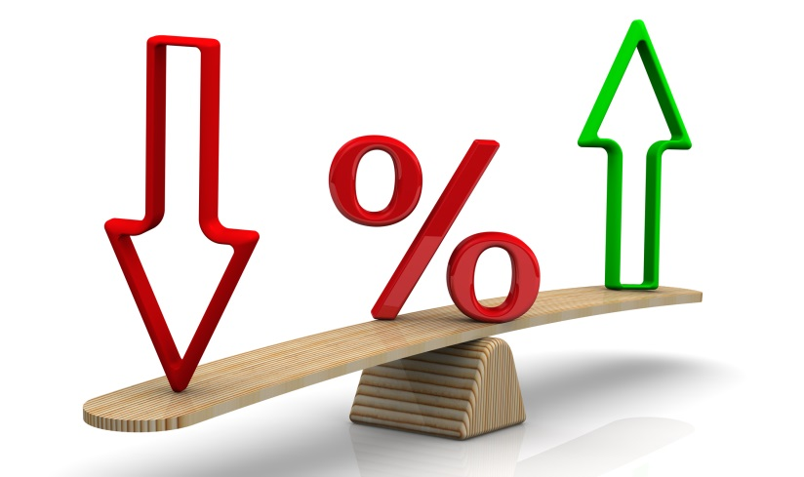
Access Easement Valuation
How to value underlying land area?
What % of value to apply for easement rights?
Considerations?
  Area has little contributory value to HOA
  Minimal interference with existing use (used as walking trail, but that area will remain)
  Subject to existing conservation
  easement, open to public

Slide 20
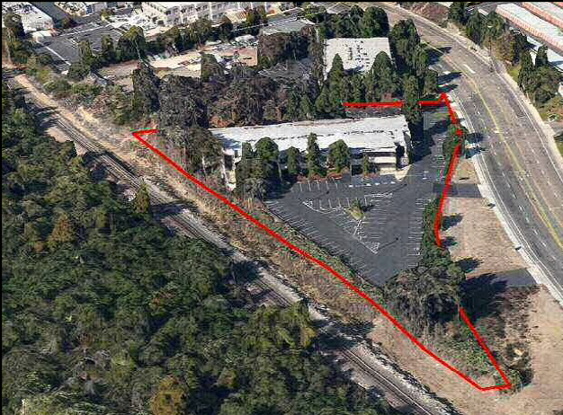
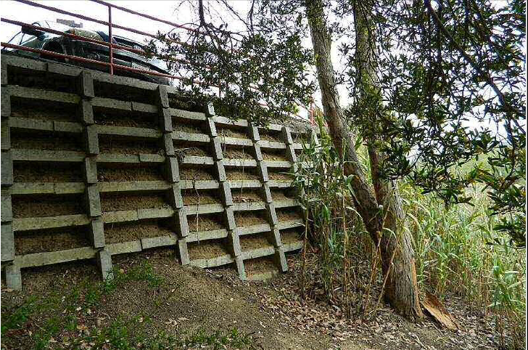
Slope Easement Example

Slide 21
Slope Easement Valuation
How to value underlying land area?
What % of value to apply for easement rights?
Considerations?
  Area has little contributory value
  No interference with existing use or HBU

Slide 22

TCE Valuation Concepts
Fair Market Value requires value based on highest and best use
TCE typically valued based on fair rental value or loss of use.
Notes:
Artin
How do you determine fair rental value? 8% or 10% of value per year? That might work for a short TCE, but longer TCE really require market data.
Longer term TCE’s or those located in high value land areas (Beverly Hills, Downtown LA, Century City) should be based on market rent data, plus recapture of property taxes and insurance premiums the owner has to carry during the easement period.

Slide 23
Temporary Severance Damages?
Can a TCE result in compensable temporary severance damages?
It may depend on actual intended use.
Other jurisdictions look at damages from perspective of hypothetical buyer.
Notes:
DG:
Poll audience. Ask under what scenarios.
1. Campus Crusade: Permits temporary service damages if construction during TCE interferes with owner’s actual intended use.
2. City of Fremont: Mere delay during TCE or inability to use during TCE is not enough. It must interfere with owner’s actual intended use (for example to sell or develop the property).
3. Baca: Confirmed standard and held that substantial impairment is only required when the taking interferes with access.

Slide 24

TCE Duration
Construction commencement date uncertain
When to start?
  Upon providing advance written notice?
  Upon execution of the agreement / OPP?
When to end?
  No deadline or upon
  notice of completion?
  Defined date?
Extensions

Slide 25

Questions?
Brad Kuhn, Nossaman LLP
bkuhn@nossaman.com
Rick Friess, Allen Matkins
rfriess@allenmatkins.com
Kevin Donahue, Cushman & Wakefield
kevin.donahue@cushwake.com

