Slide 1
Eminent Domain for Right of Way Professionals
IRWA Education Conference
Portland, Oregon
2019

Slide 2
Eminent Domain for Right of Way Professionals
Christopher W. Kramer ckramer@jsslaw.com

Slide 3
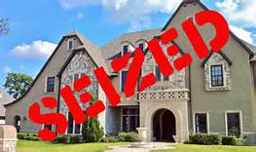

Slide 4
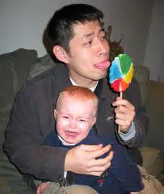
“Taking”

Slide 5


Slide 6
Eminent Domain
Inherent Right of Sovereign
Neither granted nor created by Constitution or any statute
  Necessary
  Inexhaustible
  Inalienable

Slide 7
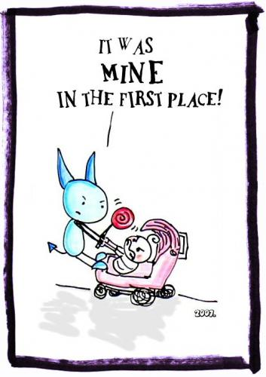

Slide 8
Hugo Grotius
The property of subjects is under the eminent domain of the state, so that the state or he who acts for it may use and even alienate and destroy such property…but that when this is done the state is bound to make good the loss to those who lose their property.” Circa 1625.

Slide 9
Ahab and Naboth
And Ahab* spake unto Naboth, saying, “Give me thy vineyard, that I may have it for a garden of herbs, because it is near unto my house: and I will give thee for it a better vineyard than it; or, if it seem good to thee, I will give thee the worth of it in money.”
1 Kings 21, King James version
*King of Samaria, circa 900 BCE

Slide 10
JUST COMPENSATION DEFINED
Just compensation is the amount of money necessary to put the property owner in as good a financial position as if the property had not been taken.

Slide 11
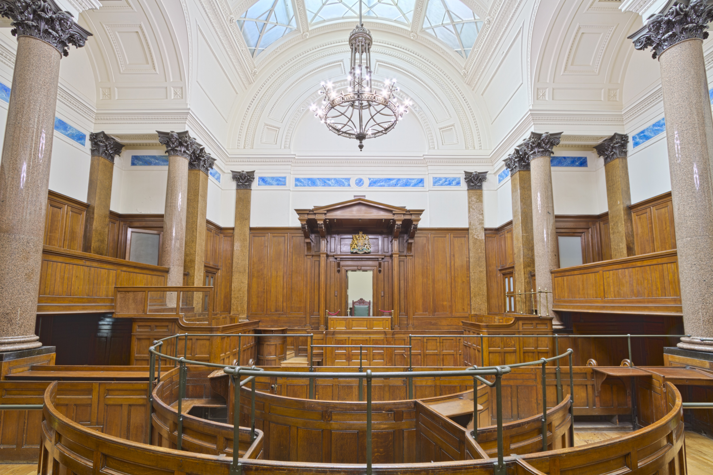

Slide 12
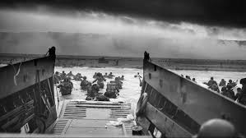
Physically occupy or invade

Slide 13


Slide 14
Eminent Domain v. Police Power
Eminent domain = property taken to benefit the public
Police power = property restricted to safeguard the public
Notes:
Eminent domain, property is taken and applied to public use on the theory that it is a benefit to the public.
Under the police power, the owner is restricted in the use of his property or it is taken or destroyed on the theory that his use is injurious to the public.

Slide 15
Going too far
  Denies the owner of all economically viable use of the land
  Not reasonably related or proportional to the public interest
Notes:
Ultimate issue is whether the public at large, rather than a few landowners, should bear the financial burden of the public undertaking
Physical invasion – almost always taking
Temporary physical invasion – case by case, specific factual inquiry. Relevant factors include: duration of invasion, foreseeability of invasion, character of land, owner’s reasonable investment backed expectations regarding the land’s use

Slide 16
EXAMPLES OF POLICE POWER
Zoning
Exactions
Blight abatement
Traffic Control
Access Control
Notes:
Zoning – if the degree of land use restriction or the conditions imposed upon a zoning approval is too extreme, the courts conclude that the property is being taken without compensation
Exactions – valid exercise of police power when sufficiently related to the public needs emanating from the proposed land use.
Traffic control – traffic island, median, double yellow lines, no parking signs, regulating curb cuts and sidewalk driveway crossings

Slide 17

RIGHT OF ACCESS
“Bundle” of property rights
Notes:
Property rights are broader than just ownership, and include a bundle of rights associated with the land.
Property rights include the obvious – right to occupy the property, right to use and enjoy, right to exclude others, right to convey – but they also include the right of access.

Slide 18
LIMITATIONS OF RIGHT OF ACCESS
Right of access means the right to reasonable access.
Notes:
However, right of access does not mean an absolute right to the same access that existed prior to government action.
Instead, courts have interpreted the right of access to mean the right to reasonable access.

Slide 19
ACCESS MANAGEMENT
Valid exercise of police power:
  Conversion of two-way traffic to one-way traffic
  Regulation of curb cuts and sidewalk crossings
  Installation of median divider (right in/right out)
  Temporary loss of access during construction
  Permanent change of access if alternative access available
Notes:
If so, issue of damages may be submitted to the jury
A number of courts have held that owners in loss of access cases are entitled to compensation when the loss of access creates a substantial injury that is not suffered by the public generally.
No one likes construction noise and inconvenience, but must be more than that.
Traditionally, an abutting owner is not entitled to access at all points between his property and the highway. If he has free and convenient access and his ingress and egress are not substantially interfered with by the public, he has no justiciable claim for compensation

Slide 20
PERMANENT CHANGE OF ACCESS

Slide 21
CITY OF PHOENIX V. GARRETSON
Notes:
In 2007, the City filed an action condemning a temporary right of entry to Garretson’s property, but did not take any land. As part of the light rail project, the City built train tracks and a concrete curb that permanently blocked both driveways along Jefferson. The curbing destroyed access to and from Jefferson, but did not affect access to or from Madison or First Streets. Believing that the property had been left with inferior access that negatively impacted its value, Garretson hired an appraiser who was prepared to testify that the potential development of the interim parking lot use for office space was harmed by the loss of access to Jefferson, which decreased its value by almost $2 million.
The City’s position was that the property still had access to Madison Street and potential access to First Street, so Garretson could not seek compensation as a matter of law. The City’s primary argument, based on Arizona precedent, was that closure of the driveways was simply a restriction on traffic flow, and hence a valid exercise of the police power that was non-compensable as long as the property retained reasonable access to the street system. After the trial court agreed with the City and entered summary judgment barring Garretson from seeking damages for loss of access, the parties stipulated to a judgment that permitted Garretson to appeal the access issue

Slide 22
CITY OF PHOENIX V. GARRETSON
Notes:
Earlier cases suggested that loss of access was not compensable unless (1) some of the landowner’s property was being acquired for a public project 2 and (2) the loss of access left the property totally or effectively landlocked.
In Garretson, the court clarified that a property owner may be entitled to just compensation under the Arizona Constitution for loss of existing access to a public street even if no portion of the property is being taken for a government project. And the property owner may have a claim for compensation if access to a public street is destroyed, even though the property has other means of access. Accordingly, the court permitted Garretson to pursue a claim for the alleged loss of value to his property caused by the City’s elimination of access to Jefferson Street for its light rail project despite the fact that the property remained accessible via Madison Street and, in the future, from First Street.

Slide 23
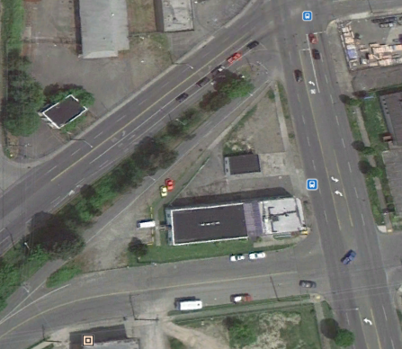
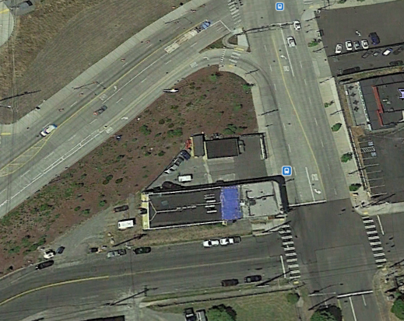
CHANGE OF ACCESS
TT Properties v. City of Tacoma
192 Wash. App. 238, 366 P.3d 465 (2016)
Loss of frontage road access held compensable.
Notes:
TPP owned property at 2620 Pacific Ave and 223 East C Street, at issue in this case.
The Pacific Ave property lacked direct access to Delin Street – however, TPP retained an express easement over the property to the south. TPP’s businesses used Delin Street to exit the property on a regular basis.
In 2009, Transit Authority, began a project designed to add 1.4 miles of new tracks on a City right-of-way, and work on the project included closing the portion of Delin Street that the Pacific Avenue property accessed via its easement.
The project also involved placing a “utility bungalow on city right of way abutting the alley near the C Street property. The bungalow encroached about one foot into the alleyway, which TPP alleged made it impossible for trucks to “swing wide” across the right of way to enter the alleyway and reach the C Street Property.
TPP filed a complaint, alleging that the removal of Delin Street damaged TPP because it was an abutting property owner who had lost access, and alleging that the utility bungalow’s encroachment damaged TPP because trucks could no longer “swing wide” to enter the alley to reach the property.
City filed a motion for summary judgment, which the court granted on the grounds that TPP still has access on two points at the Pacific Ave Property. On appeal, the Court reversed and remanded, finding a genuine issue of material fact regarding whether the removal of Delin Street substantially impaired TPP’s access to its Pacific Ave Property. TPP alleged that the removal of Delin Street had a significant negative impact on the value of the property, and that the property was sold in 2013 at a much reduced price. (No genuine issue of material fact regarding the C Street property -- while TPP has a right to access its property, it does not show that it had a property right to “swing wide” over the City's property beyond the alley to enter the alley.)
Tacoma settled this case for $120,000.

Slide 24
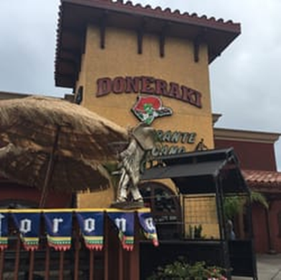
TEMPORARY LOSS OF ACCESS
Padilla v. Metro. Transit Auth. of Harris County
497 S.W.3d 78, 80
(Tex. App. 2016)
Temporary, total denial of access to restaurant held compensable.
Notes:
Doneraki Restaurant, located on a corner lot.
Between January and June 2011, Metro contractors blocked portions of the two roads that joined at the northwest corner of the restaurant while building a light rail for Metro.
Restaurant owners claims that even after construction was completed, one lane of the road on the restaurant’s northern side remained partially blocked, making access difficult but not impossible. Construction workers broke a gas line and ruptured a water line, causing a temporary total loss of use of the property for periods of time. The restaurant closed that November after its owners said they lost $500,000. They subsequently filed an inverse condemnation suit against Metro claiming the restaurant’s closure was a direct result of the lack of access caused by the project.
The state moved the court to dismiss the suit for lack of jurisdiction, saying any project-related impairments were minor and affected the community broadly rather than the restaurant specifically, and that the project didn’t amount to "taking" the property because Metro didn’t have the requisite intent. Metro argued that its contractors were the ones that actually performed the work causing any denial of access. Because the contract instructed the contractors to minimize the effects of construction on private property owners, Metro asserted that it did not know damage beyond the typical disruptions associated with construction was substantially certain to result.
The court on appeal reversed the trial court’s dismissal, finding that there was an issue of fact as to whether the construction caused a total denial of access to the property, and whether Metro had the knowledge that construction was causing or substantially certain to cause property damage to the restaurant owners.

Slide 25


Slide 26
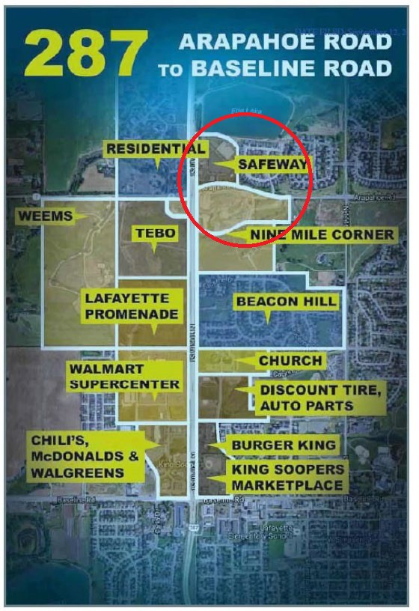
City of Layfayette v. Town of Erie, 434 P.3d. 746 (Colo. App. 2018)
The battle for King Soopers grocery Store

Slide 27
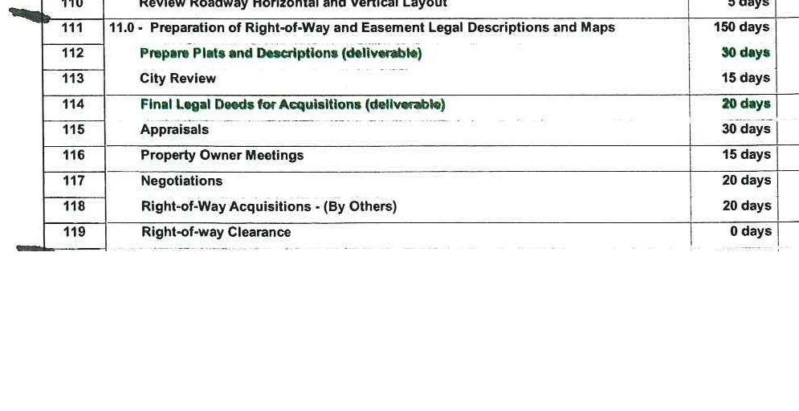
Real Schedule

