Slide 1
Generational Management
IRWA Young professionals

Slide 2
Disclaimer
All material is based on Science
If statements made during the presentation are offensive to you… Oh well!
Learn from it and move on!

Slide 3
Why This Session?
Examine the traits on what makes each generation unique and “different”
Which management styles that are working and which aren’t
Continue build and maintain a cohesive organization that is moving forward

Slide 4
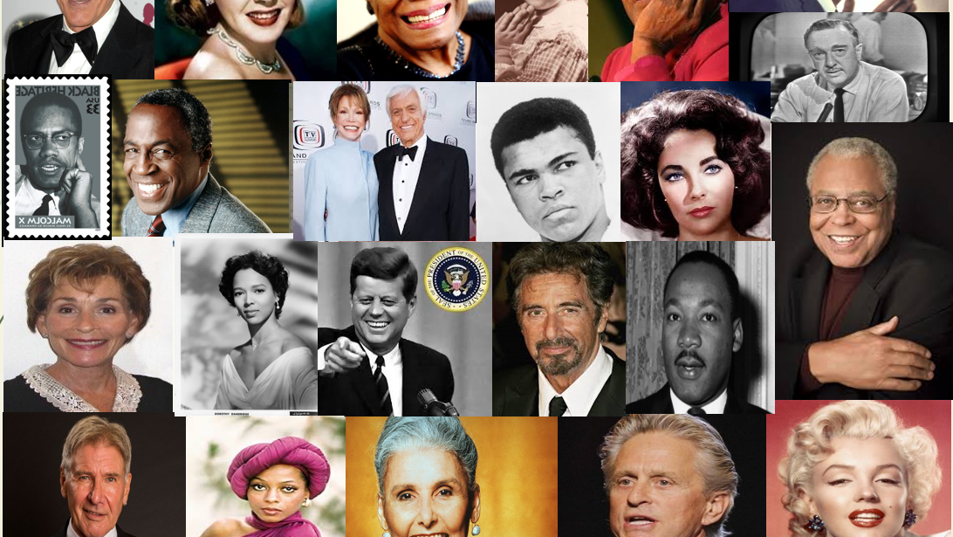

Slide 5
Traditionalists: Who Are You?
  The “Traditional Generation” are those individuals who were born from 1925 up to 1945.
  Between the ages of 63-86.
  Often referred to as the “Silent Generation” were expected to be seen and not heard.
  Times: Veterans, WWII, Korean War, and survived the Great Depression.
  Raised by parents that just survived the Great Depression.
  Experienced hard lives while growing up which were followed by times of prosperity.

Slide 6
Traditionalist Characteristics
In Understanding Traditionalists
  Adhere to rules
  CONFORMERS/Conformity
  Dedication/Sacrifice
  Discipline
  Don’t Question Authority
  Law and Order
  Patriotism
  Savers

Slide 7
Traditionalist Characteristics
Things you need to know about Traditionalists
Hardworking
Respect Authority
Tech Challenged
Value Old Time Morals, Safety, Security and Consistency
Prefer Face to Face Interaction

Slide 8
Traditionalist Characteristics
Majority of your Traditionalists had it hard
Many only work for one employer their entire life
Extremely loyal to coworkers and employers
Great team players
Grateful

Slide 9
Obvious Differences
Traditionalist
Retiring: 50 Million
Age 60s, 70s, and 80s
Value Security
Technology Challenged
Grateful
Face to Face Communication
Millennials
Starting: 70 Million
Age late teens and 20s
Value Creative Challenges & Personal Growth
Technology Savvy
Entitled
Text messages/e-mail

Slide 10
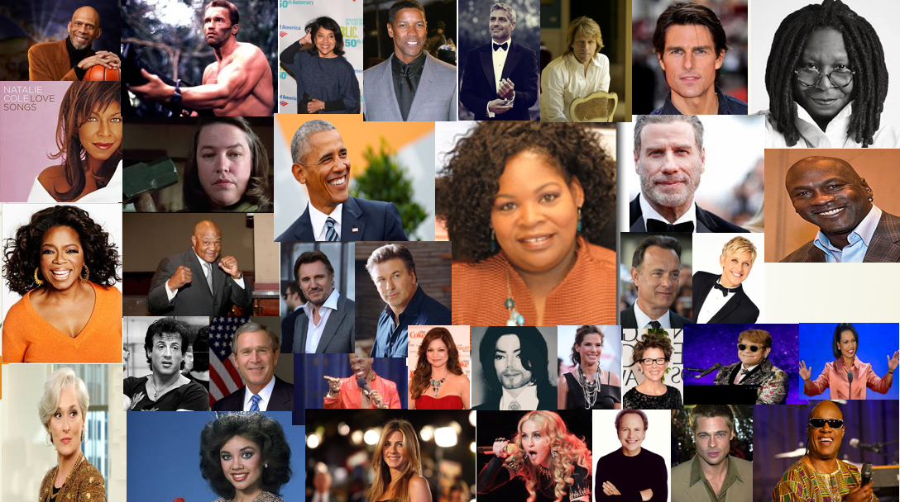

Slide 11
Baby Boomers: Who Are You?
  Individuals who were born from 1946 up to 1964
  Between the Age of 54-72
  Often referred to as the “Me Generation”, they want to be seen and heard.
  Civil Rights, Vietnam War, Sexual Revolution, Cold War/Russia, Space Travel
  Post War Babies who grew up to be radicals of the 70’s and yuppies of the 80’s
  Have the highest divorce rate and 2nd marriages in history
  The “American Dream” was promised to Baby Boomers and they pursued it
  They are seen as greedy, materialistic and ambitious

Slide 12
Boomer Characteristics
In Understanding Baby Boomers
  Moral Authority
  Extremely Loyal to their children
  Optimism
  Personal Growth/Sexual Revolution
  Team Oriented
  Want to make a difference

Slide 13
Boomer Characteristics
Things you need to know about Baby Boomers
  Ability to handle crisis
  Ambitious
  Challenge Authority
  Competent
  Competitive
  Ethical
  Good communication skills
  Live to Work

Slide 14
Obvious Differences
Baby Boomers
Retiring: 80 Million
Age: 54-72
Driven
Workaholics – Inventors of 50+ hour work week
Buy now, pay later
Acquired/Technology
Millennials
Starting: 70 Million
Age late teens and 20s
Balance
Work smarter – not longer hours
Earn to Spend
Integral/Technology

Slide 15
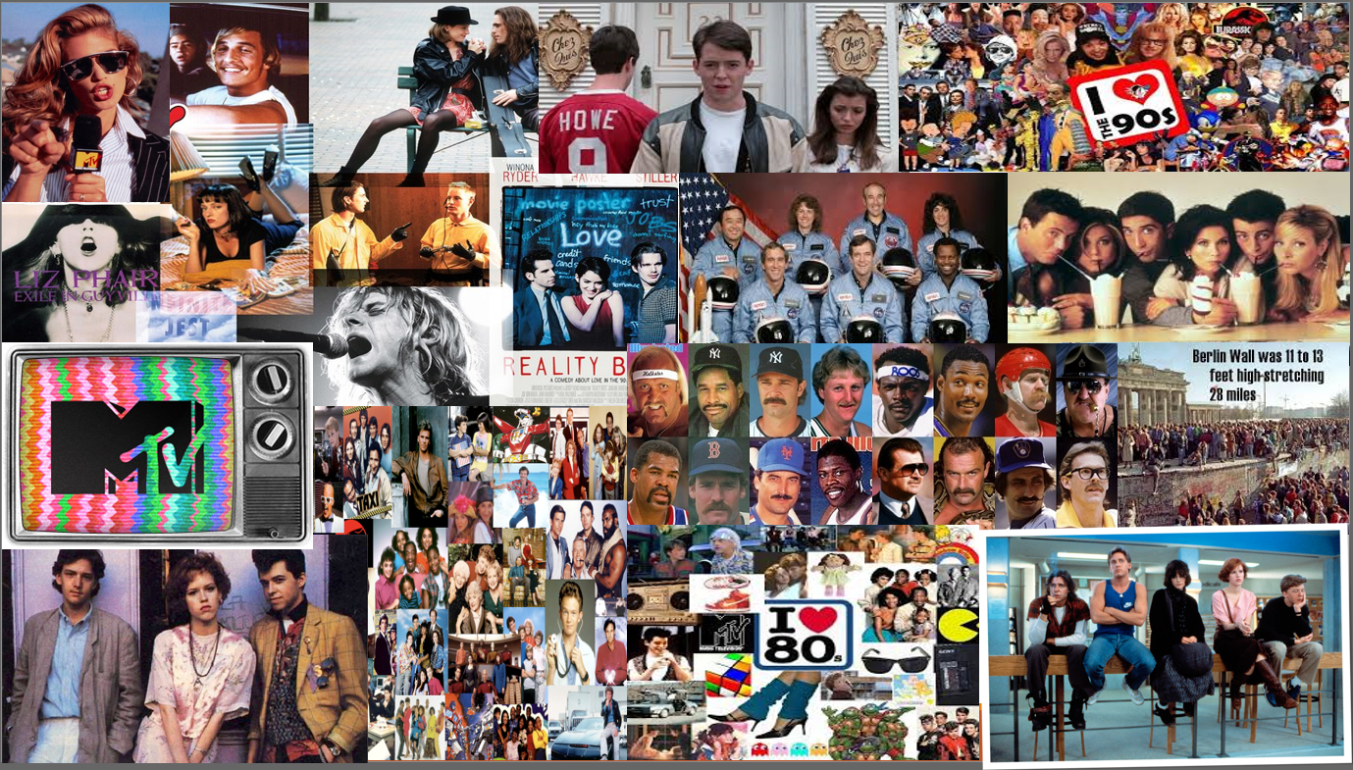

Slide 16
Generation X: Who Are You?
Make up about 31% of the economy, even though we are only 25% of the population
We outspend all other generations
35% have a college degree
Love Social Media
45% feel that advertisers ignore this group or they are not portrayed properly in advertisements
Still enjoy traditional media

Slide 17
Generation X Characteristics
In Understanding Baby Boomers
Self Reliant
Sarcastic
Seeks for Job Flexibility
Family
Traditional Generation

Slide 18
Obvious Differences
Generation X
Starting: 50 million
Age: 30s and early 40s
Better Managerial Skills
Excellent Problem Solving Skills
Revenue Generation
Less Executive Presence
Millennials
Starting: 70 Million
Age: late teens and 20s
Balance
Work smarter – not longer hours
Entrepreneurial
Opportunistic

Slide 19
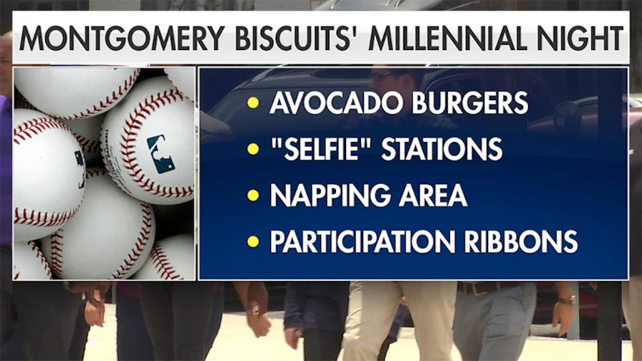
Millennials: You Already Know

Slide 20

Millennials … UGH

Slide 21
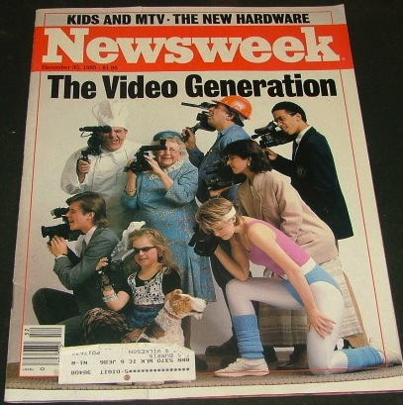
What does the media say?
“There they are, those preening narcissists who have to document every banal moment with their cutting-edge communications technology.” – Newsweek, December 30, 1985
Said about Gen-Xers

Slide 22
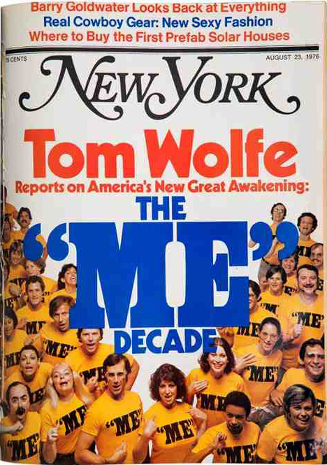


Media?
“The ‘now’ generation has become the ‘me’ generation.” – New York Times, 1976
Said about the Boomers
Then…

Slide 23
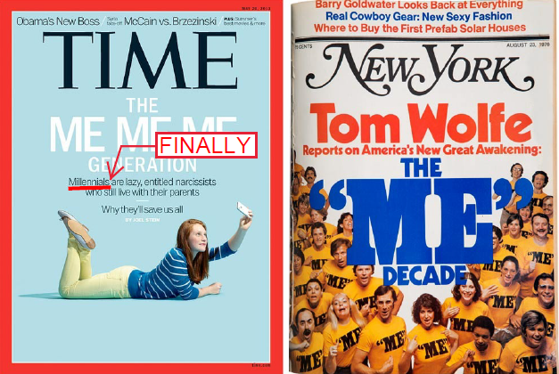
Look Familiar?

Slide 24

The Worst Generation
YES!
Says The New York Post-according to new research that’s yielded actual data to back up that notion.
University of New Hampshire surveys that a measurement of psychological entitlement and narcissism found that Gen Y respondents scored 25% higher than respondents ages 40 to 60…
… and a whopping 50% higher than those over 61

Slide 25

Generational Problem or Emerging Adulthood?

Slide 26
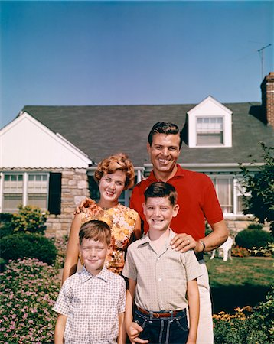
Emerging Adulthood
What Defines an Adult
Age?
Marriage?
Mortgage?
Babies?
Responsibility?
Maturity?

Slide 27

It has been said Millennials are…
Lazy
Entitled
Narcissist
Rude
Selfish
Disrespectful
Irresponsible
Disinterested
Impatient

Slide 28

In actuality Millennials are…
Tech-savvy
Collaborative
Connected
Multi-taskers
Ambitious
Entrepreneurial
Family oriented
Apathetic
Lastly (but most uniquely)… DIVERSE – more so than any other generation

Slide 29
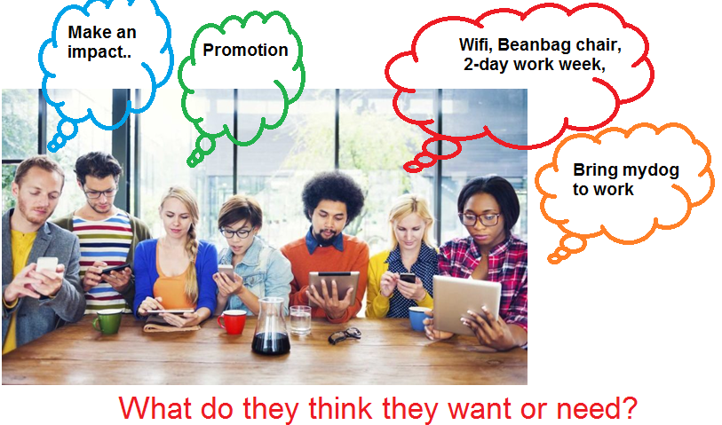

Slide 30
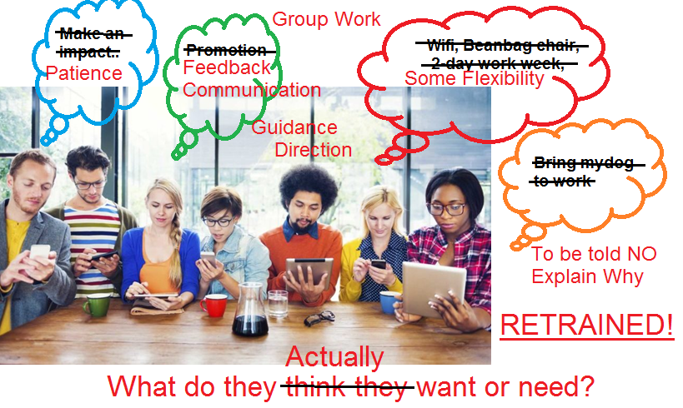

Slide 31
What’s the real difference?
There isn’t much of one!
Each Generation has things the other can agree they need to improve upon
Each Generation can bring their own unique gifts to the table
Now we have to figure out how to mold them into one cohesive unit!

