Slide 1
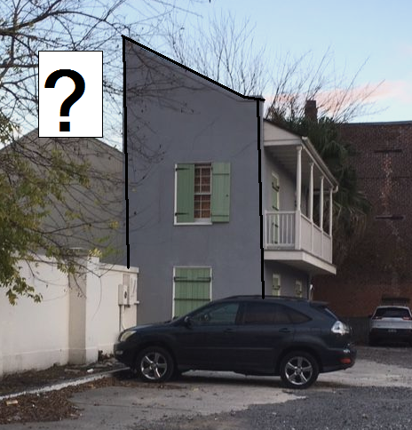
Valuation Case Studies,
Solved and Unsolved

Slide 2
HVTLs: Impact on High-end
Residential Subdivisions
Marian J. Barnes, MAI, SR/WA
Rolling & Barnes, LLC
IEC, Portland, OR, June 2019

Slide 3
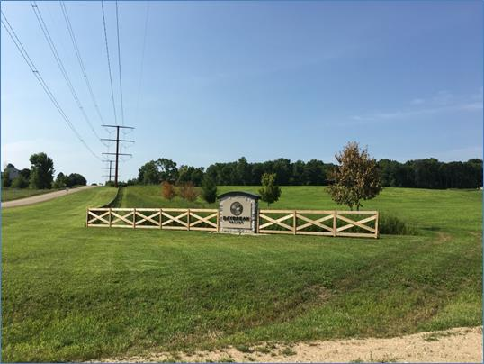
Daybreak Valley
Middleton, Wisconsin
138 kV/345 kV

Slide 4
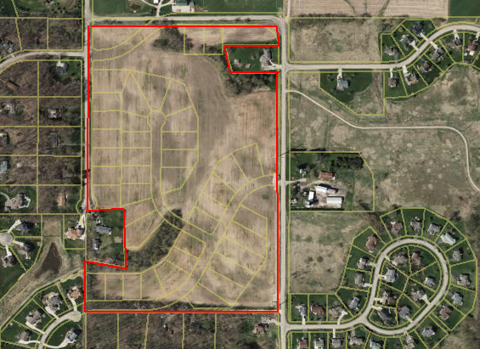
2017 Land Sale: 30% discount
Sale conditions?
55 AC
55 acres

Slide 5
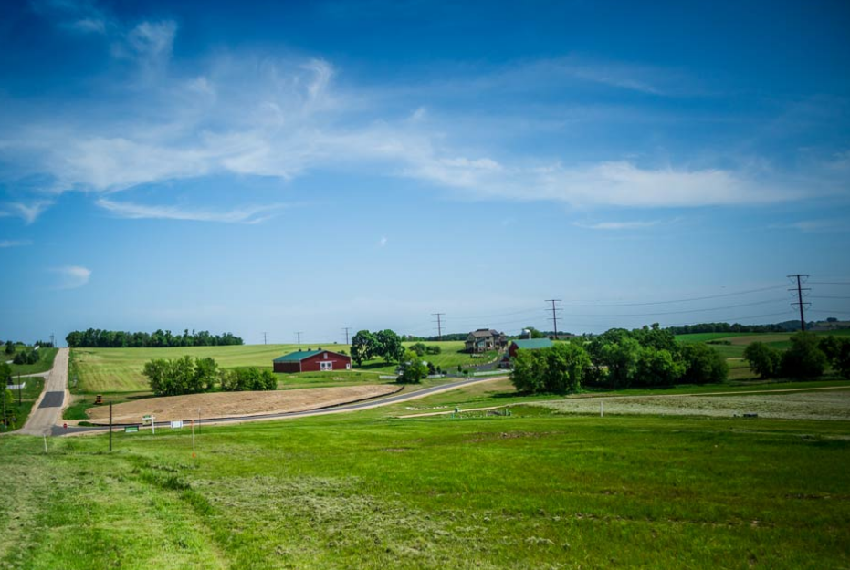
Web site…..homes starting at $500,200

Slide 6
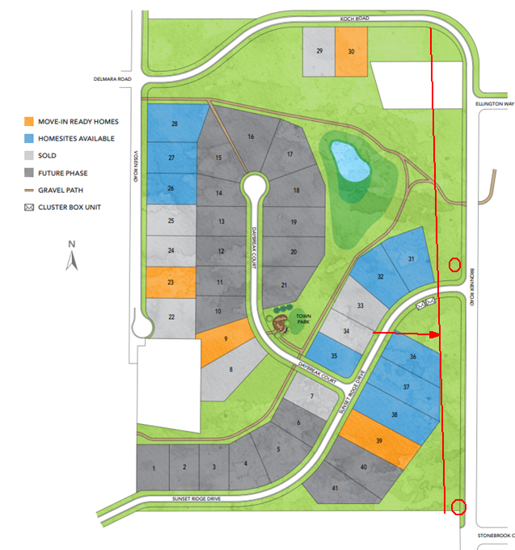
41 lots;
21 lots in Phase I
12 houses complete
6 sold per MLS
4 listed
2 custom
C
D

Slide 7
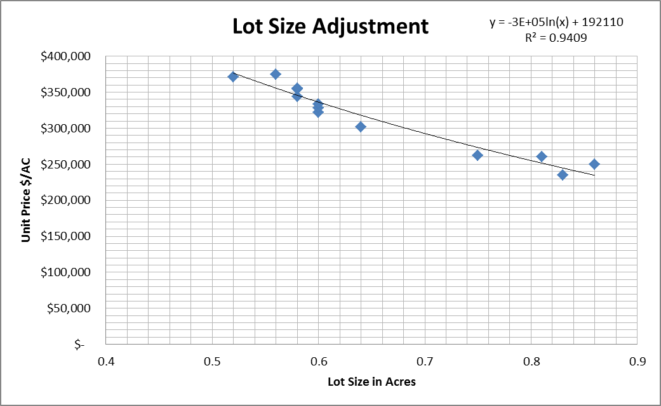
Lot Asking Prices
Individual lots are not being sold
MLS data: asking prices

Slide 8
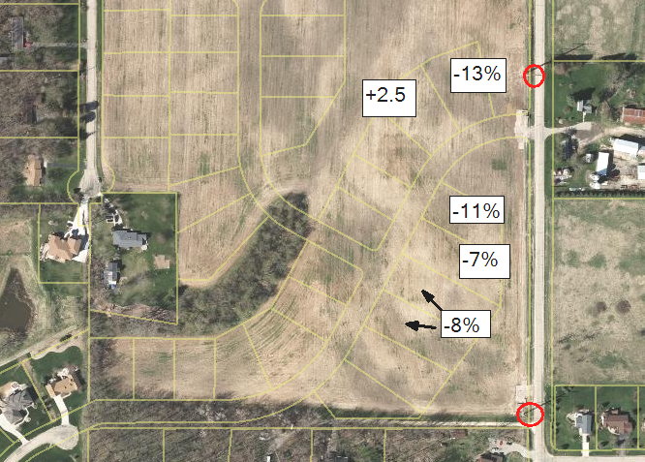
After Size Adjustment -
100’

Slide 9
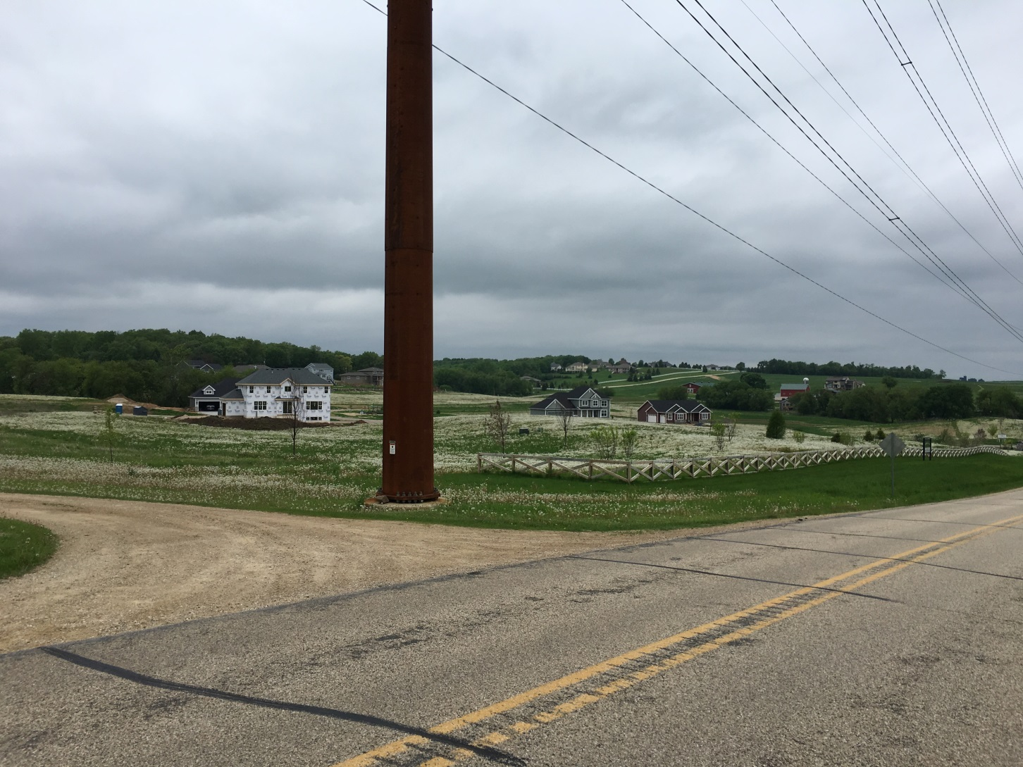
House Sales/Listings
Six Sales
Four listings

Slide 10
House Sales – Time Adjustment

Slide 11
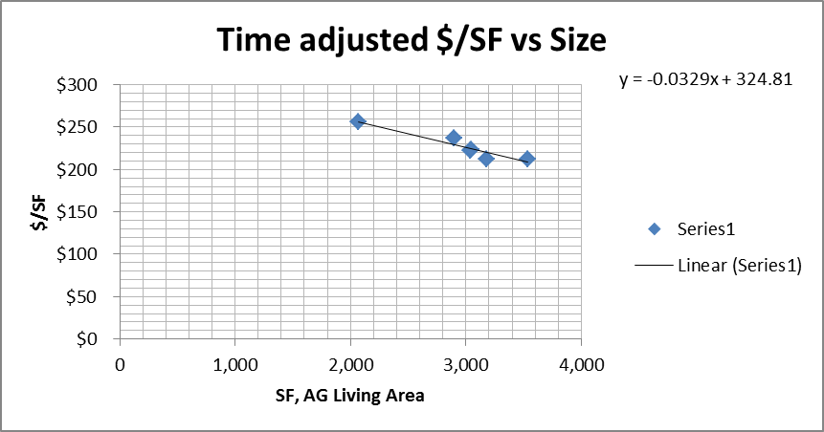
Size Adjustment

Slide 12
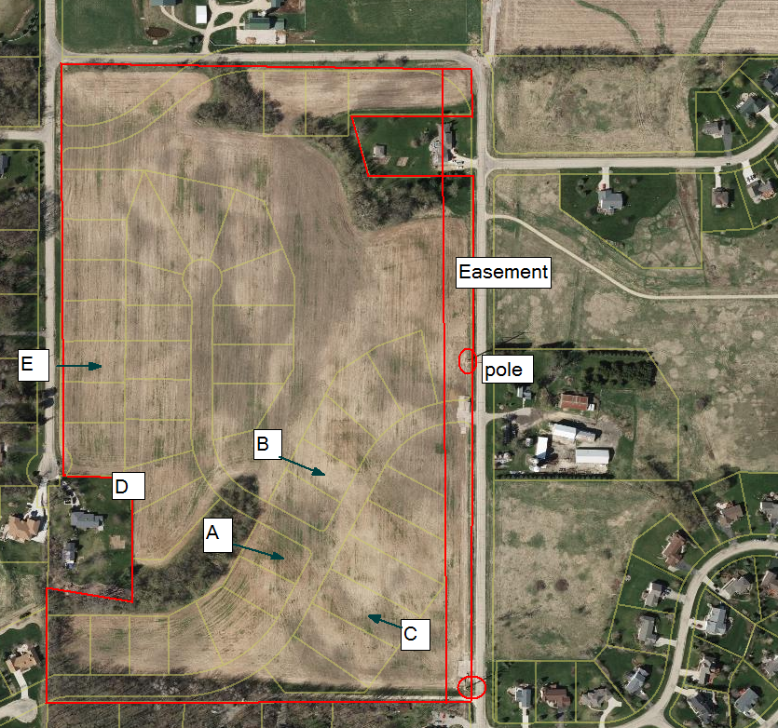

Slide 13
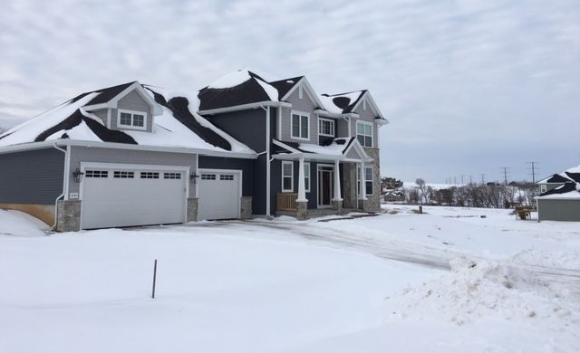
“A” sale Dec. 2018 $681,233
House A: lot 400’ from easement
Price impact?

Slide 14
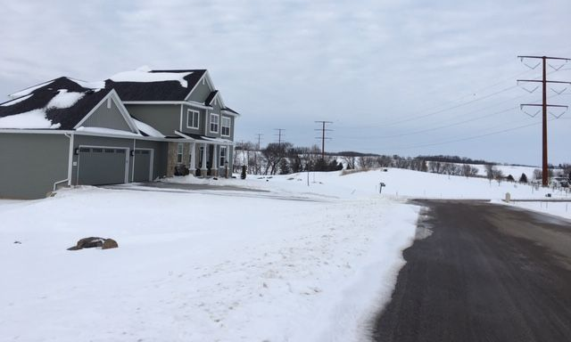
“B” sale July 2018 for $644,797
House B: lot 300’ from easement
Price impact?

Slide 16
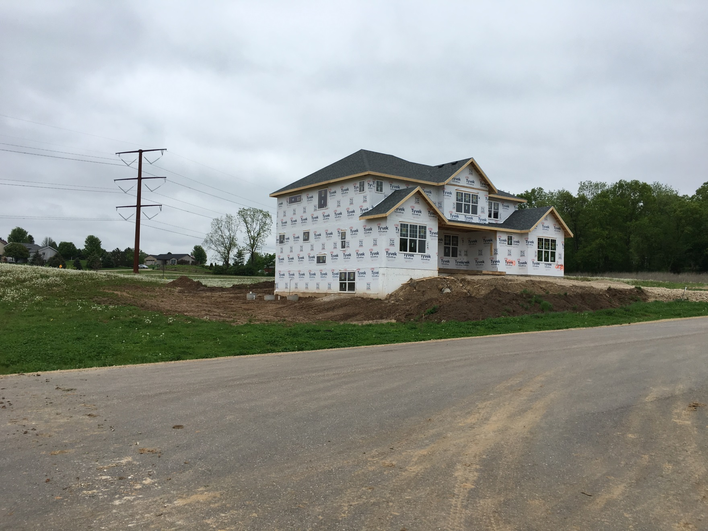

“C” Listing, easement 60’
Back View, Price Impact? 15% discount
Listing agent: price may have a discount to the lot. -11% lot equates to -3% for the improved value.

Slide 17
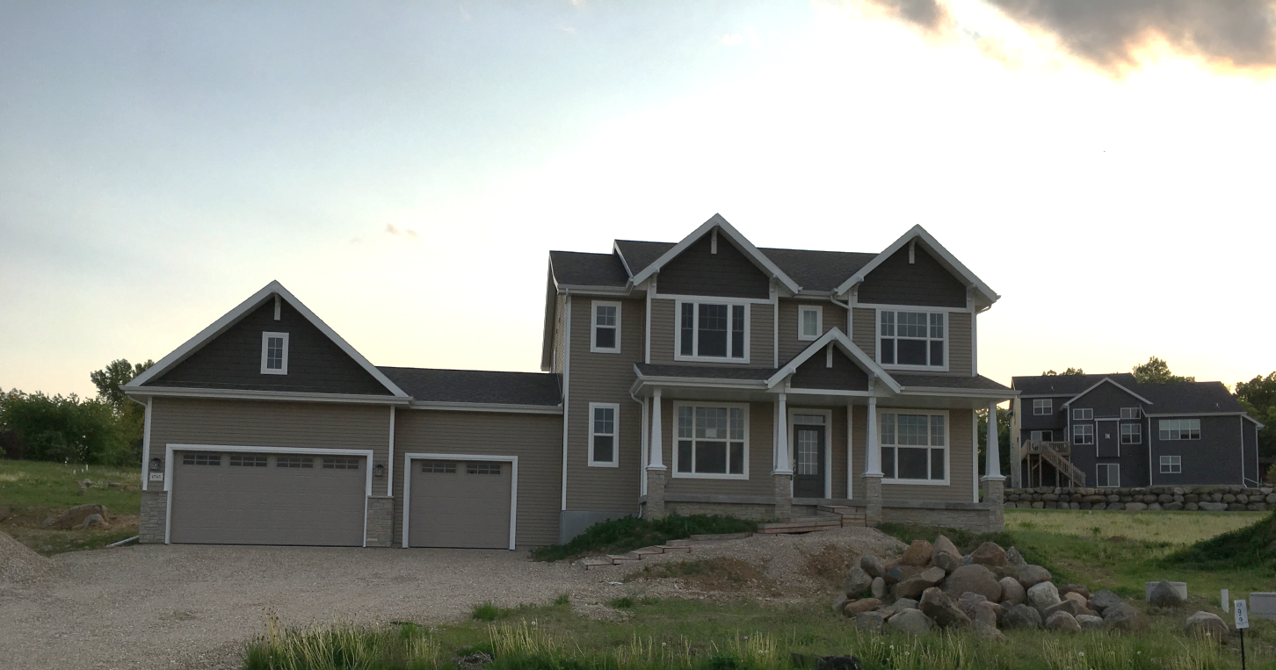
“D” Listing, front view,740’ feet
Price Impact? 10% less ??
Listing agent: HVTL not a consideration

Slide 19
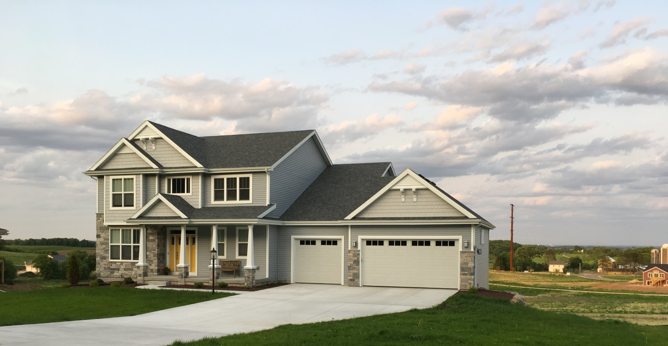
House “E” Sale
1,000’ from easement
Back View. Price Impact? 11% less but Realtor said no impact

Slide 20
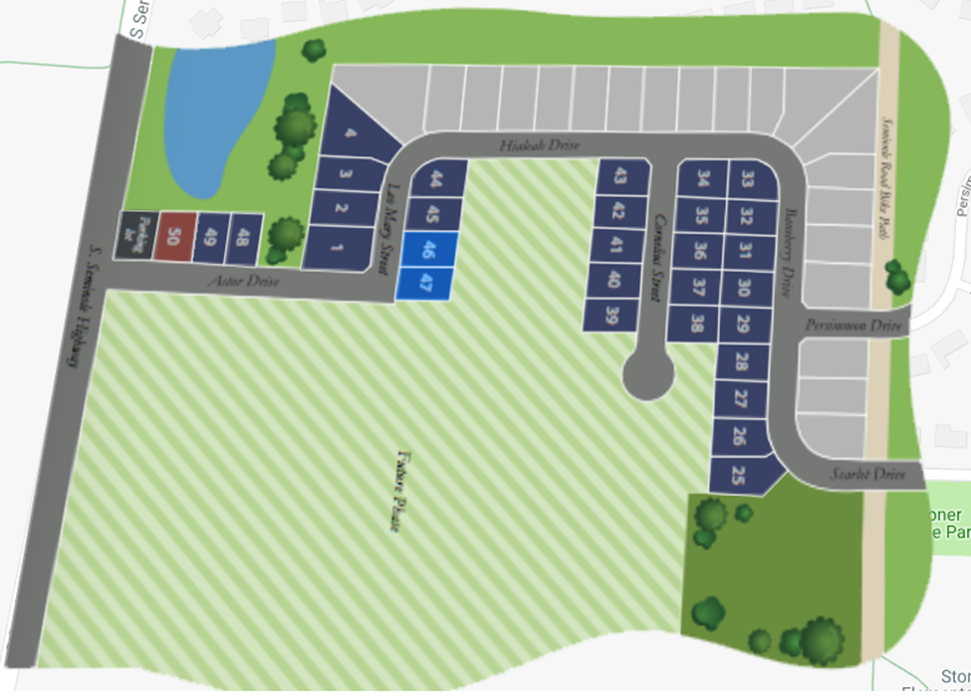
Stoner Prairie, Fitchburg, WI
Double circuit 138 kV on easement
Developer owns the land

Slide 21
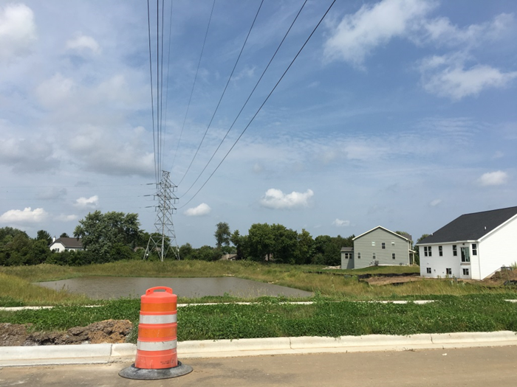

Slide 22
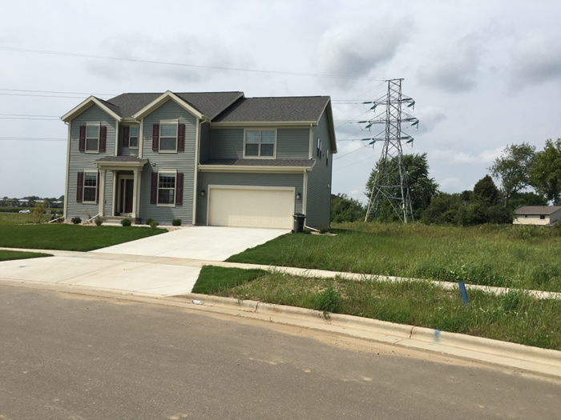
Sold 2018 for $512,000. 3,451 SF, lot about 2x larger

Slide 23
Five Comparable Sales
Standard adjustments:
-5% lower value
Adjusted for lot and building size only:
-5% lower value

Slide 24
Conclusions
HVTL may impact sale price of bulk land for residential subdivision.
HVTL may impact lot sales up to 11%
No impact on houses at 300 ft (90 m) from easement.
Impact on houses at less than 100 feet
Results consistent with published studies.

