Slide 1





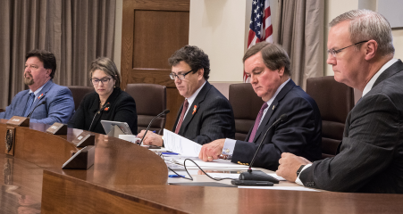

How one state uses incentives, resources, and tools for project progression
Lora Gunter, J.D., SR/WA
ROW Project Delivery Director

Slide 2
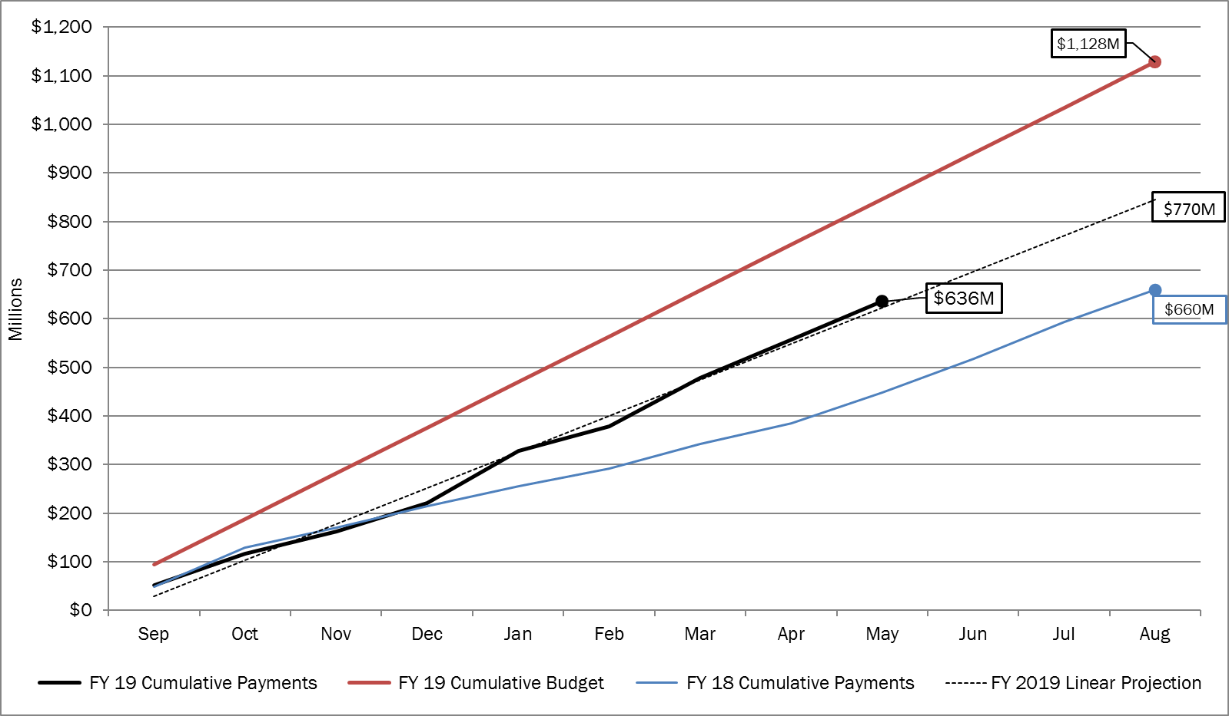
Right of Way Acquisition Expenditure Report
FY 2019 ROW Expenditures with Linear Projection and FY 2018 Actuals
Prepared by: ROW Contracts and Finance
Source: PeopleSoft 05/31/2019, DCIS, LAR Request 2016-06-18, Milestone Monitor
Date: 06/02/2019
Notes:
Analysis.
Anomalies and noteworthy findings
The number of projects requiring a management plan continues to be a small number of the total projects let with only 6 out of 129 project let in the first quarter requiring a management action plan. With such a small sample size it is hard to determine any type of pattern as to why management plans were needed on the six projects.
Were any actions taken for items that prevented or delayed the division from making their quarterly goal?
With the small sample size it is hard to determine causation. However, it should be noted that for each month, on average the projects requiring row/utility activities had less than 20 months to complete these activities, with many of the projects having less than 15 months. This is 16 months on average short of the recommended period of 36 months once the project reaches full authority to proceed (environmental clearance achieved, legal descriptions completed, and lpa row contribution signed). Projects with larger number of parcels or less time to perform the row/utilities work have management plans.
Did the actions taken improve performance toward the quarterly and/or annual goal?
ROW will continue to work with its District partners to encourage enough time be programmed into the projects schedule to allow 36 months for row/utilities to be completed once the project reaches full authority to proceed.

Slide 3
Main Talking Points
PUAs w/MRI
Administrative Settlements/Enhanced Negotiations
Advanced Acquisition
Meetings w/Stakeholders
Close Coordination with Project Manager
Contracting for ROW Acquisition Services
ROW Manual Revisions
Paperless Office

Slide 4
Talking Points
Possession and Use
Agreements with
Market Rental Incentive

Slide 5
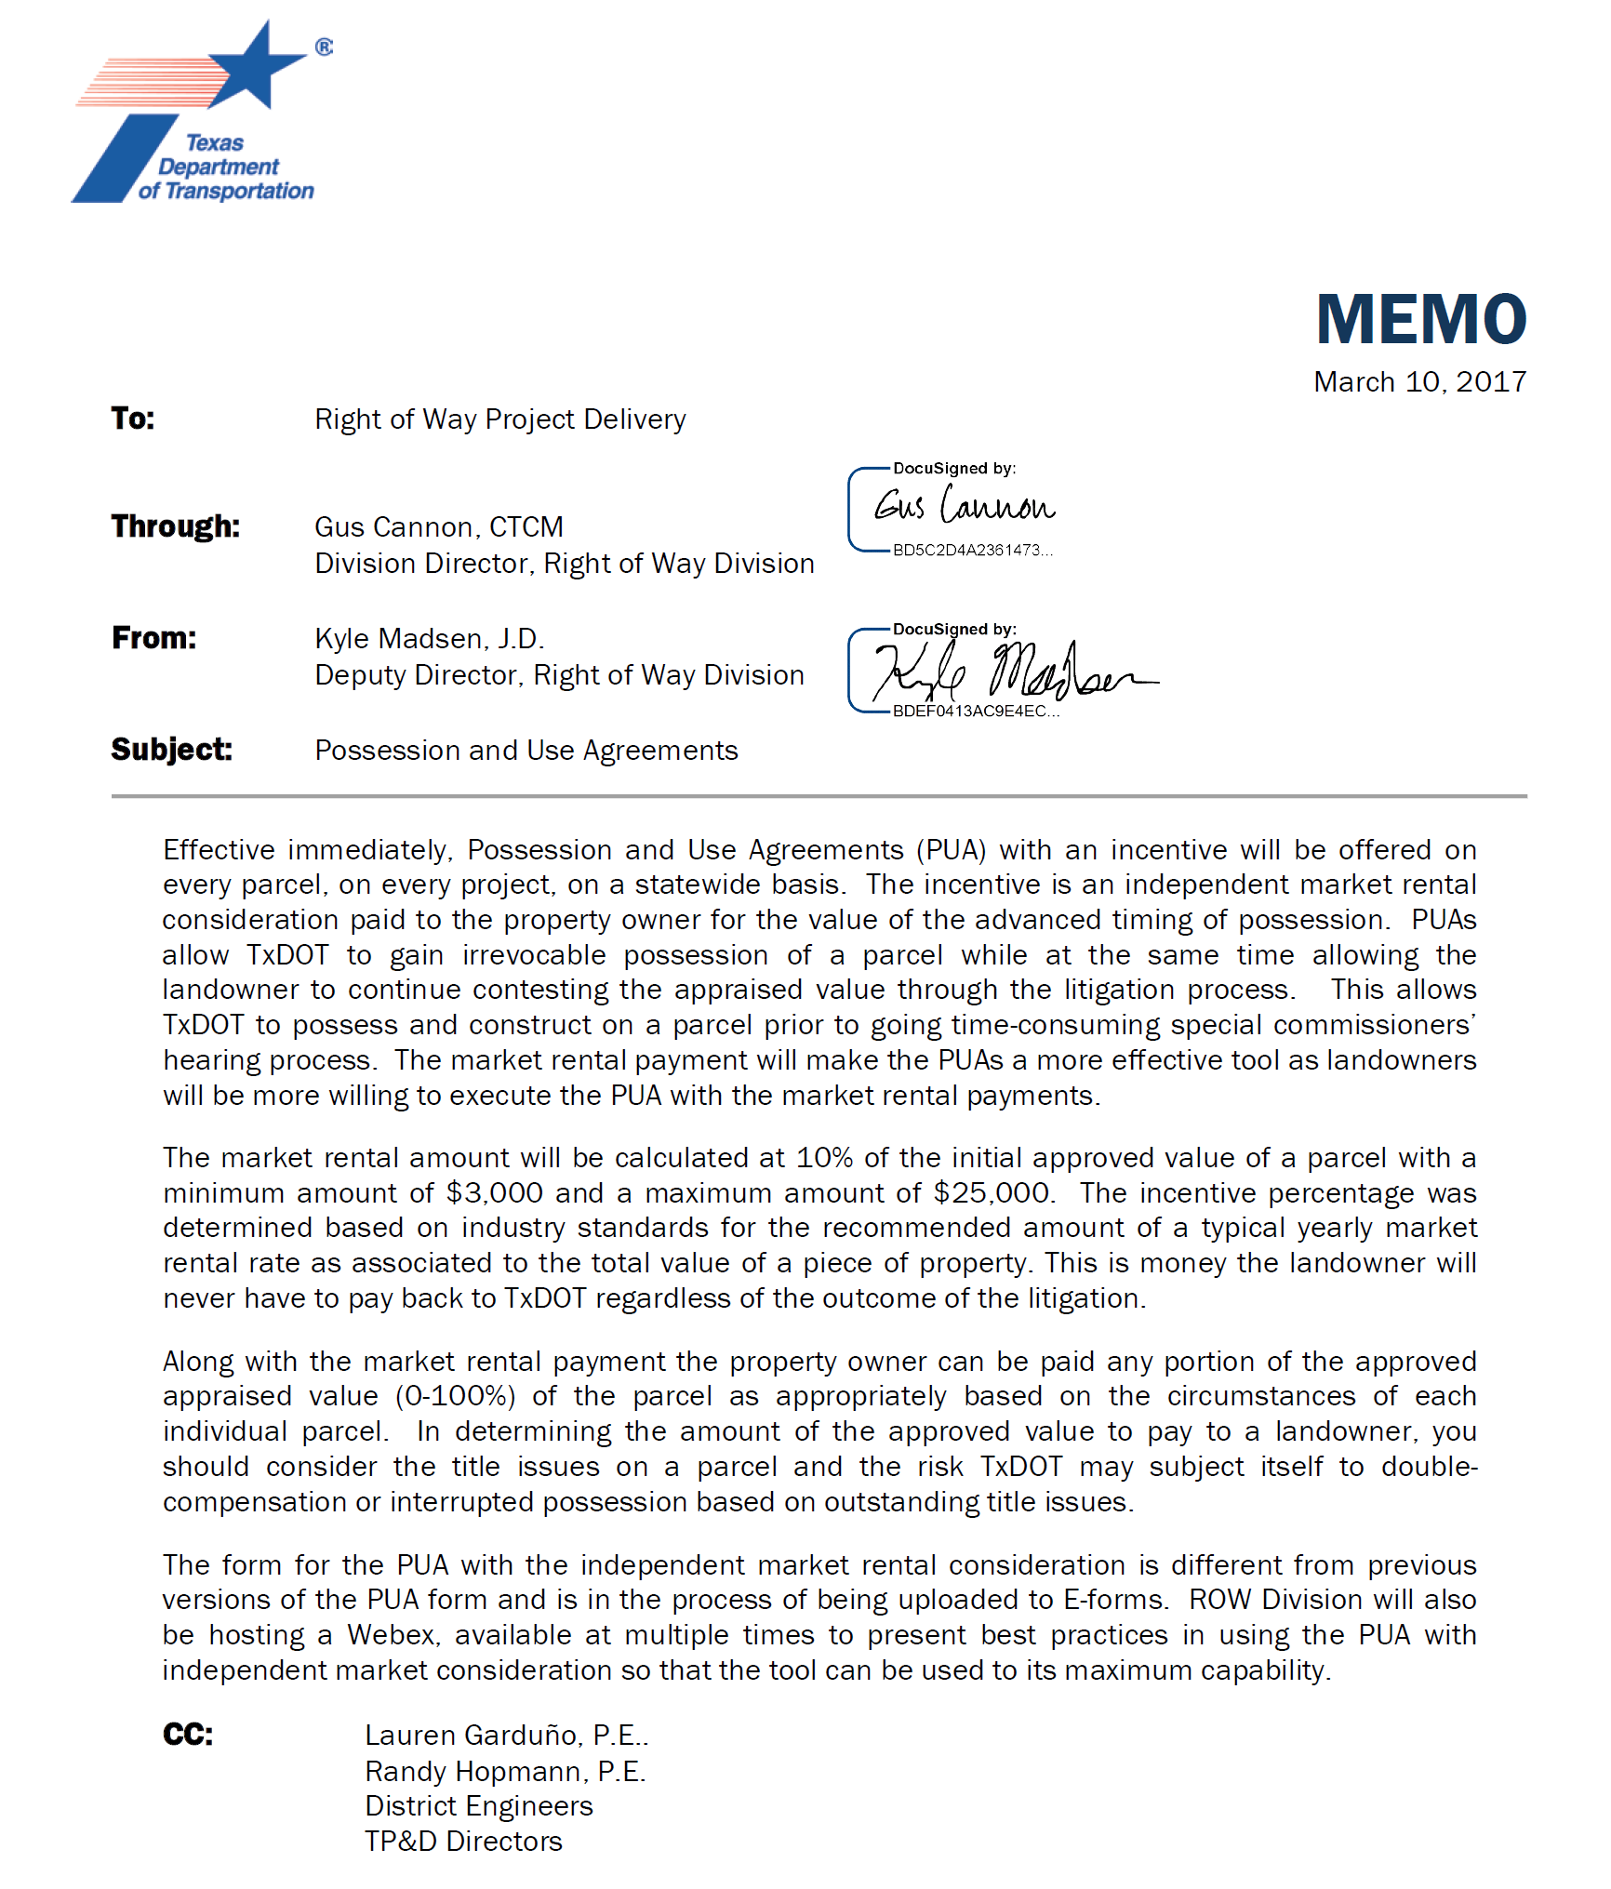
PUA w/MRI Memo

Slide 6
PUA Elements
Every parcel, every project
10% of Initial Approved Value
$3,000 MIN -- $25,000 MAX
0-100% of Approved Appraisal Value

Slide 7
POSSESSION AND USE AGREEMENT FOR TRANSPORTATION PURPOSES
STATE OF TEXAS | § | ROW CSJ:
 | § | Parcel No.:
COUNTY OF | § | Project No.:
This Possession and Use Agreement For Transportation Purposes (the “Agreement”) between the State of Texas, acting by and through the Texas Department of Transportation (the “State”) , and (the “Grantor” whether one or more), grants to the State, its contractors, agents and all others deemed necessary by the State, an irrevocable right to possession and use of the Grantor’s property for the purpose of constructing a portion of Highway No. (the “Highway Construction Project”). The property subject to this Agreement is described more fully in field notes and plat map (attached as “Exhibit A”) and made a part of this Agreement by reference (the “Property”).
For the consideration paid by the State which is set forth in Paragraph 2 below, the receipt and sufficiency of which is acknowledged, the Grantor grants, bargains, sells and conveys to the State of Texas the right of entry and exclusive possession and use of the Property for the purpose of constructing a highway and appurtenances thereto and the right to remove any improvements. Authorized activities include surveying, inspection, environmental studies, archeological studies, clearing, demolition, construction of permanent improvements, relocating, replacing, and improving existing utility facilities, locating new utility facilities, and other work required to be performed in connection with the Highway Construction Project. This Possession and Use Agreement will extend to the State, its contractors and assigns, owners of any existing utilities on the Property and those which may be lawfully permitted on the Property by the State in the future, and all others deemed necessary by the State for the purpose of the Highway Construction Project. This grant will allow the construction, relocation, replacement, repair, improvement, operation and maintenance of utilities on the Property.
In full consideration for this irrevocable grant of possession and use and other Grantor covenants, warranties, and obligations under this Agreement, the State will tender to the Grantor the sum of Dollars ($ ). The Grantor agrees that this sum represents adequate and full compensation for the possession and use of the Property. The State will be entitled to take possession and use of the Property upon tender of payment. The parties agree that the sum tendered represents percent of the State's approved value, which assumes no adverse environmental conditions affecting the value of the Property. The approved value is the State’s determination of the just compensation owed to the Grantor for the real property interest to be acquired by the State in the Property, encumbered with the improvements thereon, if any, and damages to the remainder, if any, save and except all oil, gas and sulphur. The parties agree that the sum tendered to Grantor will be deducted from any final settlement amount, Special Commissioners’ award or court judgment. In the event the amount of the final settlement or judgment for acquisition of the Property is less than the amount the State has paid for the possession and use of the Property, then the Grantor agrees that the original amount tendered represents an overpayment for the difference and, upon written notice from the State, the Grantor will promptly refund the overpayment to the State.
The effective date of this Agreement will be the date on which payment pursuant to Paragraph 2 above
*NPUA*

Slide 8
2. In full consideration for this irrevocable grant of possession and use and other Grantor covenants, warranties, and obligations under this Agreement, the State will tender to the Grantor the sum of Dollars ($55,555.55). The Grantor agrees that this sum represents adequate and full compensation for the possession and use of the Property. The State will be entitled to take possession and use of the Property upon tender of payment.

Slide 9
Form ROW-N-PUA
(12/12)
Replaces Form ROW-N-7
Page 2 of 4
was tendered to the Grantor by the State, or disbursed to the Grantor by a title company acting as escrow agent for the transaction, (the “Effective Date”).
The Grantor warrants and represents that the title to the Property is free and clear of all liens and encumbrances or that proper releases will be executed for the Property prior to funds being disbursed under this Agreement. The Grantor further warrants that no other person or entity owns an interest in the fee title to the Property and further agrees to indemnify the State from all unreleased or undisclosed liens, claims or encumbrances affecting the Property.
The parties agree that the valuation date for determining the amount of just compensation for the real property interest proposed to be acquired by the State in the Property, for negotiation or eminent domain proceeding purposes, will be the Effective Date of this Agreement.
This Agreement is made with the understanding that the State will continue to proceed with acquisition of a real property interest in the Property. The Grantor reserves all rights of compensation for the title and interest in and to the Property which the Grantor holds as of the time immediately prior to the Effective Date of this Agreement. This Agreement shall in no way prejudice the Grantor’s rights to receive full and just compensation as allowed by law for all of the Grantor’s interests in and to the Property to be acquired by the State, encumbered with the improvements thereon, if any, and damages, if any, to the remainder of the Grantor’s interest in any larger tract of which the Property is a part (the “Remainder”), if any; all as the Property exists on the Effective Date of this Agreement. The State’s removal or construction of improvements on the Property shall in no way affect the fair market value of the Property in determining compensation due to the Grantor in the eminent domain proceedings. There will be no project impact upon the appraised value of the Property. This grant will not prejudice the Grantor’s rights to any relocation benefits for which Grantor may be eligible.
In the event the State institutes or has instituted eminent domain proceedings, the State will not be liable to the Grantor for interest upon any award or judgment as a result of such proceedings for any period of time prior to the date of the award. Payment of any interest may be deferred by the State until entry of judgment.
The purpose of this Agreement is to allow the State to proceed with its Highway Construction Project without delay and to allow the Grantor to have the use at this time of a percentage of the estimated compensation for the State’s acquisition of a real property interest in the Property. The Grantor expressly acknowledges that the proposed Highway Construction Project is for a valid public use and voluntarily waives any right the Grantor has or may have, known or unknown, to contest the jurisdiction of the court in any condemnation proceeding for acquisition of the Property related to the Highway Construction Project, based upon claims that the condemning authority has no authority to acquire the Property through eminent domain, has no valid public use for the Property, or that acquisition of the Property is not necessary for the public use.
The Grantor reserves all of the oil, gas and sulphur in and under the land herein conveyed but waives all right of ingress and egress to the surface for the purpose of exploring, developing, mining or drilling. The extraction of oil, gas and minerals may not affect the geological stability of the surface. Nothing in this reservation will affect the title and rights of the State to take and use all other minerals and materials thereon, and thereunder.

Slide 10
6. …This Agreement shall in no way prejudice the Grantor’s rights to receive full and just compensation as allowed by law for all of the Grantor’s interests in and to the Property to be acquired by the State, encumbered with the improvements thereon, if any, and damages, if any, to the remainder of the Grantor’s interest in any larger tract of which the Property is a part (the “Remainder”), if any; all as the Property exists on the Effective Date of this Agreement.

Slide 11
TxDOT Right of Way Market Rental Incentive (MRI) Program*
*Program Statewide implementation March 2017.
Source: Right of Way Information System
Notes:
Data is in file:
ROW Executive Summary 2018-08.xlxs
Located at:
T:\Project Portfolio Mgmt\Resource Management\ROW Dashboard New

Slide 12
TxDOT Right of Way Market Rental Incentive (MRI) Program*
Average Days to Gain Possession with and without the MRI Program
*Program Statewide implementation March 2017.
Source: Right of Way Information System

Slide 13
TxDOT Right of Way Market Rental Incentive (MRI) Program*
Parcels in Possession by Metro, Rural and Urban Designation
*Program Statewide implementation March 2017.
Source: Right of Way Information System
Date Range: March 2017 through April 2019.

Slide 14
Talking Points
Administrative Settlements
and
Enhanced Negotiations

Slide 15
Talking Points
Advanced Acquisition

Slide 16
Background
Federal Aid Participation Rules
Limited Early Acquisition
          Parcel by parcel basis
          Donation
          Hardship
          Protective purchases
Notes:
_____________________________________________________________________
_____________________________________________________________________
_____________________________________________________________________
_____________________________________________________________________
_____________________________________________________________________
_____________________________________________________________________
_____________________________________________________________________
_____________________________________________________________________
_____________________________________________________________________
_____________________________________________________________________
_____________________________________________________________________
_____________________________________________________________________

Slide 17
Changes in the Law
Moving Ahead for Progress in the
21st Century Act (MAP-21)
June 29, 2012
An Early Acquisition Project “may consist of the acquisition of real property interests in a specific parcel, a portion of a transportation corridor, or an entire transportation corridor” 23 CFR 710.105(b)
Notes:
_____________________________________________________________________
_____________________________________________________________________
_____________________________________________________________________
_____________________________________________________________________
_____________________________________________________________________
_____________________________________________________________________
_____________________________________________________________________
_____________________________________________________________________
_____________________________________________________________________
_____________________________________________________________________
_____________________________________________________________________
_____________________________________________________________________

Slide 18
Changes in the Law
HB 2646
(effective Sept. 1, 2017)
      Affected Texas State law for Advanced Acquisition
      Amended Section 202.112, Transp. Code
*may acquire real property for possible use in a transportation facility before environmental clearance has been issued
Notes:
_____________________________________________________________________
_____________________________________________________________________
_____________________________________________________________________
_____________________________________________________________________
_____________________________________________________________________
_____________________________________________________________________
_____________________________________________________________________
_____________________________________________________________________
_____________________________________________________________________
_____________________________________________________________________
_____________________________________________________________________
_____________________________________________________________________

Slide 19
Advanced Acquisition Criteria
Project Readiness
Project
Funding
Project in UTP
Project within 6 years of RTL
Funding in LAR
Only state funds may be used
Notes:
_____________________________________________________________________
_____________________________________________________________________
_____________________________________________________________________
_____________________________________________________________________
_____________________________________________________________________
_____________________________________________________________________
_____________________________________________________________________
_____________________________________________________________________
_____________________________________________________________________
_____________________________________________________________________
_____________________________________________________________________
_____________________________________________________________________

Slide 20
Advanced Acquisition Criteria
Legal Constraints
Eminent Domain cannot be used
All ownership interests must be obtained
No turning dirt!
  Grading
  Clearing
  Demolition of structures
  Relocating utilities
Notes:
_____________________________________________________________________
_____________________________________________________________________
_____________________________________________________________________
_____________________________________________________________________
_____________________________________________________________________
_____________________________________________________________________
_____________________________________________________________________
_____________________________________________________________________
_____________________________________________________________________
_____________________________________________________________________
_____________________________________________________________________
_____________________________________________________________________

Slide 21
Talking Points
Meetings w/Stakeholders

Slide 22
Meetings w/Stakeholders
Meeting Frequency
Meeting Invitees
Use Technology

Slide 23

Meetings w/Stakeholders

Slide 24
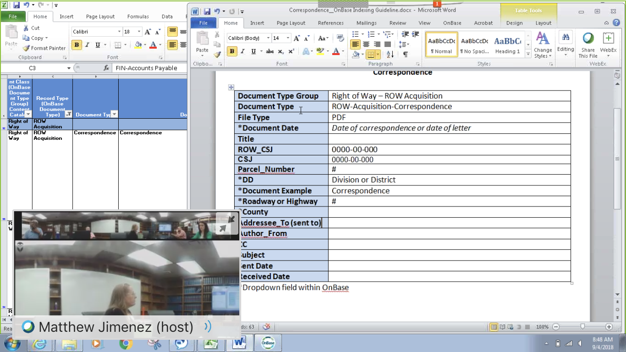
Meetings w/Stakeholders

Slide 25
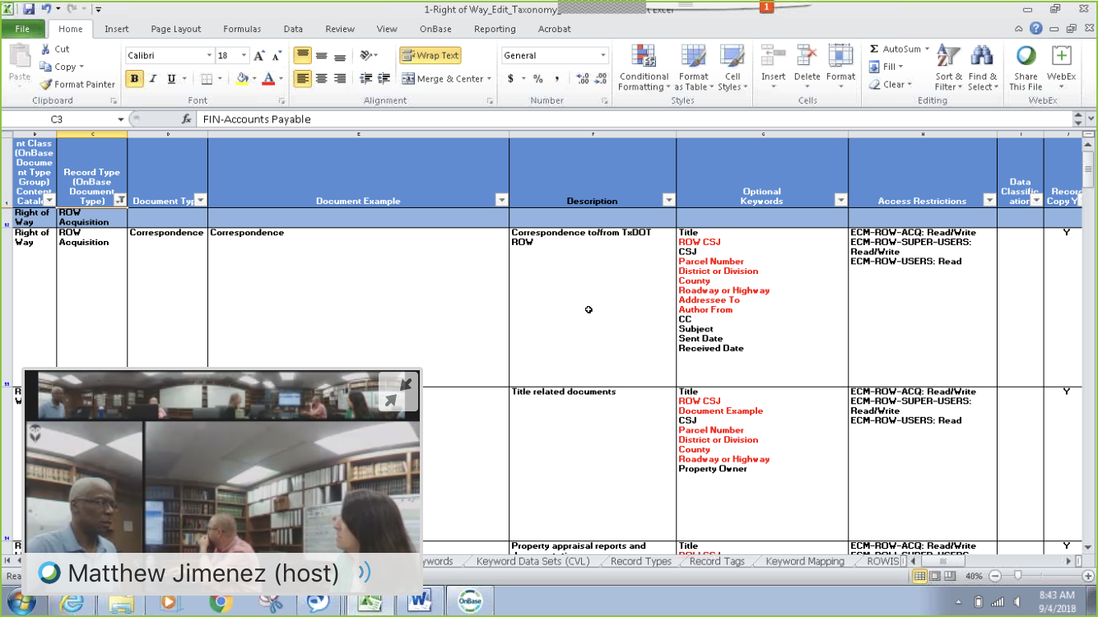
Meetings w/Stakeholders

Slide 26
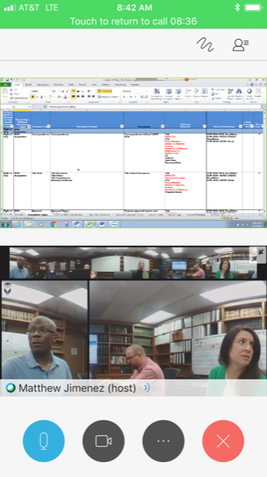
Meetings w/Stakeholders

Slide 27
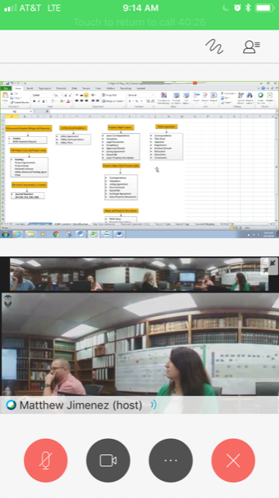
Meetings w/Stakeholders

Slide 28
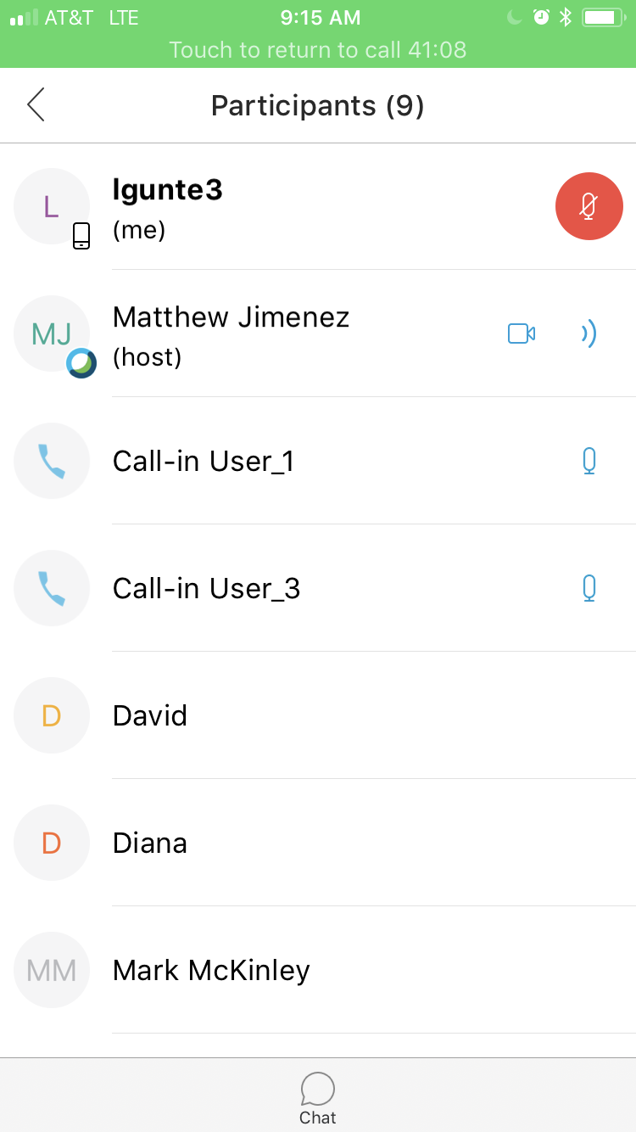
Meetings w/Stakeholders

Slide 29

Meetings w/Stakeholders

Slide 30
Talking Points
Close Coordination
with Project Manager

Slide 31
Communication
Right of Way Project Manager
Supervisor
District
Consultant
Right of Way Program Office

Slide 32
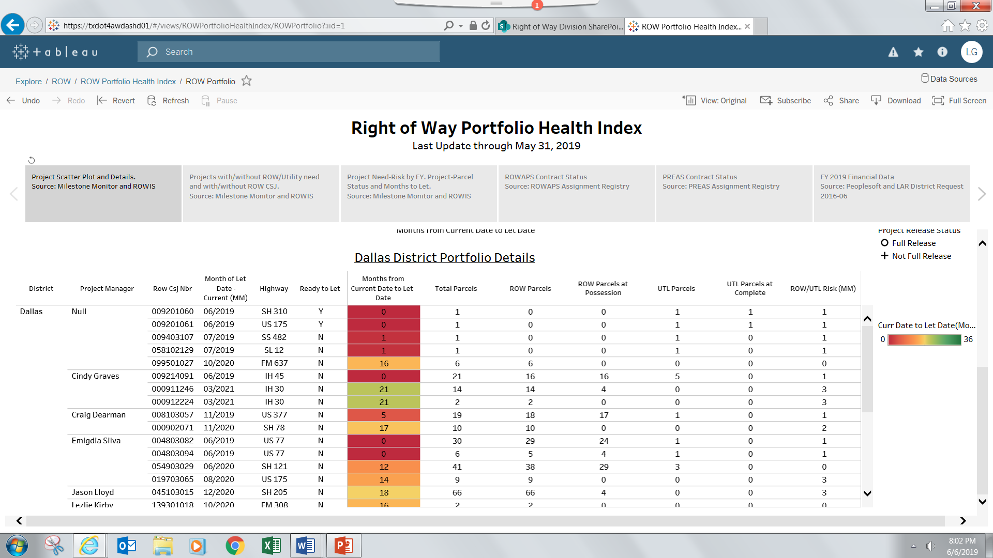
ROW Portfolio Health

Slide 33
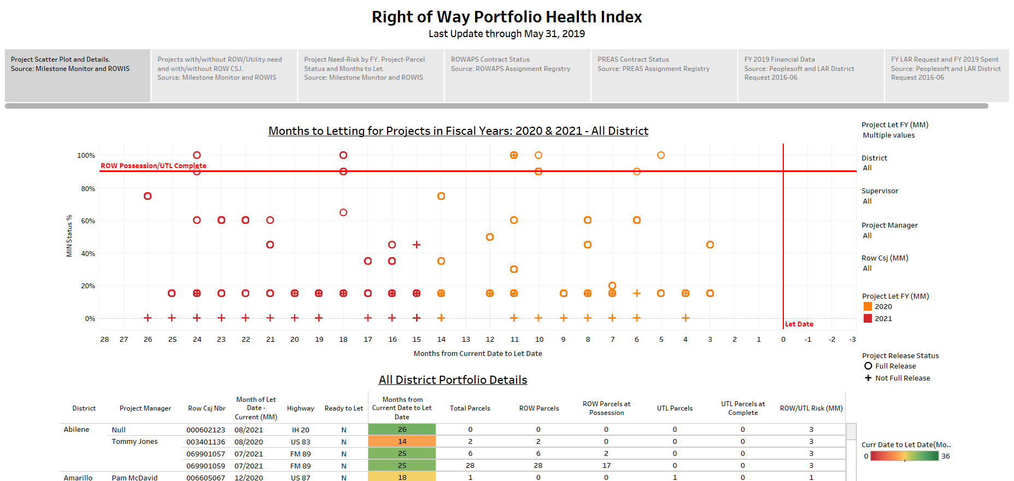
ROW Interactive Dashboards

Slide 34
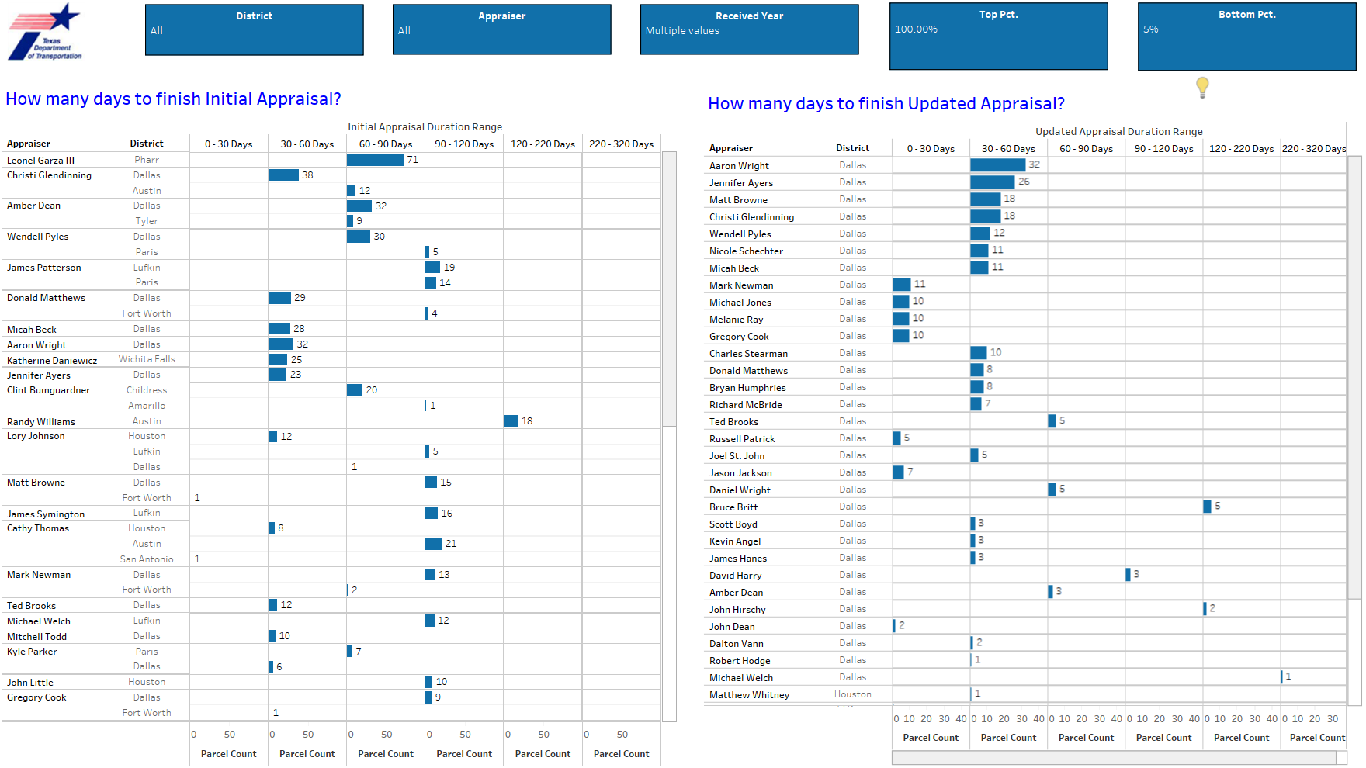
ROW Interactive Dashboards - Appraisals

Slide 35
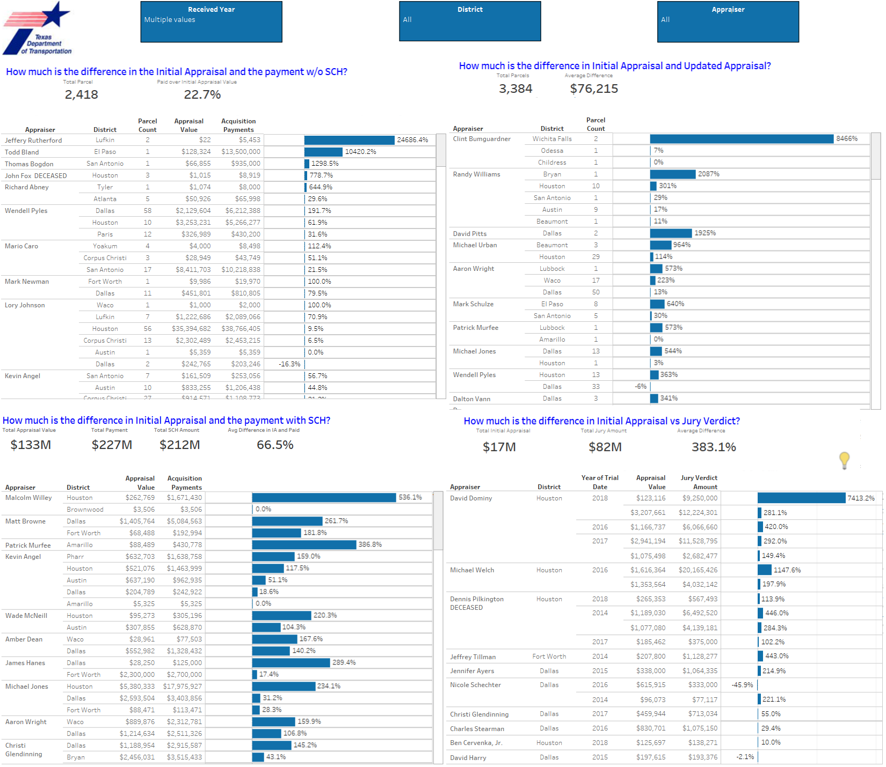
ROW Interactive Dashboards - Appraisals

Slide 36
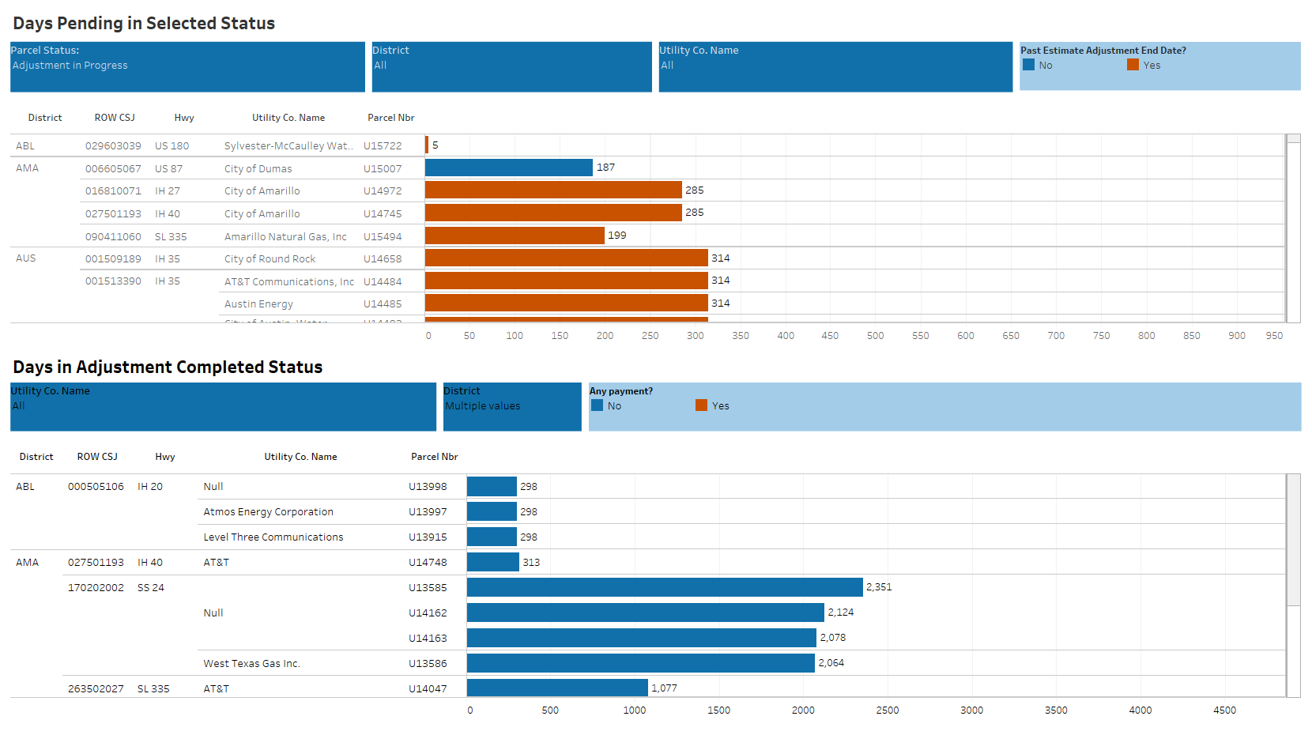
ROW Interactive Dashboards - Utilities

Slide 37
Coordination Begins Before the Project Kickoff
Meet & Greet
Open House
Project Drive
Partnering Meeting

Slide 38
Talking Points
Contracting for ROW Acquisition Services

Slide 39
Contracting for ROW Acquisition Services
ROWAPS Contracts
Right of Way Acquisition Professional Services
Appraisal is “professional”
Contract Amount
Indefinite Deliverable/Work Authorization
Milestone Based
Pros/Cons

Slide 40
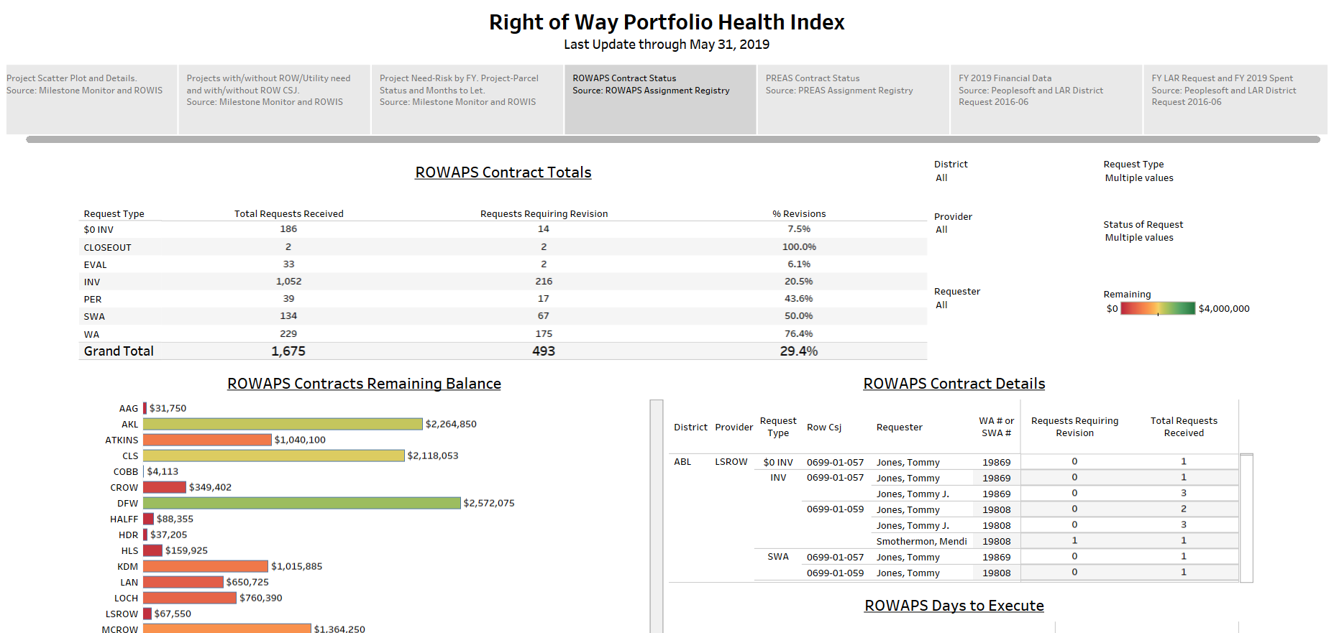
ROWAPS Dashboards

Slide 41
Contracting for ROW Acquisition Services
Other Contracting Means
Specific Deliverable Contracts

Slide 42
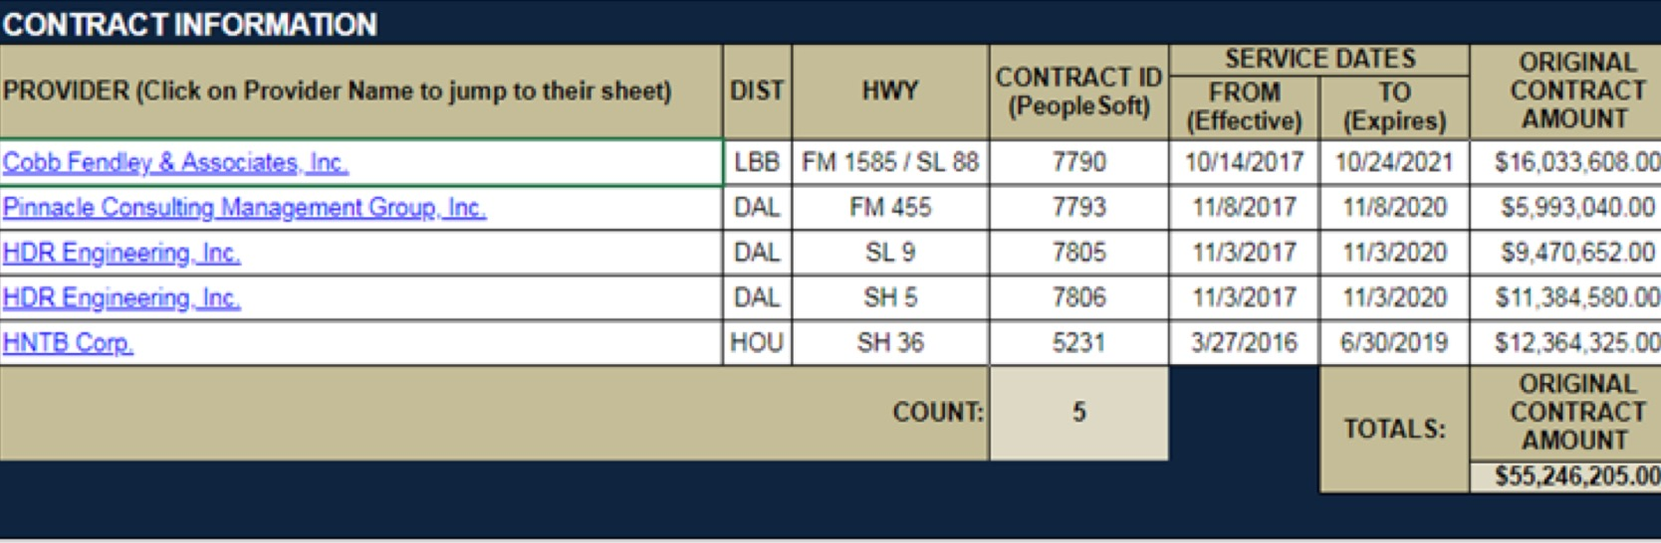
Specific Deliverable Contracts
Specific Deliverable Contract Summary

Slide 43
Contracting for ROW Acquisition Services
Other Contracting Means
Specific Deliverable Contracts
Program Management Consultant (PMC)
Professional Real Estate Appraiser Services (PREAS)
Coming Soon (hopefully)
Combo w/Engineering Development

Slide 44
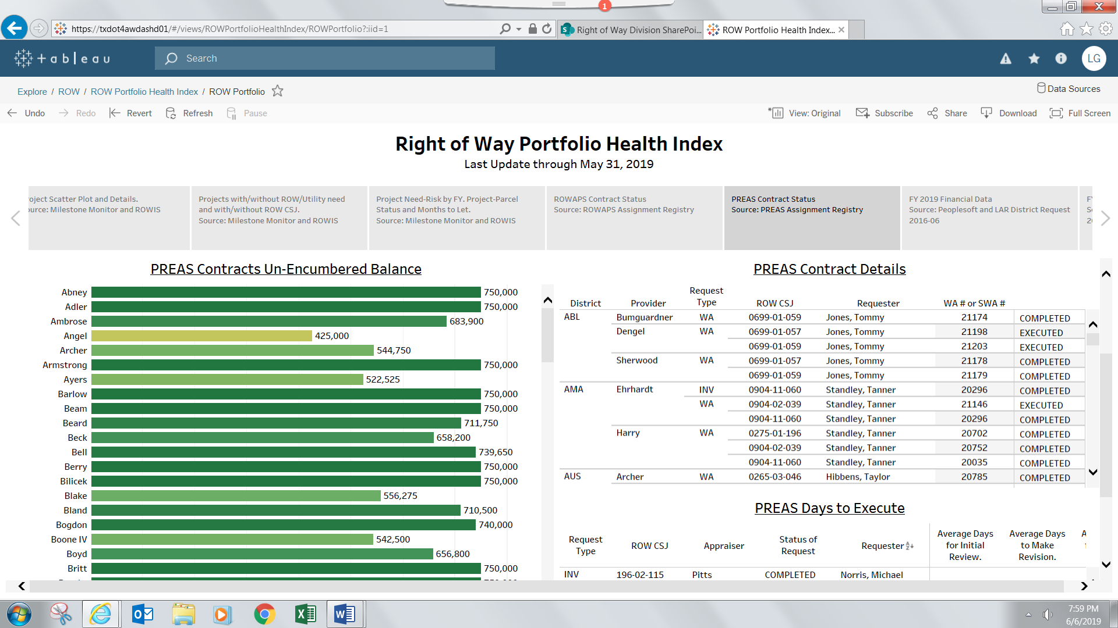
Tracking Contract Balances

Slide 45
Talking Points
ROW Manuals

Slide 46
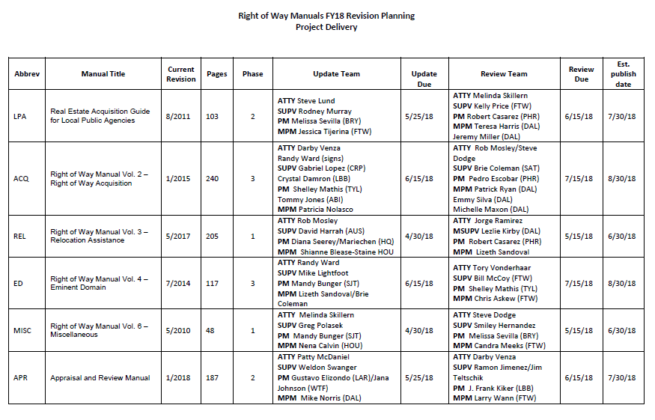

Slide 47
Two Tiers
1) Policy and Procedure Changes
      Hot off the Presses Changes
      Ex. Advanced Acquisition, Uneconomic Remainder
2) Better Flow
      Cull fluff and how-to details
      Retain legal provisions
      Eliminate inconsistencies/awkwardness that “spot revisions” have created
      Better writing, visual appearance, and ease of use for audience

Slide 48
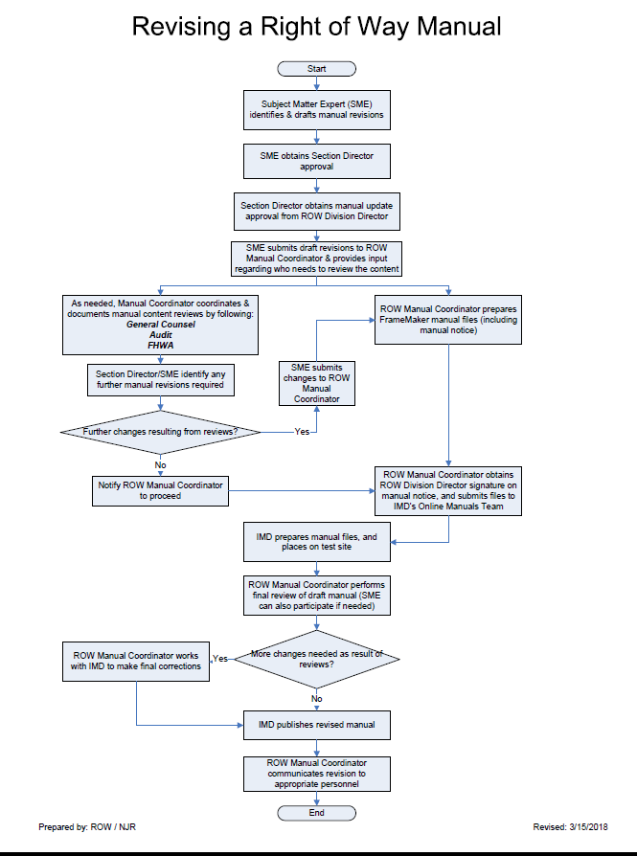

Slide 49
Round 1: Manual Update Teams
ROW Attorney
Review policy/procedure changes
ROW Supervisor
Review policy/procedure changes
ROW PM
Review policy/procedure changes
Review for good writing/grammar
Review the law
Cull for flexibility
Identify difficult/out-of-date/impractical provisions
Identify difficult/out-of-date/impractical provisions

Slide 50
Round 1: Manual Update Teams
ROW Attorney
Lead Drafter– Controls the Word Updates
ROW Supervisor
ROW PM
Schedules Collaboration Meetings
Project Manager of the Update

Slide 51
Possible Stakeholder Input
ROWAPS
Appraisers
Other Internal
Users/Customers

Slide 52
Round 2: Manual Review Teams
ROW Attorney
Review for good writing/grammar
ROW Supervisor
ROW PM
Review for good writing/grammar
Read for flow and continuity
Review for good writing/grammar
Read for flow and continuity
Read for flow and continuity

Slide 53
Round 2: Manual Review Teams
ROW Attorney
Communicates Changes Back to Update Team ROW Attorney
ROW Supervisor
ROW PM

Slide 54
Round 3: Project Delivery Approval
ROW Project Delivery Director
Review and Approval

Slide 55
Round 4: Publish
ROW
Division
Audit
FHWA
General Counsel

Slide 56
Talking Points
Paperless Office

Slide 57
Paperless Initiatives
Docusign
Onbase
Sharepoint
TxDOT Connect
Project Spreadsheets
Deed Scans
No Paper Environment

Slide 58
Questions?

