Slide 1
Seth Weinglass, JD
Program Manager, Capital Project Services
Fort Wayne City Utilities
seth.weinglass@cityoffortwayne.org
(260) 427-1330
Deep Tunnel Easements
Arriving at a Consensus of Valuation and Driving an Evolution in Legal Understanding

Slide 2
Three Questions
How far down does title to land extend?
What is it worth?
How should we request subsurface property rights?

Slide 3
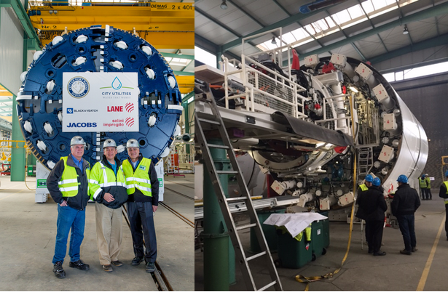
Fort Wayne’s Three Rivers Protection
& Overflow Reduction Tunnel

Slide 4
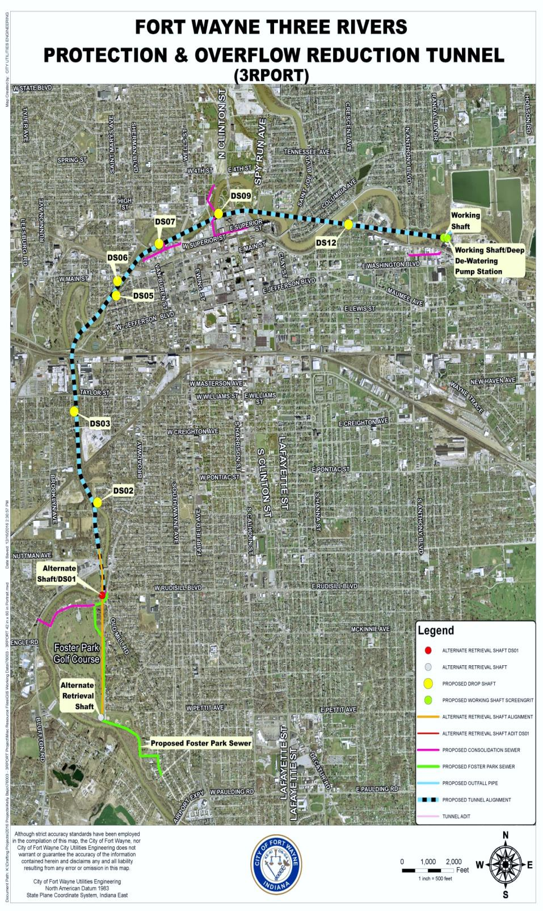
Fort Wayne 3RPORT Tunnel Route

Slide 5
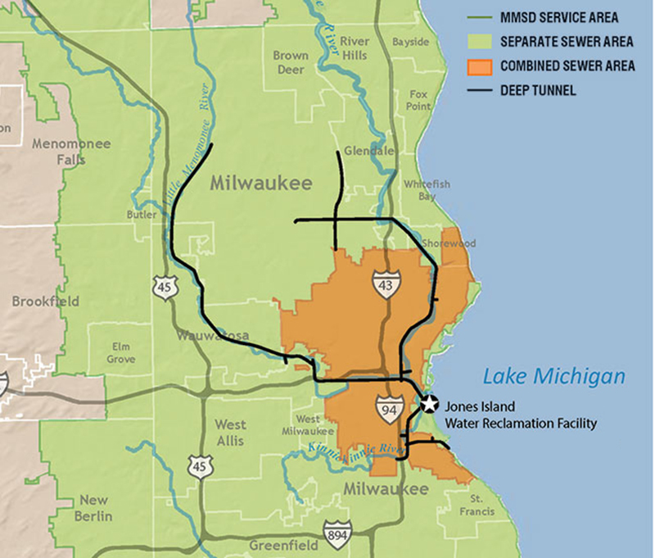
Milwaukee Deep Tunnel

Slide 6
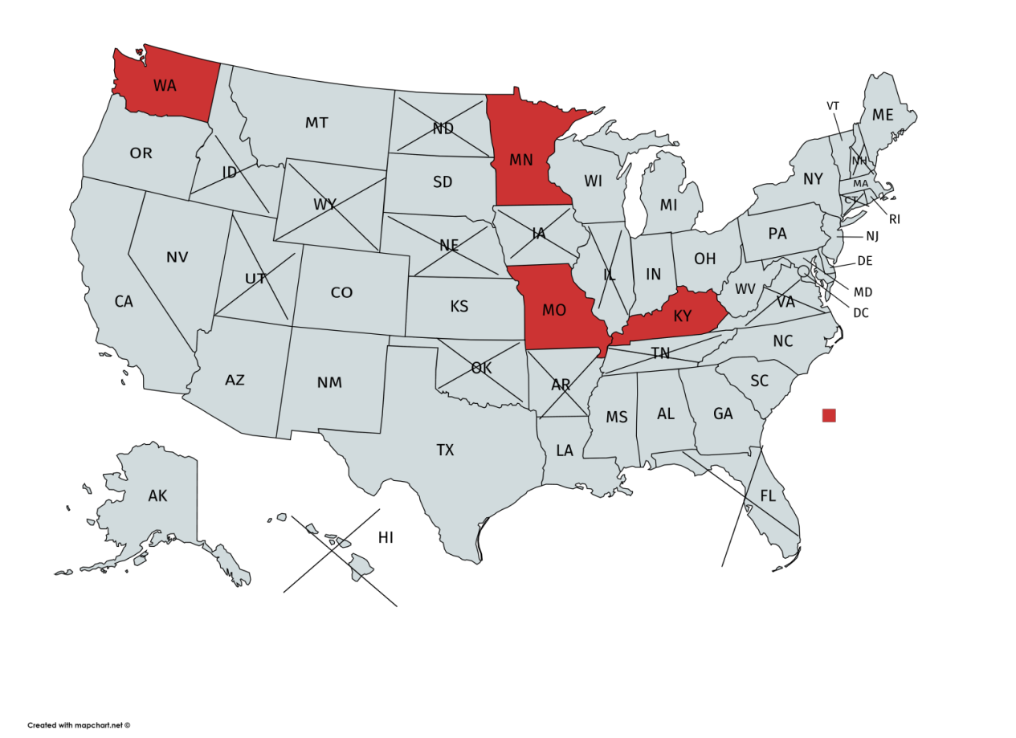
NJDOT/AASHTO survey of DOTs
“Tunnel Projects With Surface Rights Not Impaired”
http://sp.rightofway.transportation.org/Documents/tunnel_projects.pdf

Slide 7
Three Questions
How far down does title to land extend?
What is it worth?
How should we request subsurface property rights?

Slide 8
“Center of the Earth” Theory
“cujus est solum ejus est usque ad coelom et ad infernos”
to whomever the soil belongs, he owns also to the heavens and to [Hades, Hell, the depths, the center of the Earth]
8

Slide 9
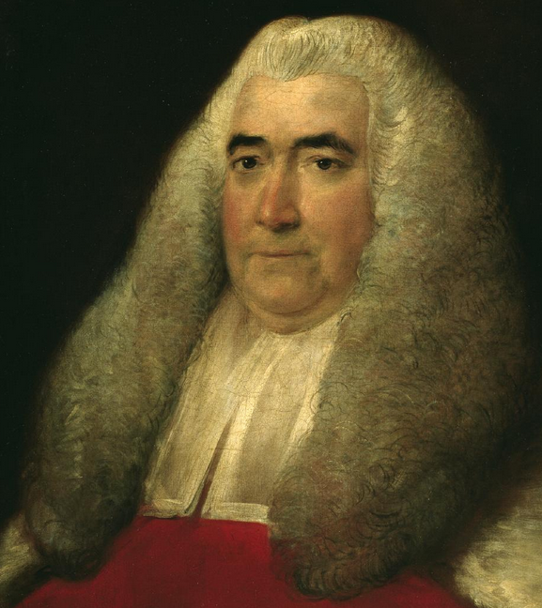
“Center of the Earth” Theory
“cujus est solum ejus est usque ad coelom et ad infernos”
to whomever the soil belongs, he owns also to the heavens and to [Hades, Hell, the depths, the center of the Earth]
William Blackstone,
Commentaries on the Laws of England
Volume 2, p. 18 (1756)
9

Slide 10
Owning the Center of the Earth
John G. Sprankling, Owning the Center of the Earth, 55 UCLA L. Rev. 979 (2008)
Center of the Earth doctrine is “poetic hyperbole,
not law.”
10

Slide 11
Legal Concept of “Dicta”
dicta /ˈdiktə/ n., pl. (Law)
Extraneous commentary in a legal opinion, not part of the basis of its decision.
Dicta is not legally binding precedent.
11

Slide 12
Deepest Land Dispute in US History
Nunez v. Wainoco Oil & Gas Co. 488 So. 2d 955 (1986)
Less than 2 miles deep
12

Slide 13
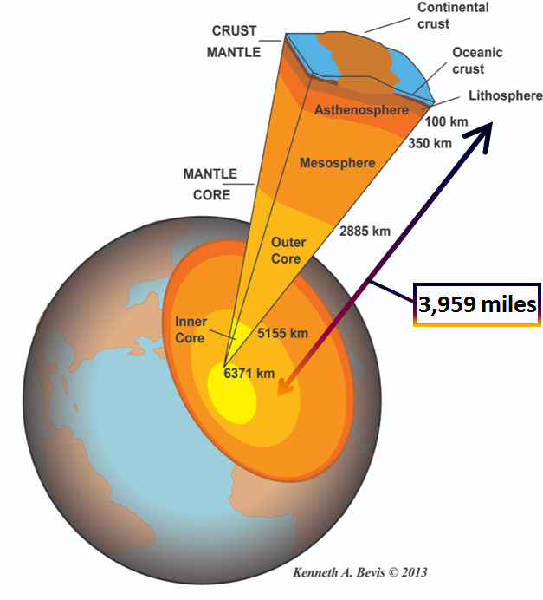
Composition of the Inner Earth
13

Slide 14
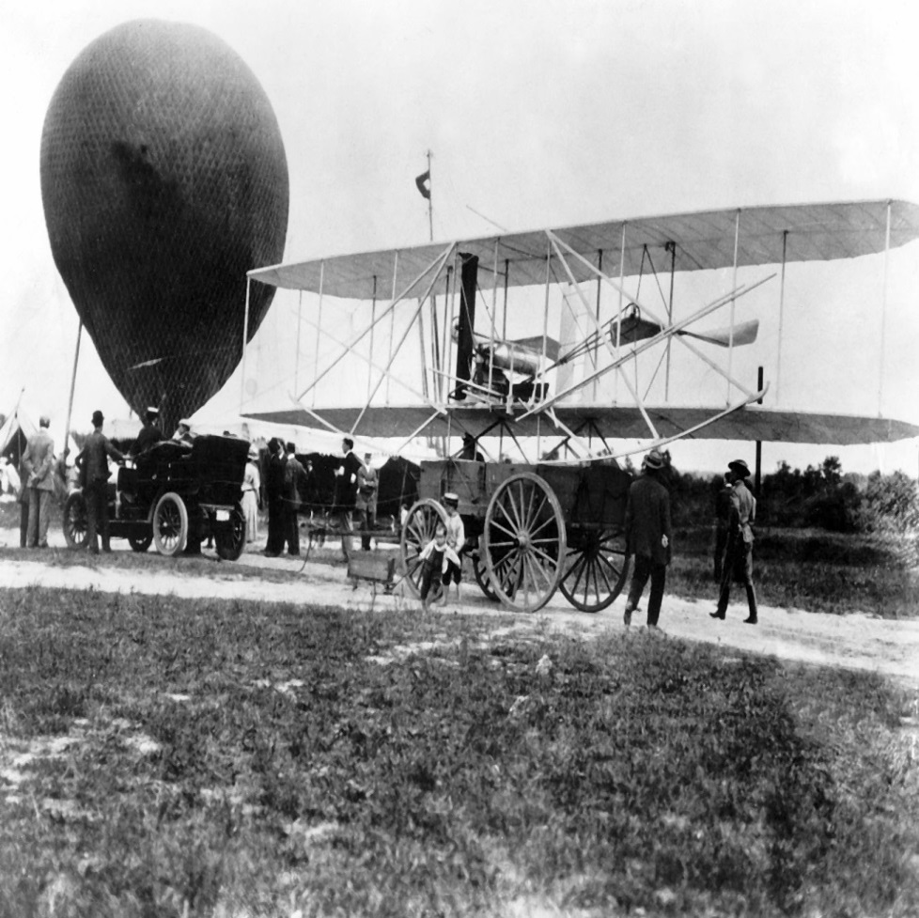
Analogy to Airspace Rights
14

Slide 15
SCOTUS ends Ad Coelum doctrine
U.S. v. Crosby 328 U.S. 256, 261 (1946)
“It is ancient [sic] doctrine that at common law ownership of the land extended to the periphery of the universe – Cujus est solum ejus est usque ad coelum. [Citation to Blackstone’s Commentaries.] But that doctrine has no place in the modern world.”
15

Slide 16
New York Tunnel Cases
In re Tunnel Street in City of New York, 160 A.D. 29 (1913)
Boehringer v. Montalto, 142 Misc. 560 (1931) (“the title of an owner of the soil will not be extended to a depth below ground beyond which the owner may not reasonably make use thereof.”)
In re Application of Gillespie, 17 N.Y.S.2d 560 (Gen Term 1940)
16

Slide 17
Oil/Gas/Groundwater Rights
“The [surface] owner in fee owns to the center of the earth. But he does not own a specific cubic foot of water, oil, or gas under the earth until he reduces it to possession.”
Gray-Mellon Oil Co. v. Fairchild 292 S.W. 743 (Ky.Ct.App. 1927)
“Exceptions swallow any supposed rule. Broadly speaking, the deeper the dispute, the less likely courts are to recognize the surface owner’s title.”
Sprankling, Owning the Center of the Earth, infra 55 UCLA L. Rev. at 1004.

Slide 18
Limits on Subsurface Trespass Claims
Taco Cabana, Inc. v. Exxon Corp. 5 S.W.3d 773, 780 (Tex.App. 1999)
Nunez v. Wainoco Oil & Gas Co. 488 So.2d 955 (La. 1986)
Chance v. BP Chemicals, Inc. 670 N.E.2d 985 (Ohio 1996)
“appellants’ subsurface rights in their properties include the right to exclude invasions of the subsurface property that actually interfere with appellants’ reasonable and foreseeable use of the subsurface.”
18

Slide 19
Three Questions
How far down does title to land extend?
Far enough for reasonable & foreseeable use.
What is it worth?
How should we request subsurface property rights?

Slide 20
Appraisal of Underground Easements
Derbes, Max J. Jr., SR/WA (1992), The Appraisal of Underground Easements, International Right of Way Association, Right of Way Magazine, October 1992: 18–24.
20

Slide 21
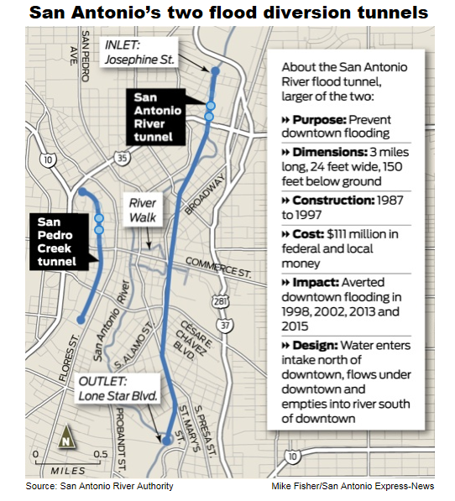
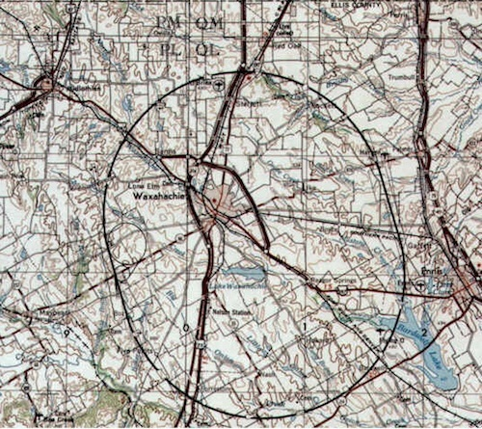
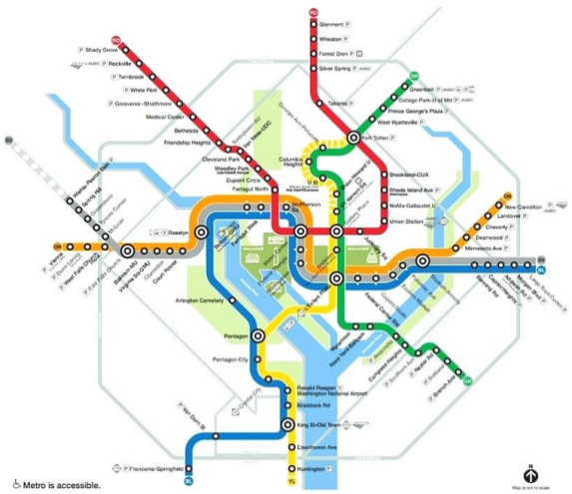
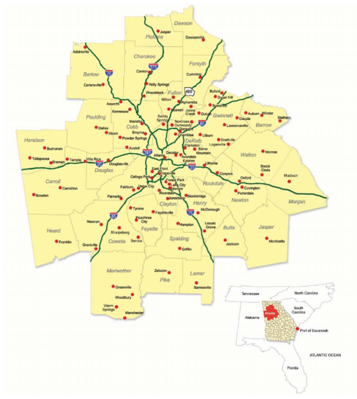
Texas Projects, D.C. & Atlanta Subways
Uniform appraisal results:
No diminution to market value

Slide 22
Highest and Best Use
Highest and best use of deep subsurface takings:
“The highest and best use of the lands below those needed for construction can best be described as holding the earth together.”
Derbes, Max J. Jr, The Appraisal of Underground Easements, infra at 19 & 20.
Unaffected by typical deep subsurface projects.

Slide 23
Three Questions
How far down does title to land extend?
Far enough for reasonable & foreseeable use.
What is it worth?
Value is nominal. Perhaps 5% of fee simple value.
How should we request subsurface property rights?

Slide 24
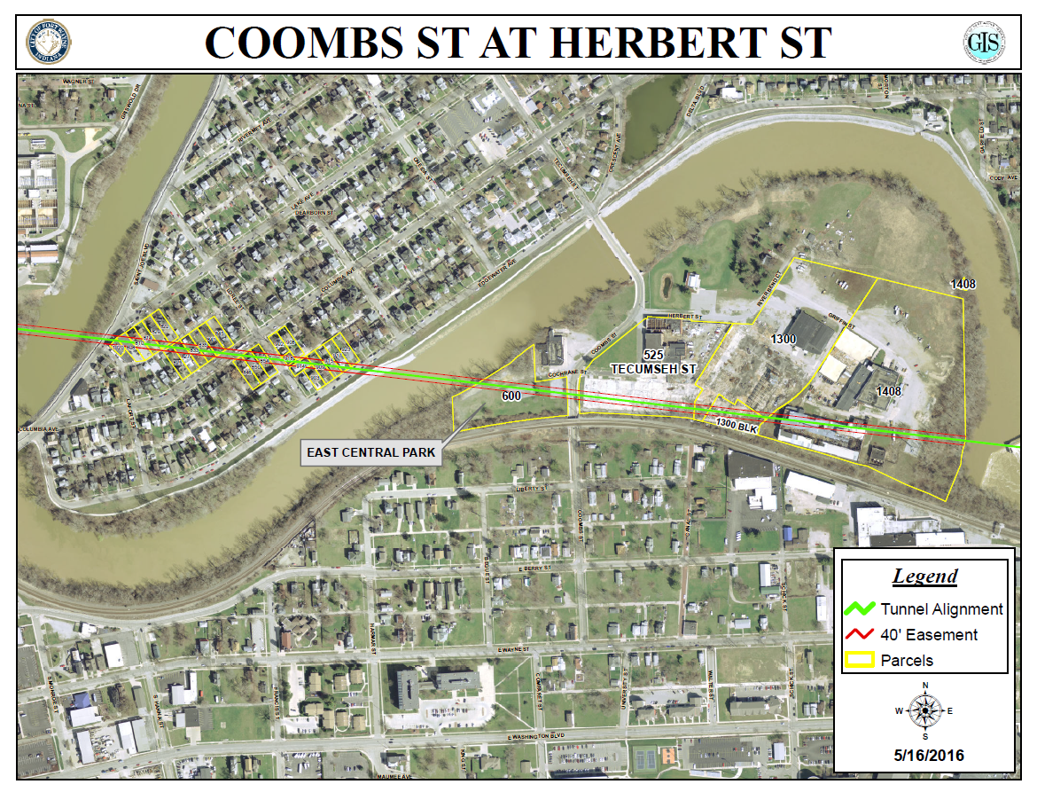
3RPORT under Coombs Street area

Slide 25
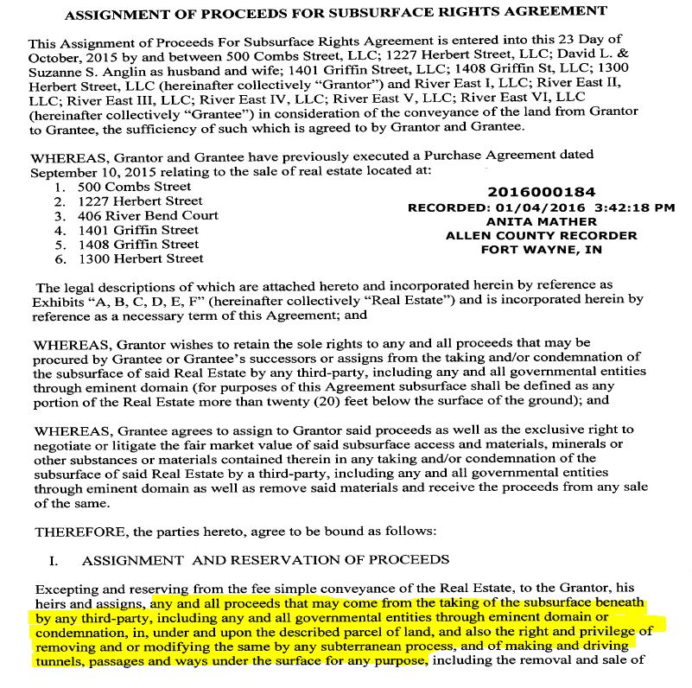
Reservation of Subsurface Proceeds

Slide 26
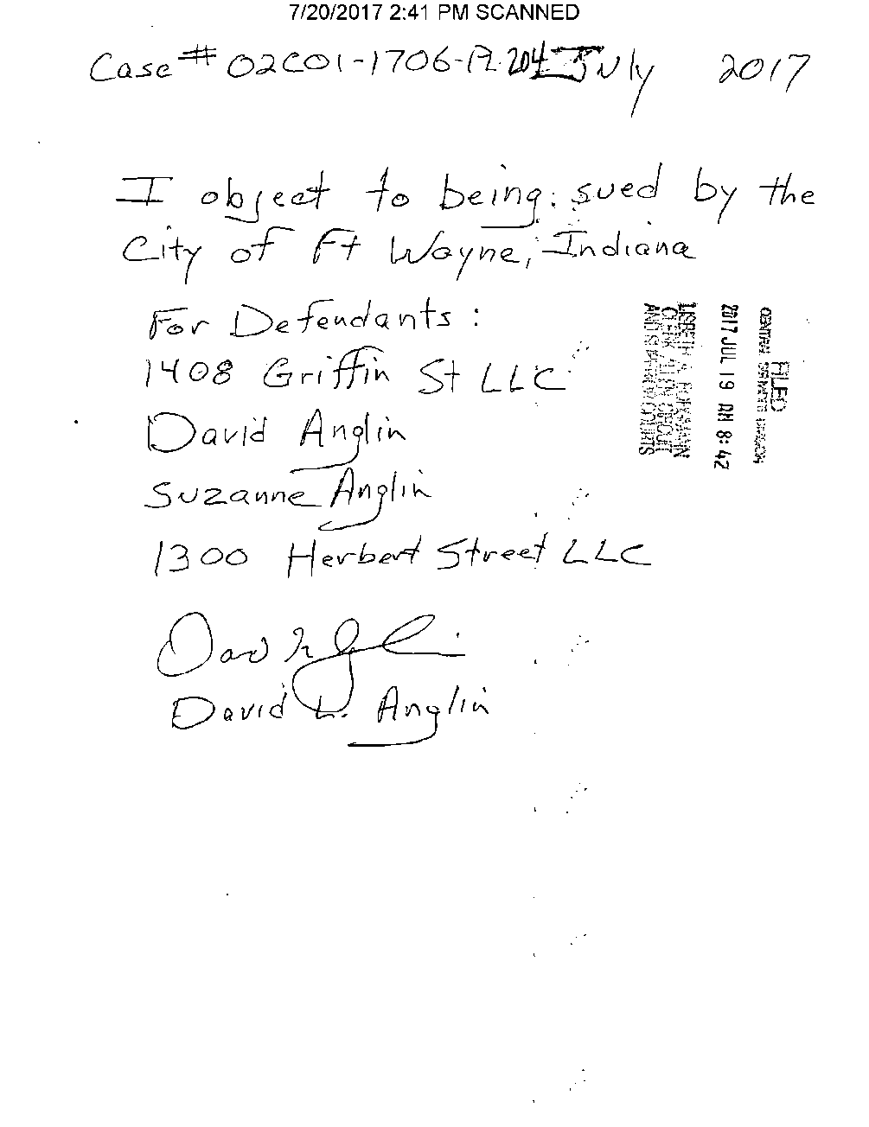
Pro Se “Objection to Being Sued”

Slide 27
Three Questions
How far down does title to land extend?
Far enough for reasonable & foreseeable use.
What is it worth?
Value is nominal. Perhaps 5% of fee simple value.
How should we request subsurface property rights?
Permanent easements – no restrictions of surface use
Token payments of nominal value
“Monetary awards,” not compensation

Slide 28
Seth Weinglass, JD
Program Manager, Capital Project Services
Fort Wayne City Utilities
seth.weinglass@cityoffortwayne.org
(260) 427-1330
Deep Tunnel Easements
Arriving at a Consensus of Valuation and Driving an Evolution in Legal Understanding

