Slide 1
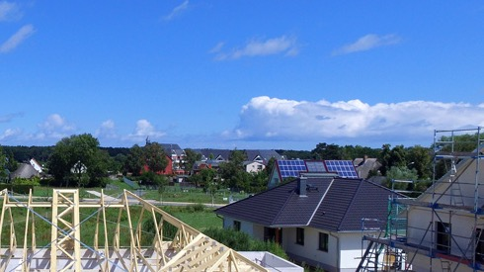

HUD and Disaster Recovery
Understanding the Uniform Act for CDBG-DR Activities
IRWA Education Conference | Portland 2019

Slide 2
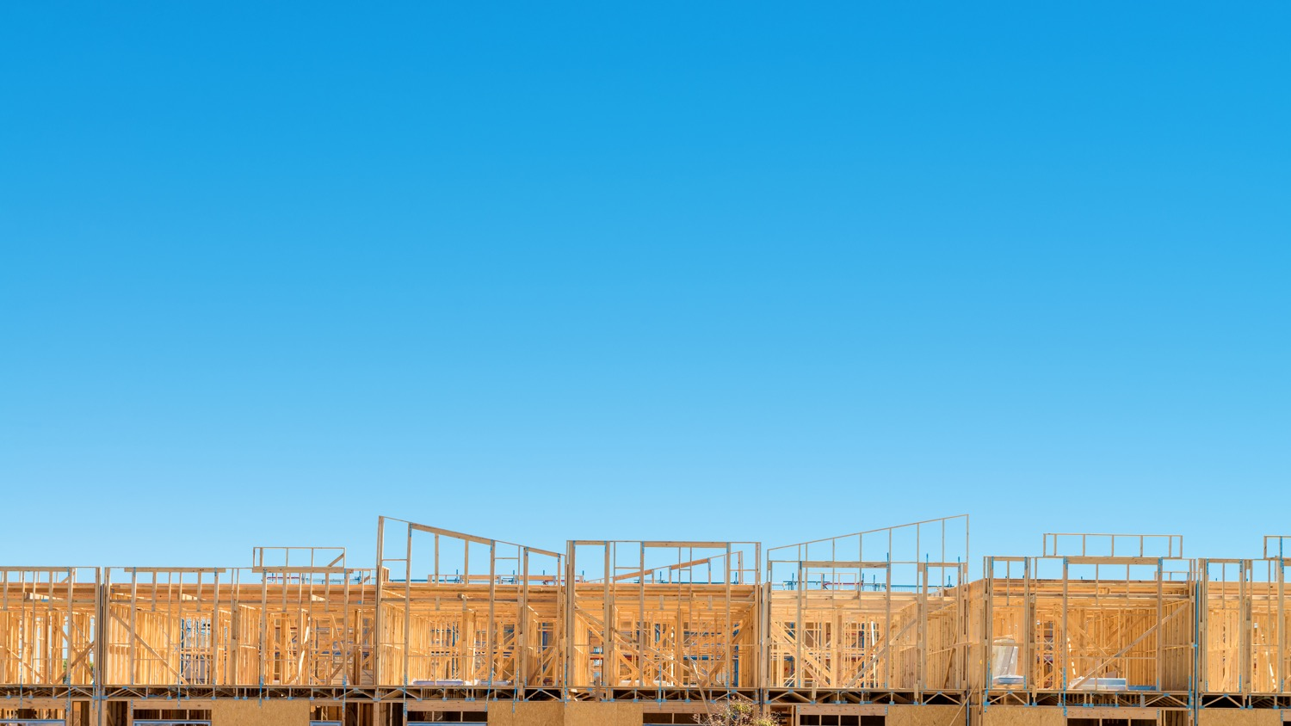

Session Agenda
Introductions
Experience with HUD Disaster Response and Recovery
CDBG-DR Topics
  Background and Context
  Recovery Process
    Supplemental Funds Lifecycle
    Waivers & Alternative Requirements
    Eligible Activities/Projects
    URA Considerations in Activities

Slide 3

Introductions & Experience

Slide 4
Regional Relocation Specialists
HUD's Relocation and Real Estate Division (RRED) is responsible for developing and implementing national policies for URA real estate acquisition and relocation activities in connection with HUD programs.
Jay Smith, Region 9
Worked collaboratively with FEMA and other federal, state, and local agencies on recovery planning after Northern California Wildfires of 2017 and 2019. While with the San Francisco Mayor’s Office of Community Development assisted with recovery efforts after the 1989 Loma Prieta Earthquake. Since 2002, has advised HUD grantees with URA compliance and related matters.
Sara Neira, Region 6
Subject matter expert on long-term disaster recovery & use of CDBG-DR funds for Katrina, Sandy, flood, tornado, & various hurricanes. Served as liaison to FEMA during active Hurricane Ike & as a member of HUD’s Region 6 Disaster Recovery Team. Prior to joining HUD in 2006, Sara provided URA services to cities, states, and local agencies for aviation, transportation, transit, and community development projects.

Slide 5
Background & Context

Slide 6
$1.6 Billion CDBG – DR
Awarded to Seven States for 2018 Disasters
STATE | ELIGIBLE DISASTER(S) | CDBG-DR* ALLOCATION
California | Wildfires and Flooding 4344 and 4353 | $124,155,000
California | Wildfires and High Winds 4407 & 4382 | $491,816,000
Florida | Hurricane Michael 4399 | $448,023,000
Georgia | Hurricane Michael 4400 | $34,884,000
Hawaii | Severe Storms, Flooding, Landslides and Mudslides 4365 & Kilauea Volcanic Eruption & Earthquakes 4366 | $66,890,000
North Carolina | Hurricane Florence 4393 | $336,521,000
South Carolina | Hurricane Florence 4394 | $47,775,000
Texas | Severe Storms and Flooding 4377 | $46,400,000
 | TOTAL | $1,596,464,000

Slide 7
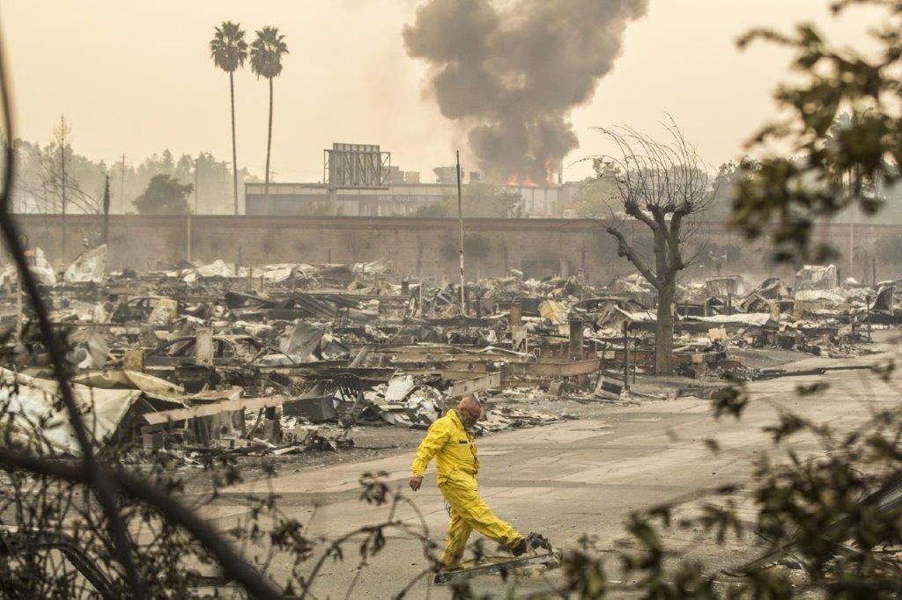
CDBG-DR Awards
DR – 4344: Tubbs Fire, Sonoma, CA
Approximately 125 grants for 59 grant recipient totaling approximately $85 billion
1998 – 2008 = $24 Billion
2009 – 2018 = $61 Billion
Journey’s End Mobile Home Park
Santa Rosa, CA (2017 Tubbs fire)

Slide 8

Response and Recovery Sequence
Response is immediate (30 – 60 days). Recovery begins day two until…?
National/State and Local Agencies
Emergency Managers
Food
Shelter
Clothing
Medical
Clean Up
Assessment of Needs Begins
Private Insurance
Homeowners
Renters
Fire
Disaster Recovery Centers
SBA Loans
Real Property, Business and Personal Loans
HUD
Contacts Grantees and PHA’s
SBA Loans
Real Property, Business and Personal Loans
HUD
Contacts Grantees, MF projects, and PHA’s
FEMA
Temp. Hsg.
Repair
Med.Dent.
Child Care
HUD
Placement at other PHA and subsidized units where possible
Long-term Recovery
Locally Driven
Interagency Recovery Group
State, Local and Fed, including HUD

Slide 9
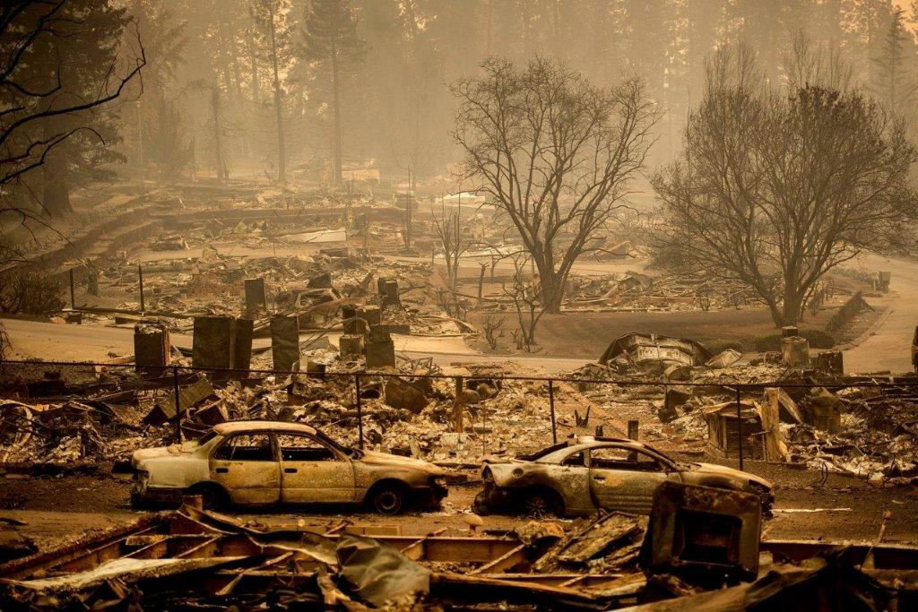
National Disaster Recovery Framework
Coordinated by FEMA: Establishes “Resource Support Function” consisting of representation from all Federal Agencies
Community Planning/Capacity Building – HUD
Economic Development - DOC
Health and Social Services – DHS
Housing – HUD
Infrastructure – Army Corps of Engrs
Natural and Cultural Resources – DOI
https://www.fema.gov/national-disaster-recovery-framework

Slide 10

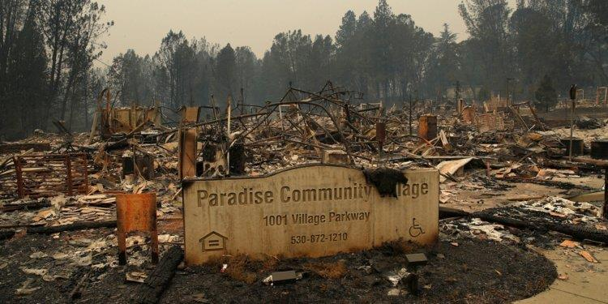
2018 Camp Fire (DR – 4407)
Butte County, California (11/8 – 11/25/18)
50,000 people displaced
14,000 homes destroyed
300 HCV holders impacted
84 units of subsidized senior hsg. in Paradise lost
30 schools destroyed

Slide 11
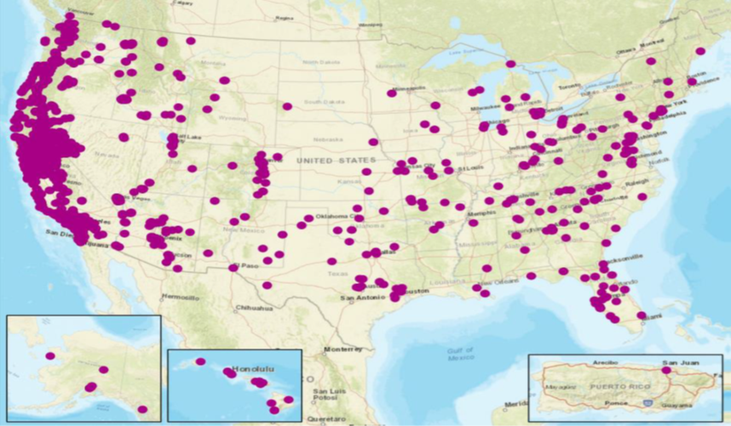
DR – 4407/Post Fire Mass Relocation
HUD Focus: After the shock of the disaster is over, those who were precariously housed but flying under the radar are now faced with even more challenges.
Considering New Metrics: Housing insecurity (affordability), unstable or temp. hsg. (stable occupancy) extremely poor quality housing (decent and safe).

Slide 12
Establishing CDBG-DR “Need” Numbers
  Housing – Damage not likely to be covered by insurance,
  SBA disaster loans, or FEMA housing assistance
  Infrastructure – State match requirement for FEMA PA.
  Economic – Damage to businesses applying for an SBA
  loan, but are denied due to inadequate credit or income
CAMP Fire disaster resulted in 22,000 FEMA registrations.

Slide 13
HUD Disaster Recovery Process

Slide 14
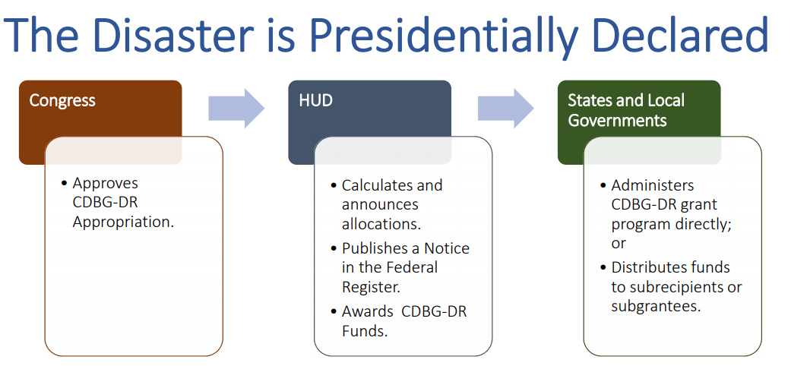
  Community Development Block Grant Disaster Recovery (CDBG-DR).
  Flexible grants to cities, counties, and States to recover from PDD’s.
  Emphasis on low-income areas, broad range of eligible activities.
  Time from PDD event to program execution may be 1-3 or more years.

Slide 15

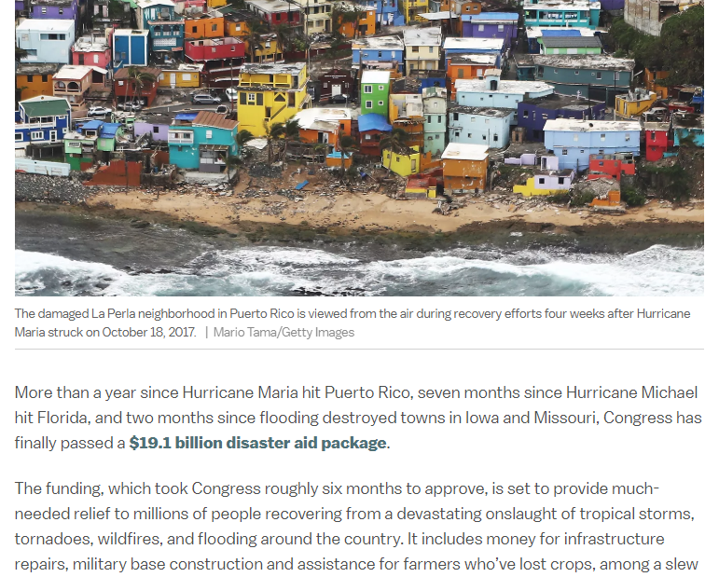

Slide 16
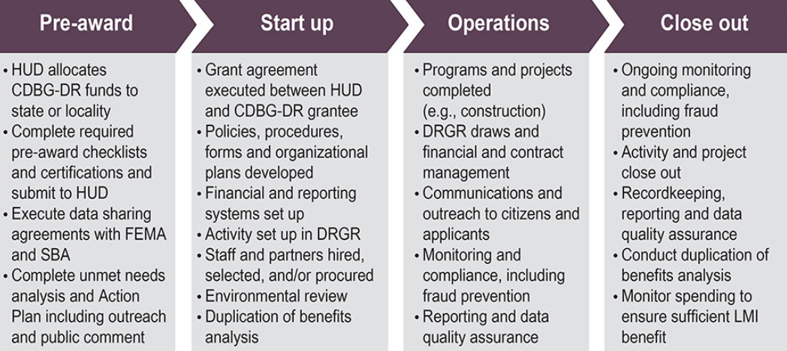
The CDBG-DR Life Cycle
Compliance begins in Start Up phase with policy & procedure development & acq/relo planning based on programs described in the Action Plan.

Slide 17
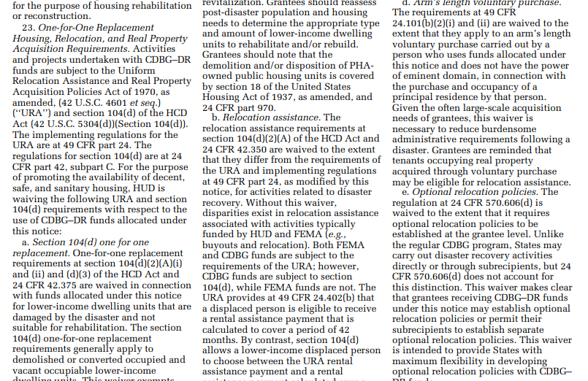
Supplemental appropriations with no permanent statutory authority or annual allocation.
CDBG regs apply unless as modified by Federal Register Notice.
Waivers are subject to change from disaster to disaster.

Slide 18
Waivers & Alternative Requirements
Waivers and alternative requirements issued to CDBG, URA, & Section 104(d) regs in Federal Register Notices are not optional.
Designed to allow for flexibility in program implementation while adhering to the statutory requirements & become the new rule for program administration.
Requirements unless states as an option grantees may or may not exercise, (i.e. Tenant Based Rental Assistance (TBRA) in lieu of cash URA relocation housing payments).
Waivers & alternative requirements included in Federal Register Notices do not apply to other funds (State or Entitlement CDBG programs, Section 108 Loans, HOME, or other HUD programs).

Slide 19
Waivers & Alternative Requirements
Waivers & alternative requirements do not apply to other funds, most restrictive requirements apply in mixed federal aid projects:
State or Entitlement CDBG, 108 & HOME programs
Affordable rental housing (LIHTC, USDA, HUD CFP, etc.)
Infrastructure or Public Facilities (DOT’s, FHWA, USACE)
Buyouts (FEMA)
Consult HUD when mixed federal aid projects are identified to ensure URA requirements are implemented consistent with requirements of all federal agencies.

Slide 20
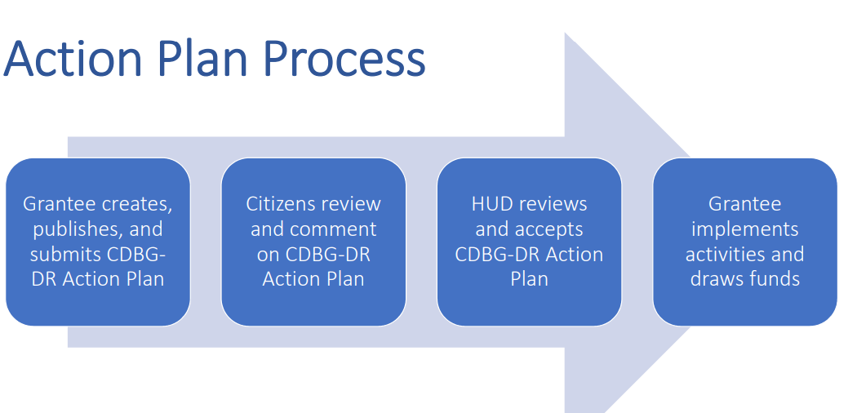
CDBG-DR Grantee Roles
Design/implement recovery programs to meet unmet need.
Ensure all activities are eligible & compliant.
Monitor performance & provide TA.
Programs described in Action Plans are usually not “site specific”, this happens at the activity level with an application for funds by the eligible applicant.

Slide 21
Program Execution
Grantees use a combination of these models to implement programs outlined in its HUD-approved Action Plan.
Direct Implementation Model – grantee hires own staff
Partnership Model – grantee works with other government agencies, subrecipients, & contractors
Method of Distribution Model – available to State grantees to provide funds to local governments for program execution
Consultants may be used to augment grantee capacity at the direct grantee or subrecipient levels, depending on the organizational model used for a specific program.

Slide 22
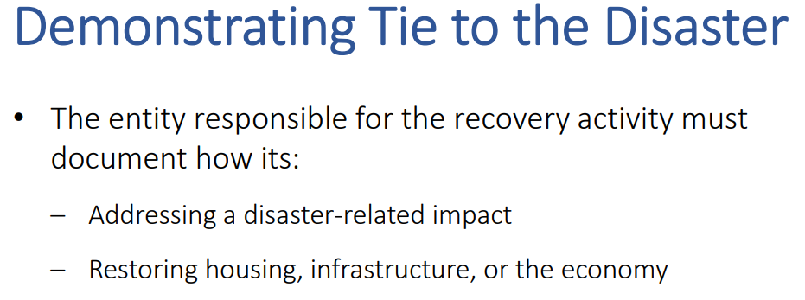
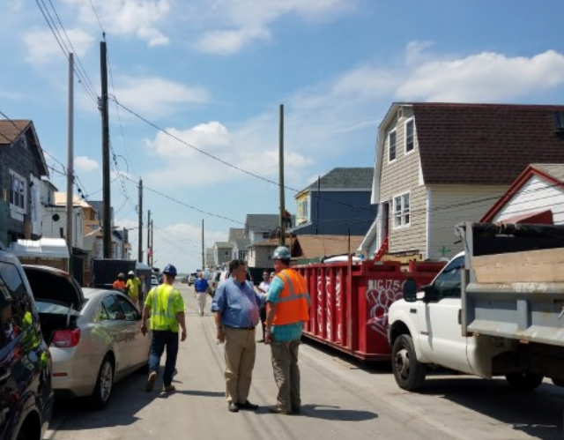
  All CDBG-DR activities (known as “projects” under the URA) must:
  Address disaster-related impacts in the covered Presidentially-declared area
  Be a CDBG eligible activity
  Meet a CDBG national objective

Slide 23
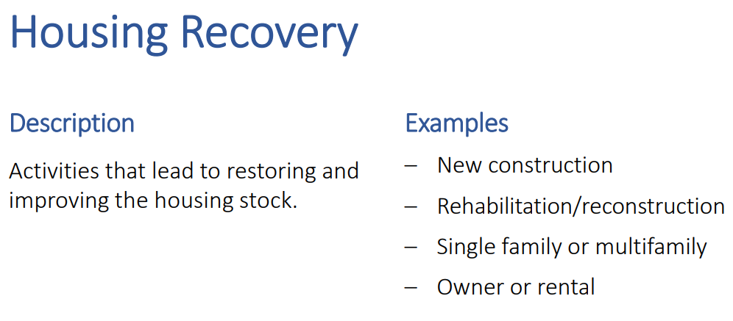
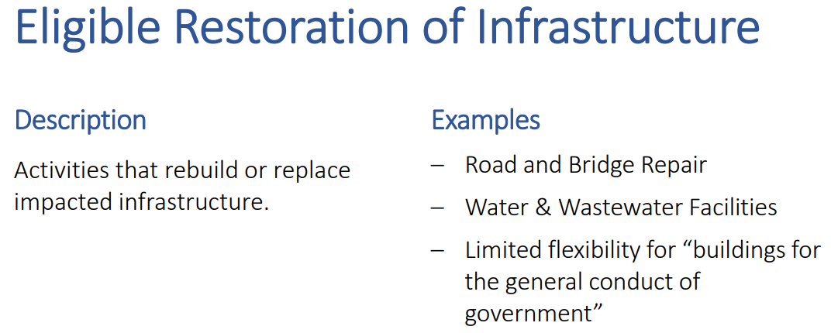
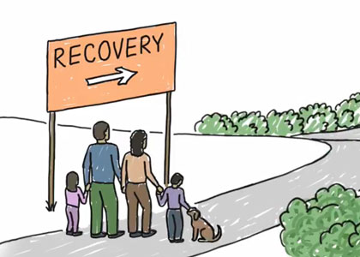
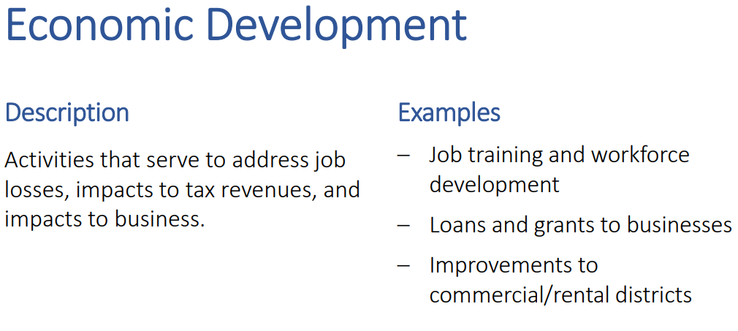

Slide 24

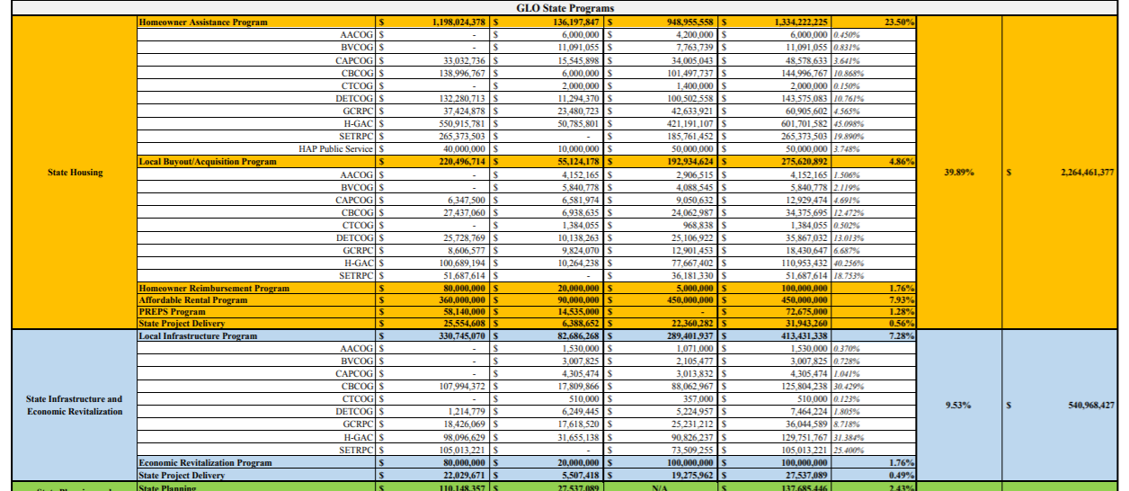
From Action Plans to Activities

Slide 25
Common Eligible Activities with URA Applicability
When federal funds are planned, intended, or used for any activity or phase of a project and the phases are interdependent, the URA applies to the land acquisition (even if CDBG-DR does not fund the sale).
Buyouts (often with “housing incentives”, i.e. optional relocation assistance).
Housing (rehabilitation, new construction, down payment assistance, etc.).
Infrastructure & public facility activities (where not completed within existing right-of-way).
Economic development activities may have URA acquisition requirements.
  Rehabilitation of an industrial building acquired by a nonprofit for use as workforce development training center, for example.

Slide 26
URA Applicability
The Grantee must analyze the timeframes of the application for federal funds relative to the date site control was obtained.
“Project" means any activity or series of activities undertaken with federal financial assistance received or anticipated in any phase.
Where activities are determined to be interdependent, the URA applies.
  If an applicant entered into a contract to acquire the property with the intention of seeking federal funds to complete a project, the entire project would be subject to URA.
  If site control was obtained prior to the availability of federal funding, such as prior to the development of a CDBG-DR Action Plan, then the URA would not apply since the funding program was not in existence at the time the real estate was acquired.

Slide 27
URA Applicability
Site identification + planned or intended use of federal funds = commence URA compliance actions
General Information Notice required “as soon as feasible” (site identification + planned use of federal funds).
Notice of Eligibility for Relocation Assistance “promptly” at Initiation of Negotiations (ION):
  “promptly” is as soon as possible (URA advises 7-10 days)
  3 comparable properties
  maximum amounts of replacement housing & moving payments
The time between the CDBG-DR application and applicable ION date* should be used to obtain household data & conduct market analysis to prepare a Notice of Eligibility at the milestone on which this occurs.
*For more info on ION, see HUD Handbook 1378 Exhibit A

Slide 28
Acquisition & Buyout URA Issues
Within each activity or project, buyouts must follow a consistent, uniform acquisition process.
Determine in advance if a project can meet all the criteria at 49 CFR 24.101(b)(1)-(5) to be exempt from or is subject to the URA’s basic acquisition policies at Subpart B.
When an agency complies with the “voluntary acquisition” requirements, it provides written notice to the owner that eminent domain will not be used to force a sale.
Once the voluntary approach has been initiated an agency is precluded from using eminent domain.

Slide 29
Acquisition & Buyout URA Issues
The URA does not require an appraisal when the acquisition is exempt from the Subpart B basic acquisition policies. For voluntary acquisitions, estimates of market value must be prepared by a person familiar with real estate values and include the basis for the agency’s determination.
An appraisal is a recommended best practice for determining the property’s market value and for documenting cost reasonableness in accordance with CDBG program rules.
HUD recommends the use of State licensed or certified appraisers.
A technical appraisal review for high value and/or complex valuation problems, such as disaster-damaged property, may also be reasonable.
Regardless of the method chosen, it must be logically supported and uniformly applied as evidenced in individual casefiles.

Slide 30
Acquisition & Buyout URA Issues
In a “voluntary acquisition”, acquiring agencies should consider alternative sites to complete the project prior to entering into any purchase agreement at an amount that exceeds the agency’s estimate of market value but cannot be reasonably supported and justified.
Unlike acquisitions subject to the basic acquisition policies of the URA Subpart B, agencies cannot use the costs and risks associated with eminent domain to support a negotiated settlement in a voluntary acquisition.

Slide 31
Acquisition & Buyout URA Issues
It is possible to pay more than market value when purchasing a property using either the voluntary or involuntary acquisition approach.
In both approaches, acquiring agencies should be guided by administrative settlement provisions at 49 CFR 24.102(i) for settlements in excess of the property’s estimated market value or established just compensation.
When federal funds pay for or participate in acquisition costs, the acquiring agency must maintain written justification for the higher amount stating the available information to support the incremental cost over and above the estimated market value or established just compensation.
  The agency’s documentation should be commensurate with the CDBG-DR expenditure, a minor increase will typically require less support.

Slide 32
Acquisition & Buyout URA Issues
Grantees are prohibited from arriving at a purchase price by automatically applying a percentage of value to all properties and are subject to the cost principles in 2 CFR Part 200.404.
Grantees can only use CDBG-DR funds towards eligible costs as justification for paying more than market value.
  Example, since payment of liens is an ineligible use of CDBG-DR funds, the value of any liens on the property would not serve as justification for a negotiated price more than the agency’s established just compensation or estimate of market value.

Slide 33
Duplication of Benefit
Like other CDBG-DR expenditures, CDBG-DR funds received by people as relocation or acquisition payments through the URA are subject to a DOB review in compliance with The Stafford Act, (49 CFR 24.8(n)).
HUD November 2011 publication, “Clarification of Duplication of Benefits Requirements Under the Stafford Act for Community Development Block Grant (CDBG) Disaster Recovery Grantees” and in subsequent CDBG-DR Federal Register Notices.

Slide 34
HUD Compliance Monitoring
HUD reviews CDBG-DR Action Plans and project level details, such as an applications and individual case files, for evidence the project met the criteria to be exempt from the URA’s basic acquisition policies at Subpart B.
49 CFR 24.101(b)(1)-(5).
Records of negotiations between the acquiring agency and the owner.
Justification for any deviation between the agency’s estimate of market value and the final purchase price commensurate with the size of the CDBG-DR investment (cost reasonableness).
See HUD Handbook 1378 Chapter 6, Recordkeeping.
Incorrect payments, ineligible costs, timing of notices, etc.

Slide 35
HUD Resources
CDBG Disaster Recovery Website: https://www.hudexchange.info/programs/cdbg-dr/
CDBG-DR Supplemental Appropriations & Federal Register Notices:
https://www.hudexchange.info/programs/cdbg-dr/cdbg-dr-laws-regulations-and- federal-register-notices/
HUD Relocation & Real Estate Division Contacts
https://www.hudexchange.info/programs/relocation/contacts/
HUD URA Regs, Policy, Forms, Training, & More
https://www.hudexchange.info/programs/relocation/#handbooks

Slide 36
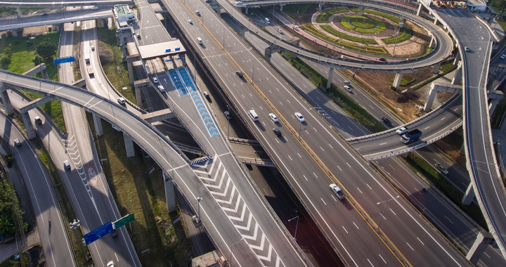
Q & A
Jay Smith, Region 9 Relocation Specialist
(415) 489-6591 / jay.smith@hud.gov
Sara Neira, Region 6
(817) 978 – 5937 | Sara.M.Neira@hud.gov

