Slide 1
Practical Project Management for Right of Way Professionals
Melanie Rabaglia, SR/WA
Janice Warren, PMP, SR/WA

Slide 2

Why do we need right of way (ROW) professionals to use project management skills to deliver successful projects?
Project management requires deliberate planning, critical thinking, documentation, and continuous improvement.

Slide 3

ROW is a unique industry and is on the critical path of ALL projects. Key elements ROW professionals bring to the table:
We understand that engineers do not always consider practical solutions and the ‘human’ element’
We are problem solvers
We know how to work with people to find a reason to say ‘YES’
We break down complex puzzles to find solutions

Slide 4
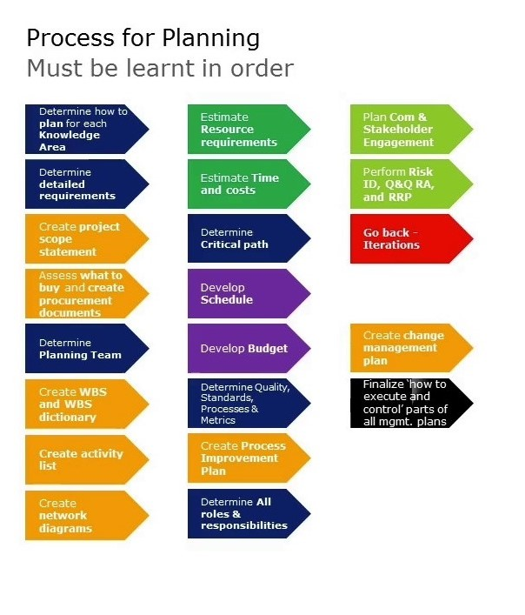
Planning is the key to project success:

Slide 5
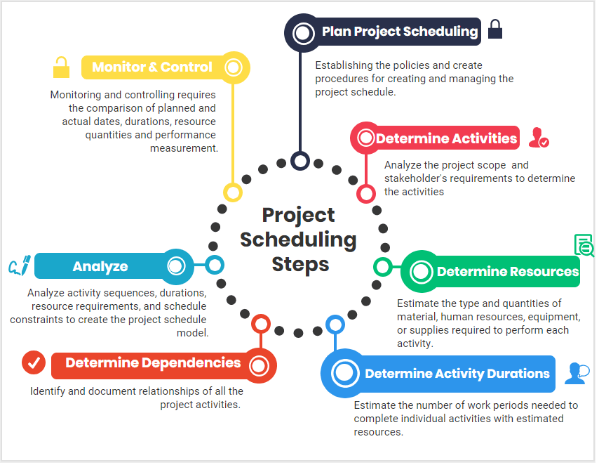

Slide 6

Collaboration is a key element to ensure project success. Most projects fail due to lack of effective communication. Talk to each other, even if it is difficult.

Slide 7


Slide 8



