Slide 1
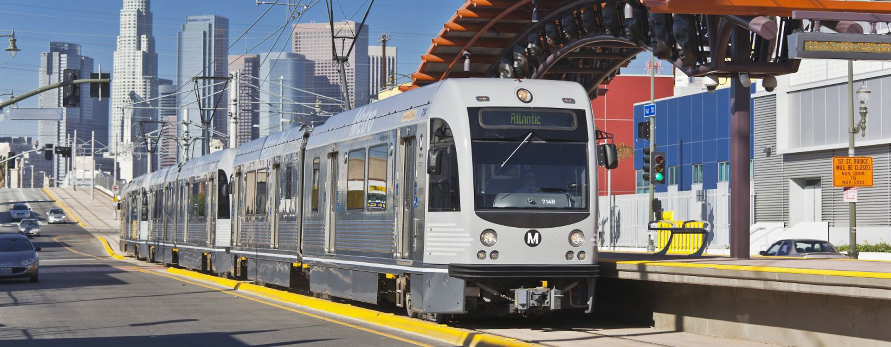

RE-IMAGINING LA COUNTY
Holly Rockwell
Senior Executive Officer
LA Metro
BJ Swanner
R/W Planning Manager
Epic Land Solutions, Inc.
June 11, 2016

Slide 2
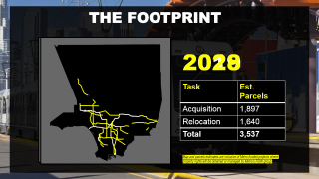
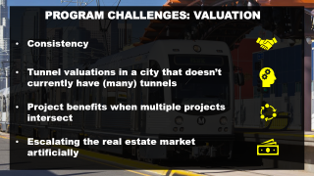
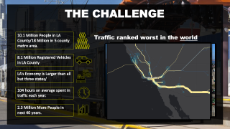
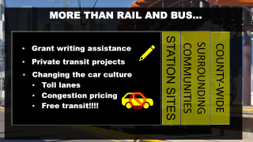
RE-IMAGINING LA COUNTY
The Challenge
The Plan
The Program
The Other Hat

Slide 3

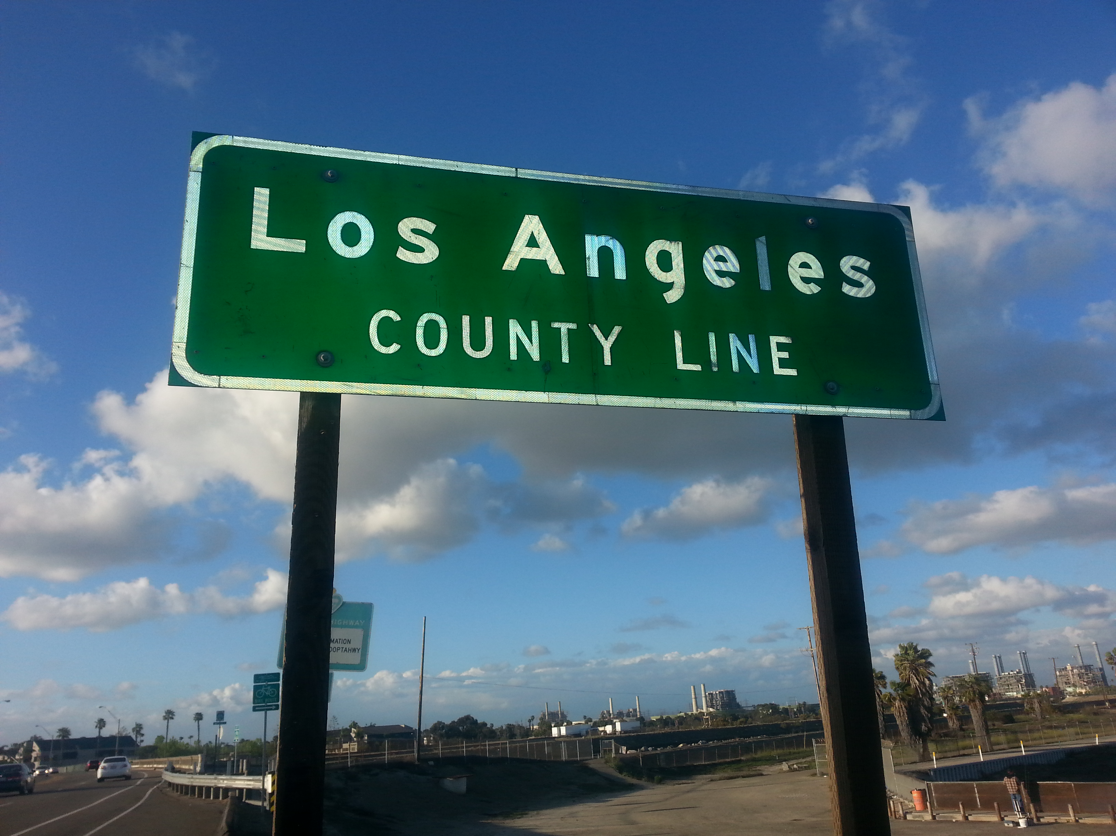
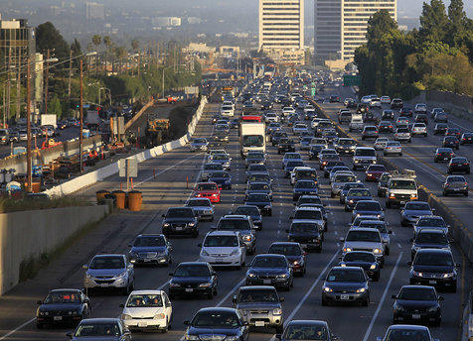
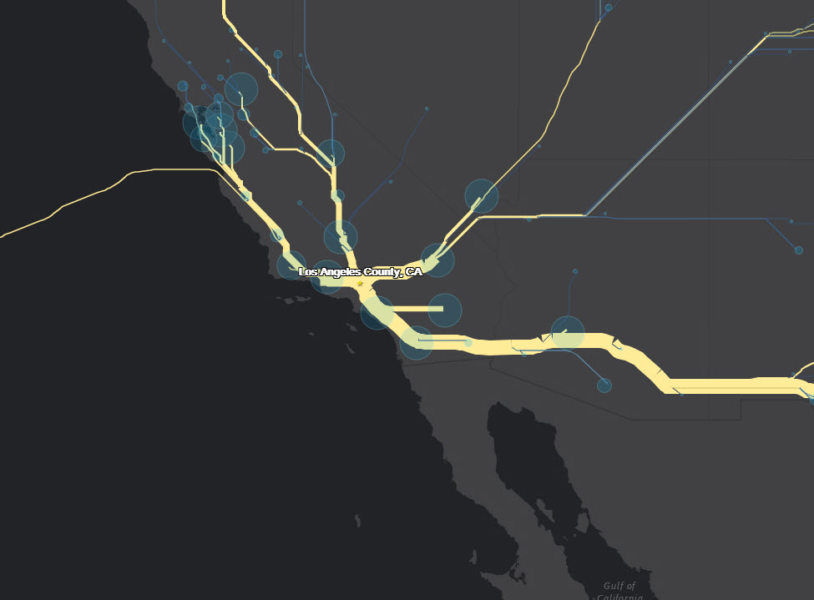
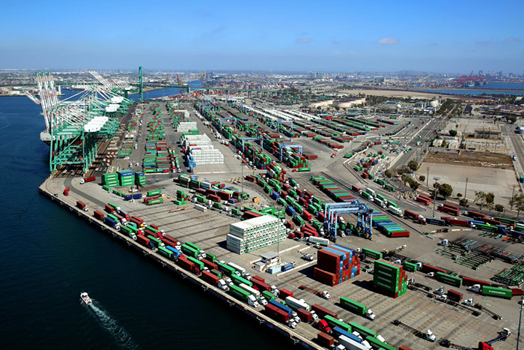
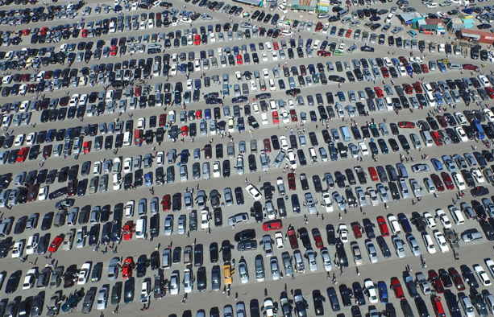





THE CHALLENGE
10.1 Million People in LA County/18 Million in 5 county metro area.
Traffic ranked worst in the world
8.1 Million Registered Vehicles in LA County
LA’s Economy is Larger than all but three states/
104 hours on average spent in traffic each year.
2.3 Million More People in next 40 years.

Slide 4
THE CHALLENGE
November 2016
- taxpayers voted by 70.15% to increase sales tax by ½ % to raise $120 BILLION for better transportation in LA County
Program | Billions
Local Return | 20.4
Highways | 22.8
Transit Operations | 32.4
Transit First/Last Mile | 44.4

Slide 5
THE OLYMPICS
September 2017
LA awarded the Olympics in 2028
January 2018
Metro Board approved the Twenty-Eight by ‘28 Initiative; 20 projects already slated for completion by 2028
Jan 2019
Estimated $26.2 billion needed to accelerate delivery of the other eight projects by 2028
What’s at stake for LA?
Fall 2020
LA Stadium at Hollywood Park

Slide 6
THE FOOTPRINT
2028
2019
Task | Est. Parcels
Acquisition | 1,897
Relocation | 1,640
Total | 3,537
Map and parcels estimates are inclusive of Metro funded projects where property rights will be obtained or managed by Metro’s ROW group.

Slide 7
RE-IMAGINING LA COUNTY
Parcel estimates are inclusive or Metro funded projects where property rights will be obtained or managed by Metro’s ROW group.

Slide 8




PROGRAM CHALLENGES: VALUATION
Consistency
Tunnel valuations in a city that doesn’t currently have (many) tunnels
Project benefits when multiple projects intersect
Escalating the real estate market artificially

Slide 9
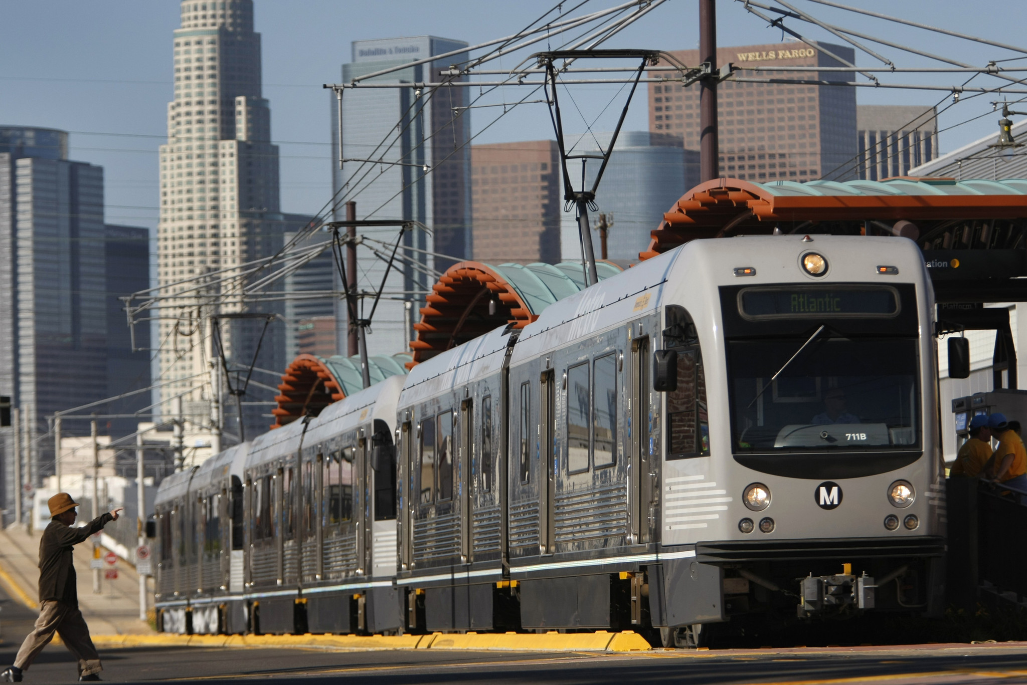
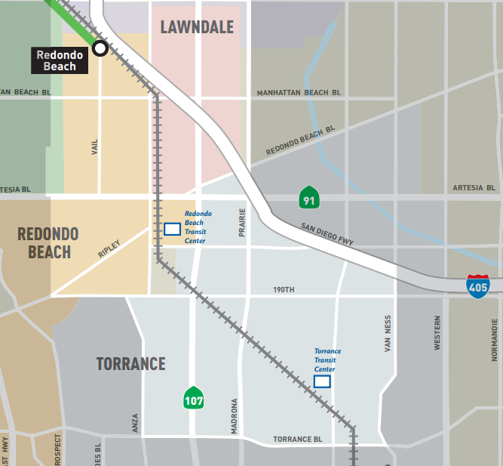
Bottom ¾ of listings sell for a 4.2% premium¹
Top ¼ of listings see a 10.5% penalty¹
Median sale price in Lawndale: $565,400²
Median sale price in Torrance: $817,700²
Median sale price in Redondo: $1,090,400²
¹https://www.trulia.com/research/la-metro/
²https://www.zillow.com/home-values/

Slide 10
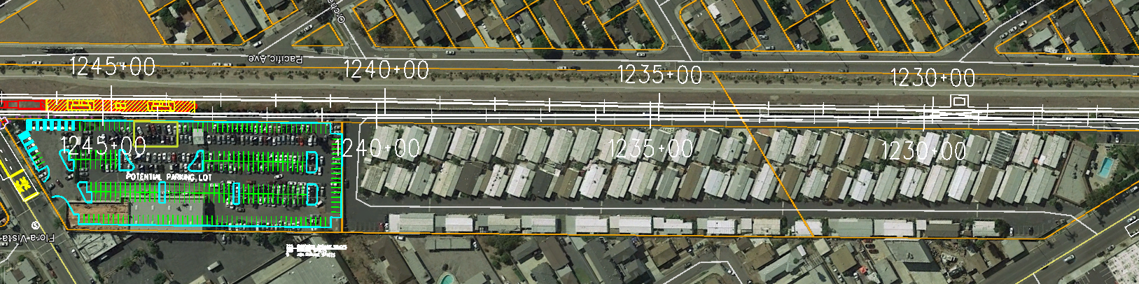
PROGRAM CHALLENGES: DISPLACEMENT
Availability of replacement locations
Suitability
Affordability

Slide 11
PROGRAM CHALLENGES: EQUITY
California Public Utilities Code Section 130001:
“(e) The Transportation system should offer adequate public transportation to all citizens, including those immobilized by poverty, age, physical handicaps, or other reasons,”
Metro Equity Platform Framework

Slide 12
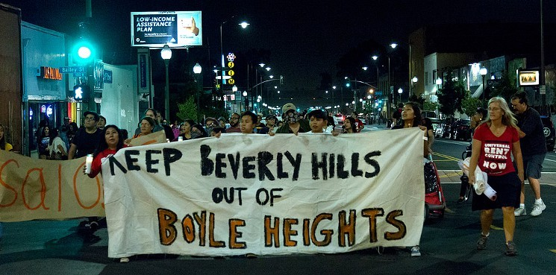
PROGRAM CHALLENGES: EQUITY
Changing neighborhoods
Affordable Housing

Slide 13

PROGRAM CHALLENGES: CAPACITY
METRO STAFF
Original Timeline
METRO BOARD
CONSULTANTS
COURTS
20x28 Timeline

Slide 14








MORE THAN RAIL AND BUS…
STATION SITES
SURROUNDING COMMUNITIES
COUNTY-WIDE
Parking
Grant writing assistance
First/Last Mile
Private transit projects
Joint Development
Changing the car culture
  Toll lanes
  Congestion pricing
  Free transit!!!!
Land Use Planning
Bike Share
Scooters

Slide 15
THE END

