Slide 1
URA Guidance for the Gray Areas in Relocation
Michele Folk, SR/WA, R/W-URAC, R/W-RAC, R/W-NAC
Senior Vice President, OPC
Lisa Barnes, SR/WA, R/W-RAC
VP of Training, O. R. Colan Associates, LLC
Lisa Harrison, SR/WA, R/W-URAC, R/W-RAC, R/W-NAC
President, Pinnacle Consulting Management Group, Inc.

Slide 2
Tenant Pays Little to No Rent

Slide 3
Rents on project site are below market rent
§24.404
(2) Base monthly rental for displacement dwelling. The base monthly rental for the displacement dwelling is the lesser of:
(i) The average monthly cost for rent and utilities at the displacement dwelling for a reasonable period prior to displacement, as determined by the Agency (for an owner-occupant, use the fair market rent for the displacement dwelling. For a tenant who paid little or no rent for the displacement dwelling, use the fair market rent, unless its use would result in a hardship because of the person's income or other circumstances)
What is the definition of “little rent”?

Slide 4
Agency must adopt a policy
Consistent policy across a project
If rents are “x”% below market rent, rent is raised to market rent for purposes of base monthly rent calculation (ex. 50%, 25%)
Economic rent versus fair market rent concept
“Unless it creates a hardship” – financial hardship defined as more than 30% of gross monthly income towards replacement housing costs – but 30% income is considered anyway (if Low Income), and what is “hardship” due to other circumstances?

Slide 5
Displacement Rent = $500; 30% Income = $1,100 (Low Income)
Comparable Rent = $1,200; Market Rent = $1,000
Scenario 1: Tenant’s displacement rent is raised to fair market rent
$1,000 (New Displacement Rent) < $1,100 (30% of Income)
Base Monthly Rent = $1,000
$1,200 - $1,000 = $200 x 42 months = $8,400 RAP
Scenario 2: Tenant’s displacement rent remains the same
$500 (Displacement Rent) < $1,100 (30% of Income)
Base Monthly Rent = $500
$1,200 - $500 = $700 x 42 months = $29,400 RAP

Slide 6

Exchange for Services
Tenant works for the property owner in some capacity and receives free or reduced rent as part of his/her compensation
- on-site apartment manager
- security
- maintenance

Slide 7
Facts:
On-site manager receives rent reduction as part of compensation package
Rent for unit is normally $1,000 per month
Tenant pays $200 per month rent
Tenant receives $1,500 per month in wages
Rather than the tenant paying $1,000 a month for rent and receiving $2,300 per month in wages, the tenant’s rent is simply reduced

Slide 8

Displacement Rent:
$200 rent raised to $1,000 normal rent for unit
Income:
$800 rent reduction added to gross household income
$1,500 + $800 = $2,300 monthly income (Low Income)
30% Income = $690
Comparable rent = $1,200
$690 (30% Income) < $1,000 (Displacement Rent)
$690 = BMR
$1,200 - $690 = $510 x 42 months = $21,420 RAP

Slide 9
Or…….
Amount of rent reduction is not added to household income
Displacement Rent:
$200 rent raised to $1,000 normal rent for unit (little to no rent concept)
Income:
$1,500 per month in wages
30% Income = $450
Comparable rent = $1,200
$450 (30% Income) < $1,000 (Displacement Rent)
$450 = BMR
$1,200 - $690 = $750 x 42 months = $31,500 RAP

Slide 10

Does approach change with knowledge the tenant will lose their job and inexpensive unit?
If so, does income become $0 for the calculation of rental assistance?
Do we track any other tenant after their move or adjust entitlements if household circumstances change after the move?

Slide 11
Calculating Income

Slide 12
Cash Income
How to document cash income?
Letters from employers
Self-certification of income
Budget worksheet
When not to consider income in RAP calculation?

Slide 13
Seasonal Income
If using year to date income, must understand start and stop dates for job
Compare year to date income with W-2 or tax returns from previous year – may catch increased income during certain seasons not yet reflected in YTD income docs

Slide 14
Inheritance/Investments/Savings
If tenant is not working and is living on
savings, investments or an inheritance, how is
income calculated?
- budget worksheet
- account statement documenting withdrawals
- interest and dividend statements/tax returns

Slide 15
Alimony and Child Support
Sporadic payments – supposed to be monthly
Payments received in amounts less than court ordered amount
Document what they are actually receiving in a 12- month period versus basing income calculation on what they may ultimately collect

Slide 16
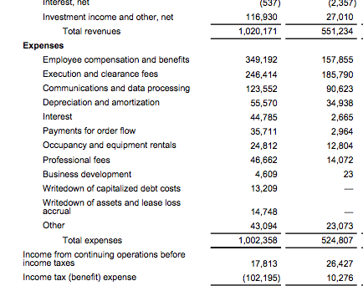
Income Derived from Business
Only income declared is from net profit from a business
Tax returns show net profit of $10,000 per year
Displacement rent alone is $1,200 per month
How do you proceed?

Slide 17
One Business or More?
Determining Number of Businesses at the Site for Fixed Payment Eligibility

Slide 18
Determining the Number of Businesses
One business on site has potential to be two or more separate businesses and claim separate fixed payments
Examples: real estate offices, hair cutting salons, doctor/dental offices, attorney offices
If agency determines a single business, eligibility is for single fixed payment

Slide 19
Determining the Number of Businesses (cont.)
Uniform Act regulations provide criteria/factors for agency to consider
These factors apply to number of businesses eligible for fixed payment
Agency must weigh all factors at 49 CFR 24.305(b) before making decision

Slide 20
Displaced Business – University BBQ
Clyde, owner-operator, interested in fixed payment
Difficult to move business and remain profitable; he thinks tax returns would support maximum payment
His wife, Candie, is co-owner of restaurant business; is not involved in business operation
Clyde tells relocation agent that Candie manages a separate catering business

Slide 21
Let’s Look –
University BBQ & Candie’s Catering
In determining whether two or more displaced legal entities constitute a single business, which is entitled to only one fixed payment, all pertinent factors shall be considered, including the extent to which:

Slide 22

Factor #1
§24.305(b)(1)
The same equipment and premises are shared
Are the businesses obviously physically separate from each other at the site?
Do the businesses share common equipment?

Slide 23
Factor #1 - University BBQ
(The same premises and equipment are shared)
Candie has desk & phone in Clyde’s office
Purchases her own supplies and owns delivery van
Candie’s catering business uses same kitchen and equipment for food preparation as University BBQ
No separation of space for restaurant and catering business

Slide 24
Factor #2
§24.305(b)(2)
Substantially the same business functions are carried out and business and financial affairs are commingled
Are there differences in the products or services between the entities?
Are customers able to perceive a difference in the functions of the entities?
Are there separate legal entities constructed for tax or other purposes?
Are payments for products or services made to each entity separately or are all payments made to the same entity?
Does the income from each entity go into one bank account or different bank accounts?

Slide 25
Factor #2 – University BBQ
(Same business functions and commingled financial affairs)
Catering service started for special occasions and now is good-sized part of total revenue
Separate tax ID numbers and tax returns
Separate bank accounts and payments are made to University BBQ or Candie’s Catering

Slide 26
Factor #3
§24.305(b)(3)
The entities are held out to the public as one business
Is there one sign on the outside of the building?
Do you believe that the public would perceive this as one business?
Are there separate entrances different customers enter for different businesses?
Are there any indications inside the structure that might indicate multiple businesses?

Slide 27
Factor #3 – University BBQ
(Entities held out to the public as one business)
Exterior sign for “University BBQ”
Take-out/pick-up entrance for restaurant is also entrance for catering service pick-up with sign “Candie’s Catering Pick-Up”
Menu has separate catering menu and phone number for ordering
Interior sign at restaurant entrance that says “We Do Catering! Call Candie’s Catering at 555-0202”
Separate yellow page advertising and website for restaurant and catering services

Slide 28
Factor #4
§24.305(b)(4)
The same person, or closely related persons, own or manage the affairs of the businesses
Who owns the entitles and how are they related?
How are the entities structured?
Who manages the business operations of the entities and how are they related?
Who handles the financial affairs of the entities and how are they related?

Slide 29
Factor #4 – University BBQ
(The same person(s) own, control, or manage business affairs)
Clyde and Candie own University BBQ and Candie’s Catering together
Clyde manages restaurant and financial affairs, Candie manages catering
Clyde and Candie both signers on each bank account.

Slide 30
One Business or Separate Businesses?
Factor 1 – equipment & premises shared
Factor 2 – same business functions, business/financial affairs commingled
Factor 3 – held out to public as one business
Factor 4 – same person(s) own, control, manage business entities
One business
Two businesses
???
One business

Slide 31
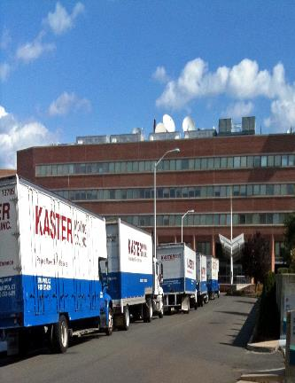
Non-residential Moves

Slide 32
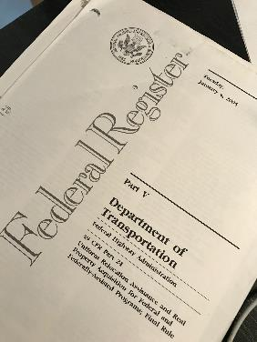
24.301
Any owner-occupant or tenant who qualifies as a displaced person and who moves from a business, farm or non-profit organization is entitled to payment of his/her actual moving and related expenses, as the Agency determines to be reasonable and necessary.

Slide 33
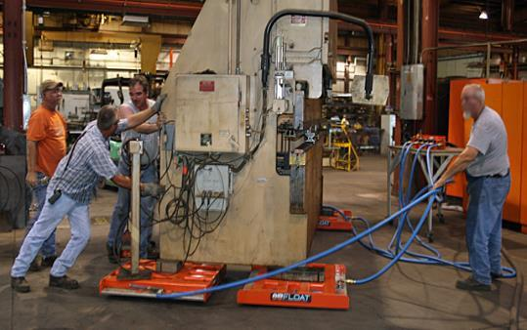
Moving – All About Stuff
  Includes packing, crating, unpacking, and uncrating of the personal property, disconnecting, dismantling, removing, reassembling, and reinstalling relocated machinery, equipment, substitute personal property, and connections to utilities available within the building;

Slide 34
Code Compliance
It also includes modifications to the personal property, including those mandated by Federal, State or local law, code or ordinance, necessary to adapt it to the replacement structure, the replacement site, or the utilities at the replacement site, and modifications necessary to adapt the utilities at the replacement site to the personal property.

Slide 35
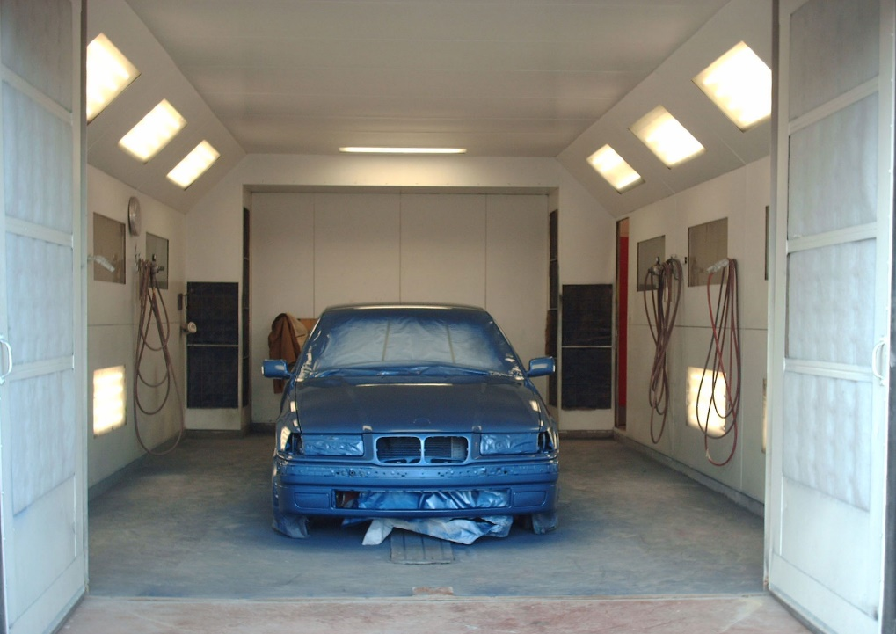
Paint Booth Example
SUBJECT PAINT SPRAY BOOTH Paint spray booth, 34'lg x 21'w x 10'h, steel, open front, including: (12) explosion proof fluorescent lights, 4'lg, 4-tube, wall and ceiling mounted; (1) dry chemical fire suppression system; (2) quartz lamps, with adjustable arms, wall mounted; (1) updraft exhaust system, with fan and 3'dia. galvanized exhaust duct through roof

Slide 36
Paint Booth Example con’t
At the replacement site, the volume of the room requires that the booth have a make-up air unit for the exhaust system to replace the air at the least 3 times per hour.
Is the make-up air unit compensable as a move cost?

Slide 37
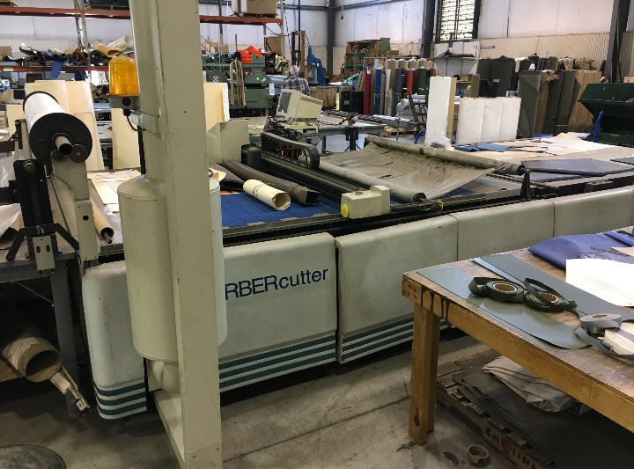

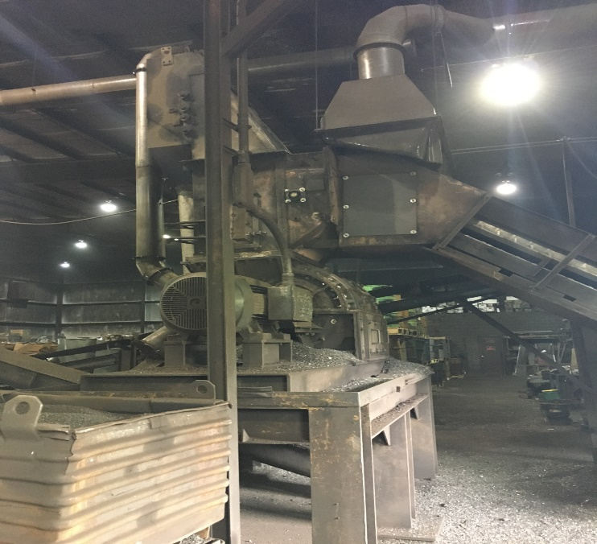
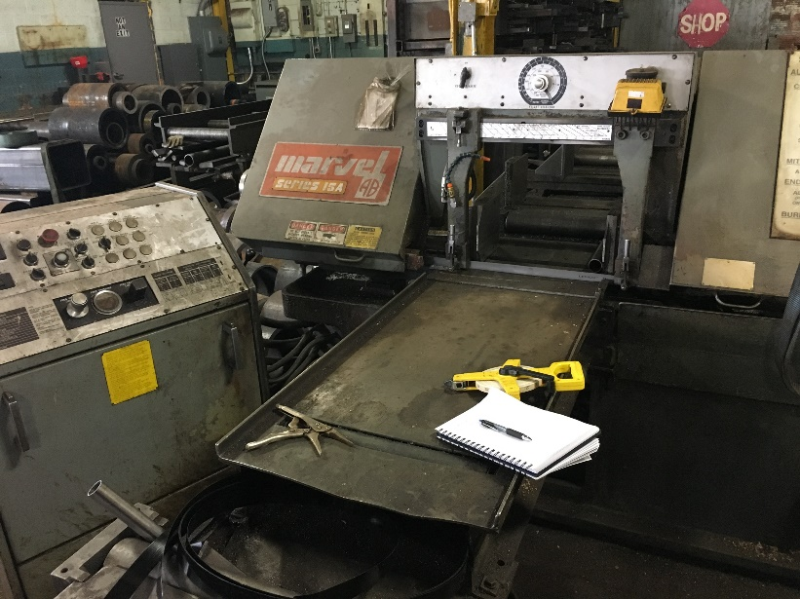
Dust Collection Example
What if a dust suppression system is required because of the combination of equipment but individual pieces would not require one?
Would the suppression system be eligible
as a move cost?

Slide 38

Materials Example
The materials used in the business are dangerous and a safety shower is required (by code) in several areas of the replacement site. Are the showers compensable as a move cost?

Slide 39
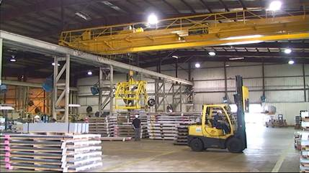
Fork Lift Example
The business generates significant metal dust. At the subject they have 9 electric forklifts. Due to the metal dust, OSHA requires the forklifts be gas operated due to explosion potential.
Is the business eligible to convert the forklifts to gas or substitute with gas forklifts as a move cost?

Slide 40
FHWA FAQ
60. §24.301(g)(3) and §24.304(a)(1). Are costs incurred in complying with OSHA and other code requirements at the replacement location considered eligible costs in situations where the business was not subject to the requirement at the displacement property because of a grandfathered provision?
Modifications to personal property mandated by Federal, State or local law, code, or ordinance that are necessary to reassemble or reinstall the personal property or adapt it to the replacement structure, the replacement site, or the utilities at the replacement site are eligible for reimbursement under §24.301(g) (3). The modifications authorized by this subsection must be clearly and directly associated with the reinstallation of the personal property and cannot be for general repairs or upgrading of equipment or facility. Finally, expenditures for authorized modifications must be reasonable and necessary.

Slide 41
FHWA FAQ con’t
Costs for repairs, modifications, or improvements to the replacement real property due to the requirements of laws, codes, or ordinances can only be paid under §24.304(a)(1) and are limited to the $25,000 maximum payment under this subsection. Any costs in excess of $25,000 are ineligible.

Slide 42
Things to Consider
Reasonable and Necessary
Personal property vs Business vs Real Property
Installation vs Operation
Was the personal property actually grandfathered or just out of compliance?

Slide 43
“Cussin and Discussin”
Did you change you answers?
  Paint booth?
  Dust suppression system?
  Safety showers?
  Fork lifts?
  Remember that the official answer to all relocation questions is
  IT DEPENDS. Justify the answer. Be consistent across a project. Get specific guidance from your Agency.

Slide 44
Questions?
Bring additional thoughts and questions to the Relocation Talk Show Wednesday morning.
Want to get more involved with relocation? Join the Relocation Community of Practice!

