Slide 1

An update from the UK
A review of major infrastructure projects from across the pond
Jonathan Stott: Chair, Compulsory Purchase Association; Managing Director, Gateley Hamer
Richard Asher: Director, Savills, and former Chair of the Compulsory Purchase Association
Meyric Lewis: Barrister and former Chair of the Compulsory Purchase Association
Notes:
Thank you for your hospitality
Learnt a lot

Slide 2
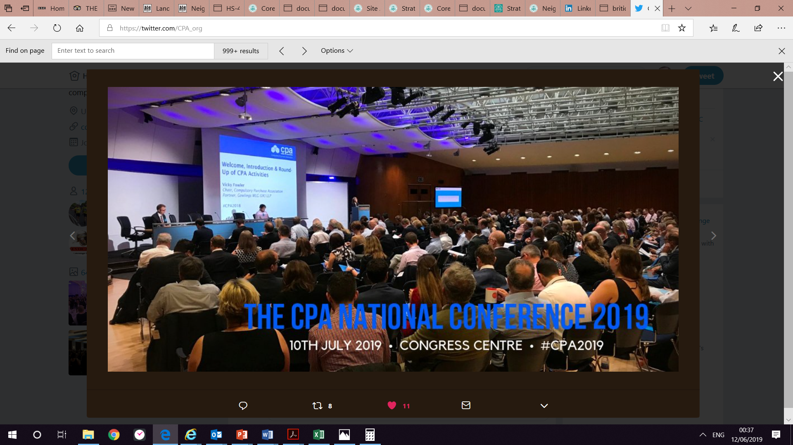
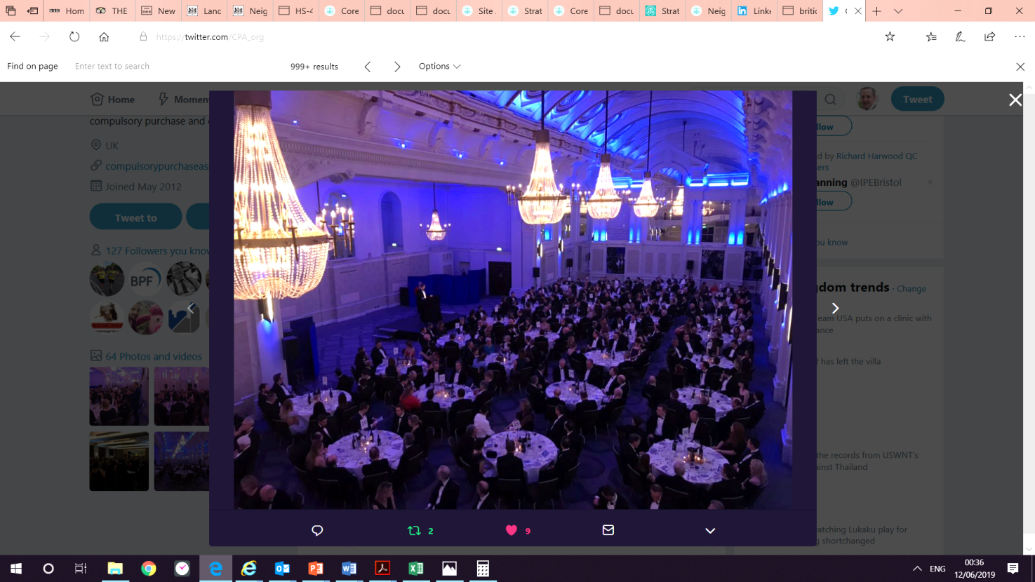
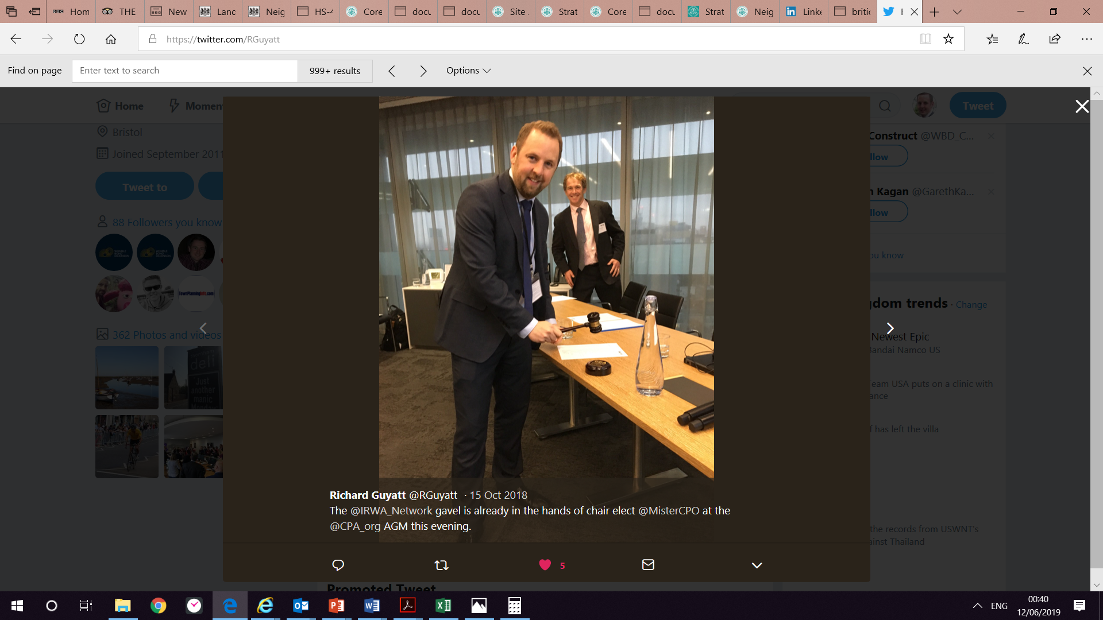
Compulsory Purchase Association
Who are we?
What do we do?
Notes:
Explain who I am and what I do – would be a Right of Way Appraisor in the US, I think!
Multi disciplinary
900+ members (not sure where we would rank if we were an IRWA chapter)
Exist in order to develop and share best practice in the field of compulsory purchase
Monthly Board meetings; annual conference; annual black tie dinner; annual law reform lecture; annual AGM and educational lecture; regional meetings; Young CPA

Slide 3
Compulsory Purchase in the UK
Compulsory purchase powers are available to Government agencies, Local Authorities, rail and highway authorities and, in some cases, private developers.
Different consenting regimes exist for different types of projects, but all must pass the same key test: Is there a compelling case in the public interest?
Notes:
Used for urban regeneration projects, housing renewal schemes, new road and rail projects, energy projects, rail freight terminals, sports stadia.
Basically any scheme in the public interest

Slide 4
Compulsory Purchase in the UK
Identify need for compulsory purchase powers and the appropriate consenting regime
Undertake landowner consultation and make efforts to acquire interests by agreement
Prepare and make compulsory purchase order application
Landowners may object. A public inquiry is usually held
The Government decide whether or not to grant the compulsory purchase powers
The powers are available to be used. A minimum of 3 months’ notice is given to landowners
Landowners may request an ‘advance payment’ of compensation, but the earliest it is received is the date of possession being taken
In most cases possession is taken and compensation (including market value of land and disturbance costs) is settled afterwards
Disputes can be referred for assessment by the Upper Tribunal (Lands Chamber)
12-18 months
12 months
3 years to use powers
Compensation may take 6yrs + to settle

Slide 5
Compensation and relocation
Displaced landowners and businesses are entitled to:
Market value of land acquired
Disturbance costs (incl relocation costs, loss of profits, redundancy costs, fit-out costs professional fees etc)
Compensation is usually paid after possession has been taken and title has vested.

Slide 6
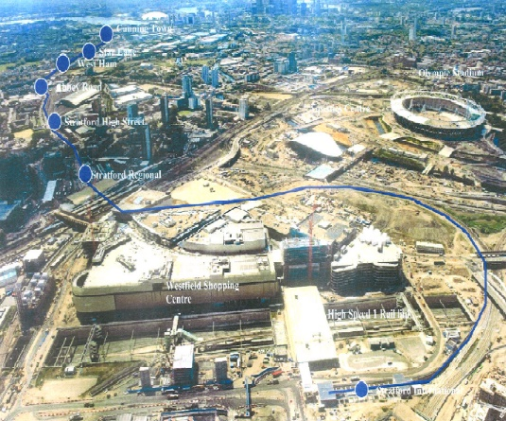
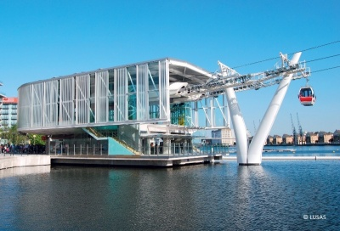



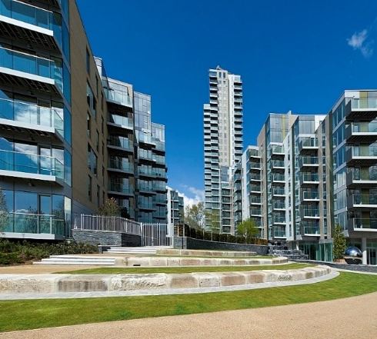
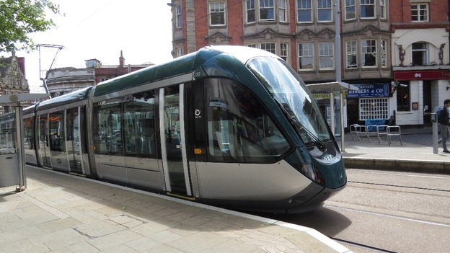
Use of CP powers is on the increase

Slide 7
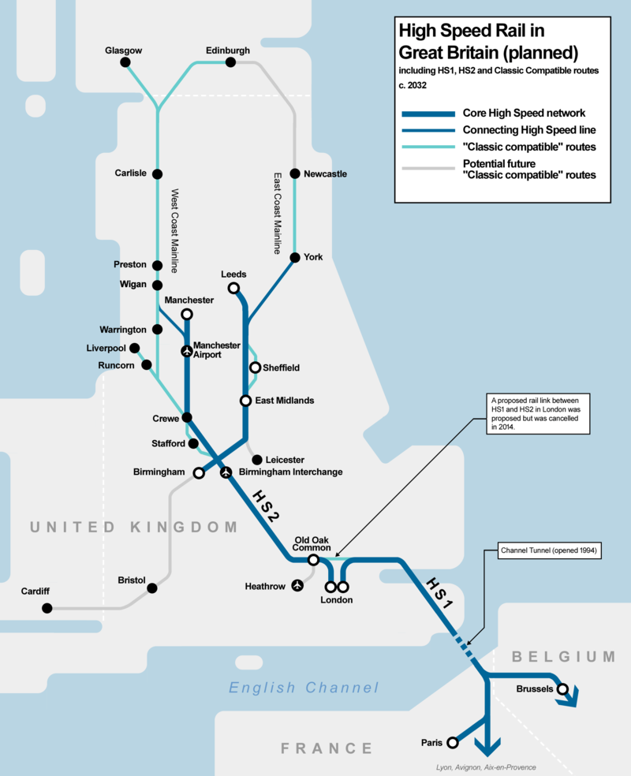
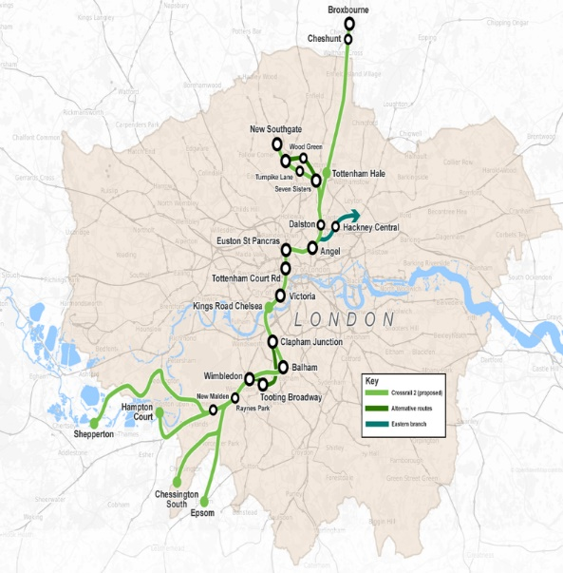
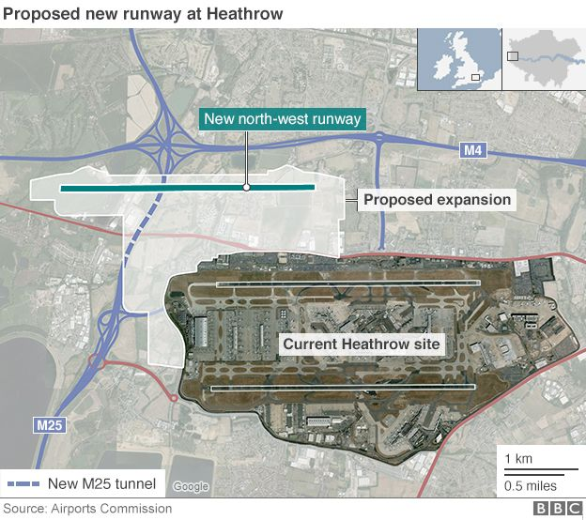

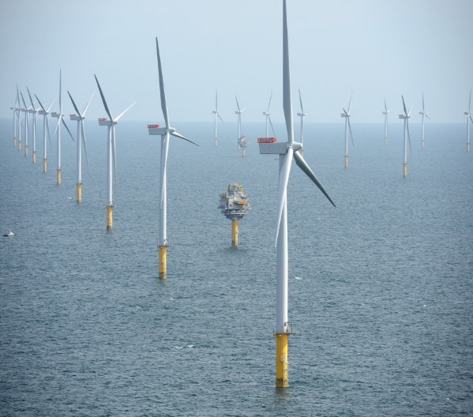
Compulsory purchase – facilitating major infrastructure
Notes:
HS2 - 330 miles (530 km)
£52 billion budget (c. £100m per km)
Figures published by HS2 in response to a freedom of information request from the campaign group Stop HS2, showed 902 residential properties, farms or pieces of land had been bought by the company between 2011 and 2018.
The total cost of the acquisitions was nearly £600m.
Property budget c. £3billion
Crossrail 1 - £17.5billion of which £4.1billion was raised through land value capture
Crossrail 2 - £41.3billion; 47 stations; 73 miles; construction start in 2023, opening early 2030s
Heathrow Third Runway and new terminal buildings - £13 billion; submit application 2020, ready by early 2030s.
First coal-free week since 1882 in May 2019. Carbon free by 2025.
1.5% energy from waste
2.3% hydro
3.4% solar
14.8% wind
21% nuclear
Say 43% of UK’s energy is now being generated by infrastructure facilitated by compulsory purchase
5G rollout has just launched in the UK. Government recognised the need for operators to have powers akin to compulsory purchase so passed a new Electronic Communicaitons Code in 2017.
Compulsory purchase is facilitating so many developments and so much infrastructure that we rely on everyday.

Slide 8
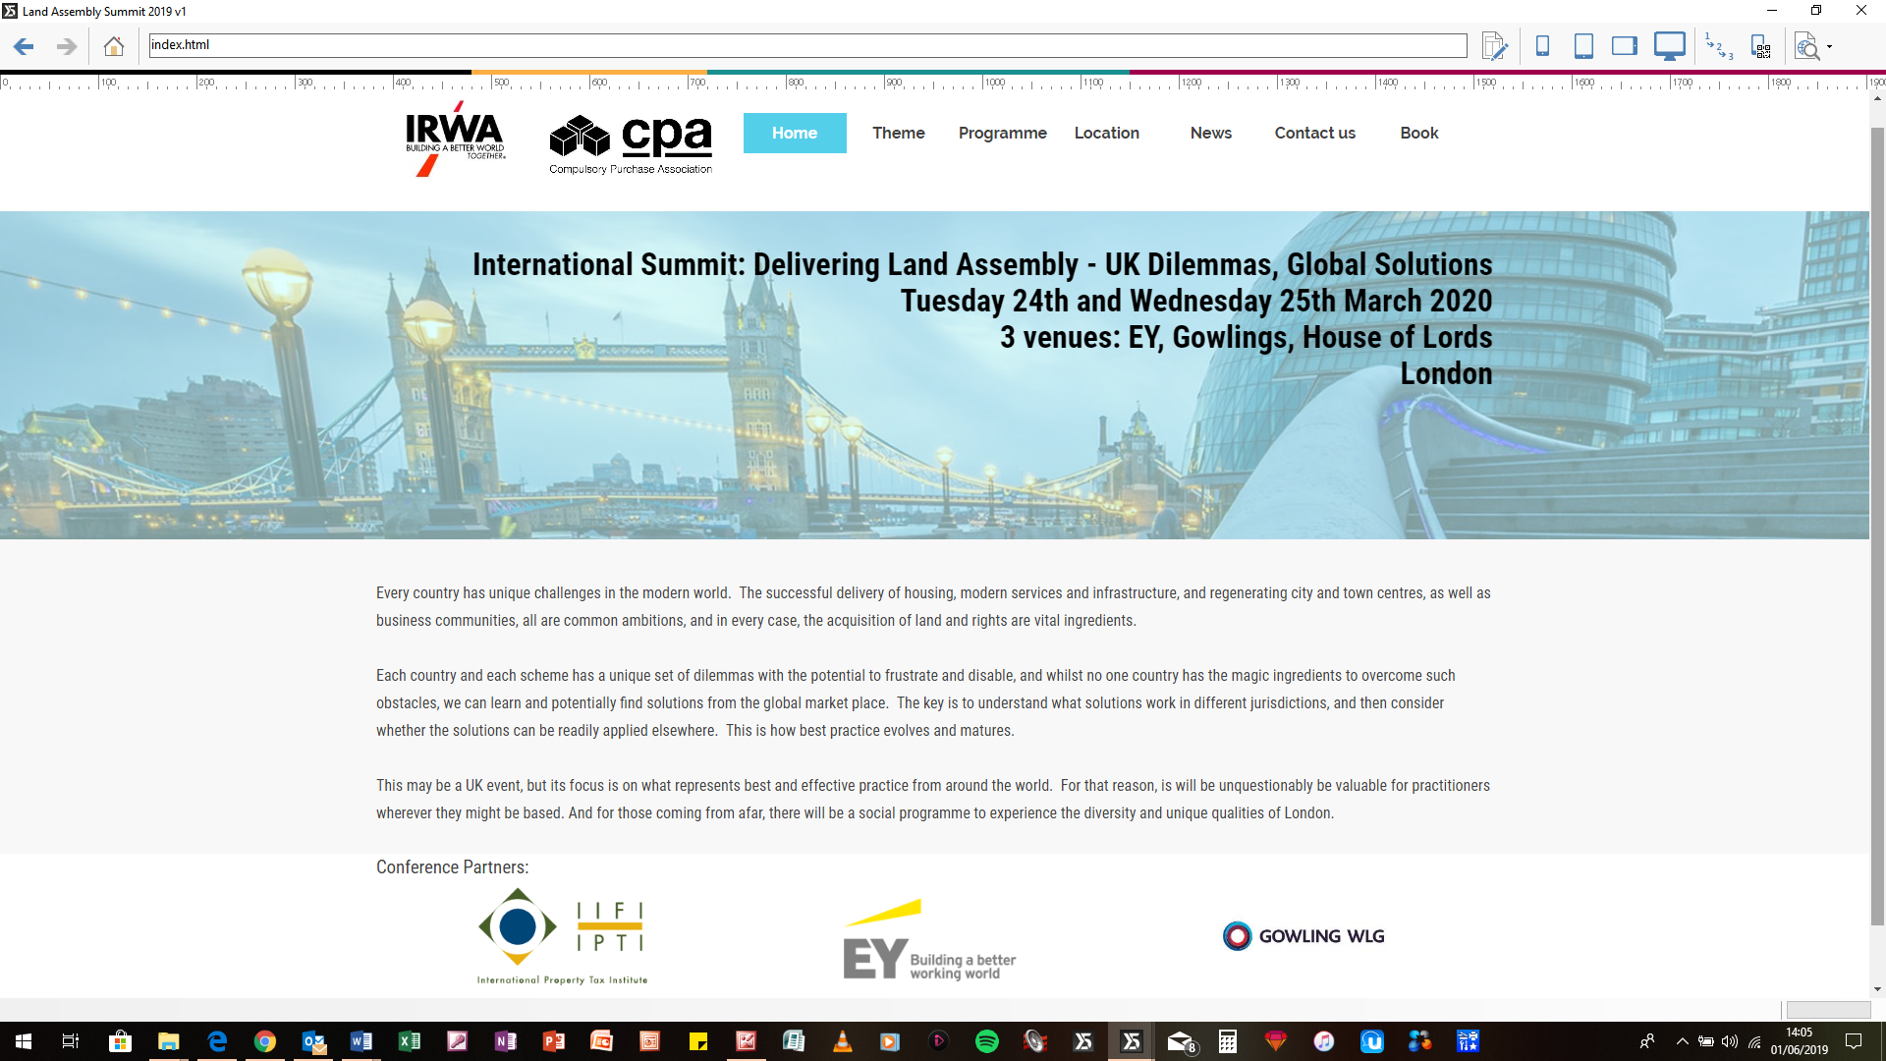
Come over to our International
Summit in 2020
Notes:
Event partners
IRWA invited CPA to hold such an event
CPA and its events partner CPT Events have jointly developed the programme and event features
The International Property Tax Institute are participating and supporting the event
EY – Ernst and Young, are supporting the event and providing a venue
Gowlings WLG, the Canadian international law firm who have a major presence in the UK are also supporting by providing a venue on day 2
Both venues are within 1 minutes walk of each other
The House of Lords is a boat ride away and offers networking and drinks on day 1

Slide 9
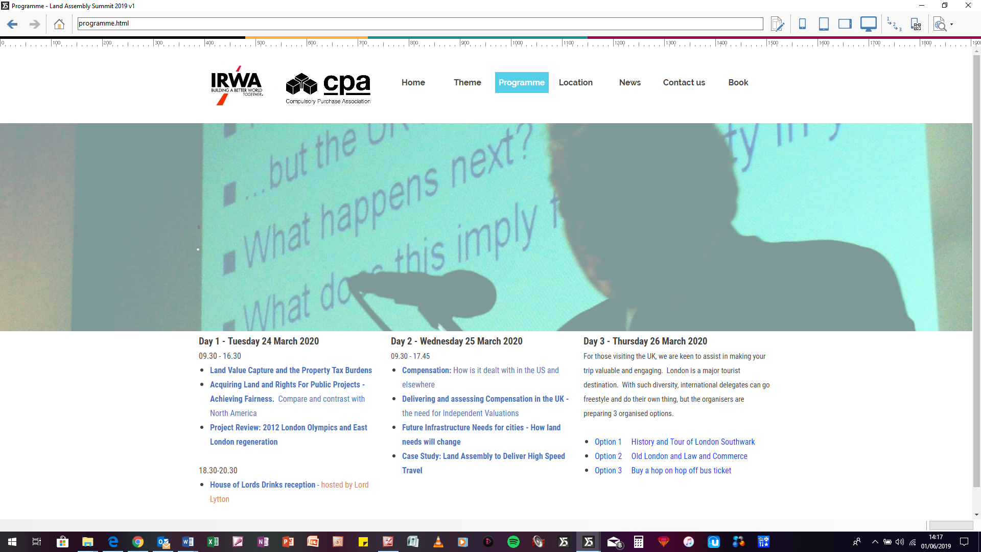
International Summit 2020 –
Draft itinerary
A Call for papers and possible speakers
If you have a paper or case study that you feel could be added to the programme, please make contact - cpa@compulsorypurchaseassociation.org
Notes:
Summary
Every country has unique challenges in the modern world. The successful delivery of housing, modern services and infrastructure, and regenerating city and town centres, as well as business communities, all are common ambitions, and in every case, the acquisition of land and rights are vital ingredients.
Each country and each scheme has a unique set of dilemmas with the potential to frustrate and disable, and whilst no one country has the magic ingredients to overcome such obstacles, we can learn and potentially find solutions from the global market place. The key is to understand what solutions work in different jurisdictions, and then consider whether the solutions can be readily applied elsewhere. This is how best practice evolves and matures.
This may be a UK event, but its focus is on what represents best and effective practice from around the world. For that reason, is will be unquestionably be valuable for practitioners wherever they might be based. And for those coming from afar, there will be a social programme to experience the diversity and unique qualities of London.
Common Global challenges, but laws and processes vary across the globe
Sharing best and effective practice – and understanding the detail that explains why it works, allows the solution to be considered in other jurisdictions. This Summit uses a variety of presentations – case studies, compare and contrast, and discussion to inform and stimulate new ways to drive best and effective practice.

Slide 10
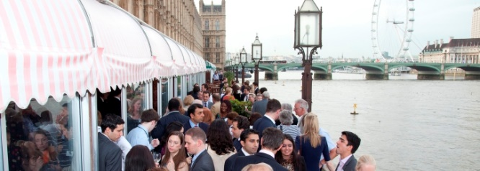
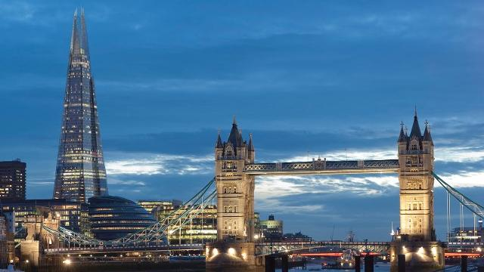
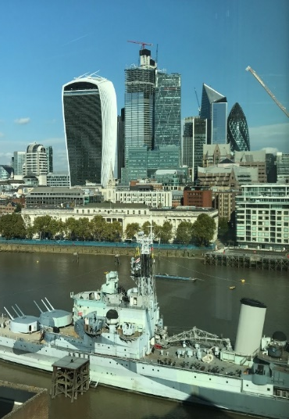
International Summit 2020 –
How to book
Website is live now and
international delegates can book and will have a free cancel period of 100 days so they can co-ordinate flights and hotels at preferential rates
No payments will be sought until Dec 2019
www.landassemblysummit.org

Slide 11
Any questions?
Jonathan.stott@gateleyhamer.com
@MisterCPO

Slide 12

IRWA Conference
Richard Asher – Director, Savills (UK) Ltd, Compulsory Purchase Team

Slide 13


Richard Asher FRICS - Credentials
Head of Savills Compulsory Purchase Team
Previously Head of Team with JLL
Founder and Second Chair of Compulsory Purchase Association
Member RICS Governing Council
Advises Claimants and Acquiring Authorities

Slide 14
“Two nations separated by a single language” attributed to George Bernard Shaw
UK | USA
Valuation | Appraisal
Valuer | Appraiser
Compulsory purchase | Eminent Domain
Flat | Apartment
Ground Floor | First Floor
First Floor | Second Floor
But US words were here first – the original 17th Century Language!

Slide 15
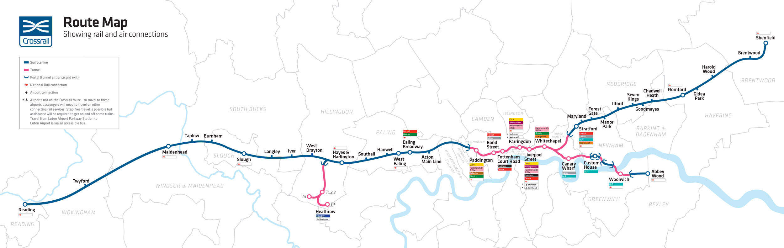
Crossrail Regional Map

Slide 16
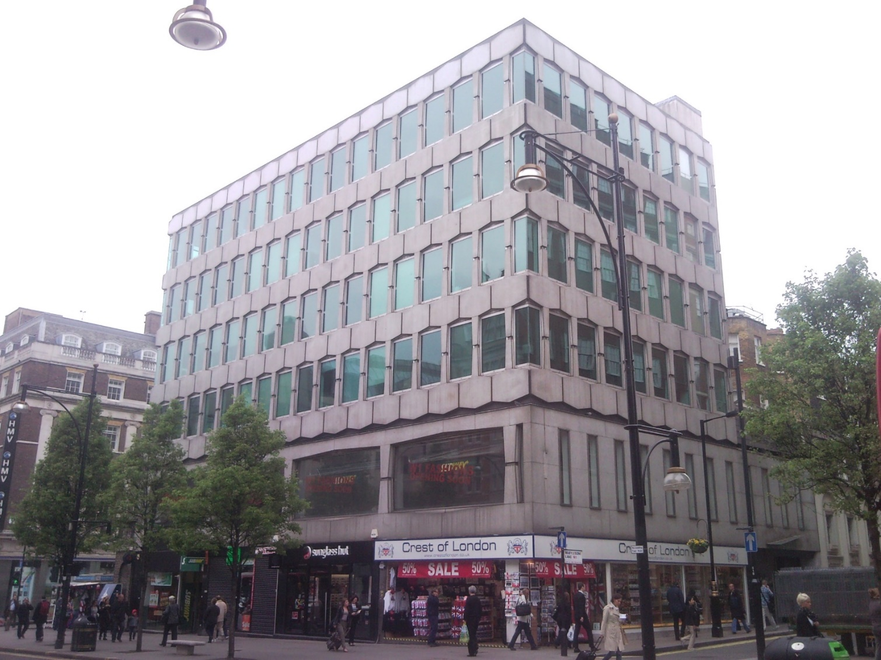
354-358 Oxford Street, London
- Aberdeen Asset Management

Slide 17
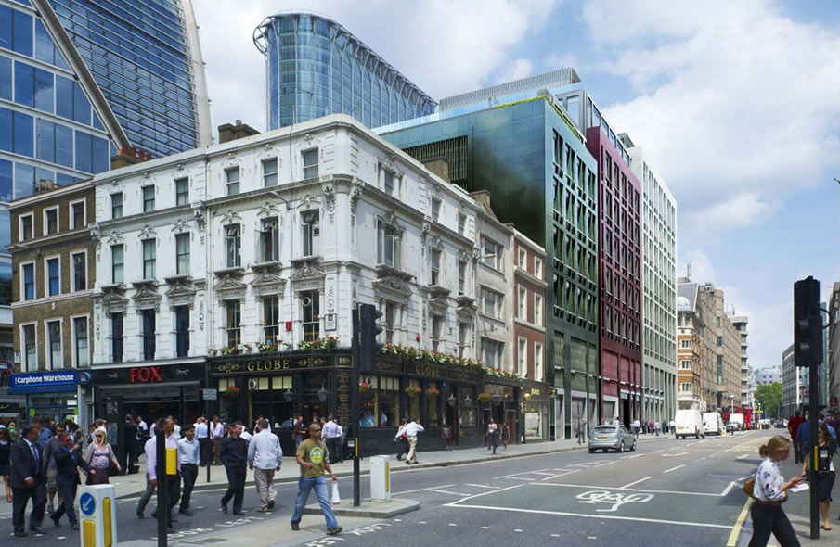
101 Moorgate - Aviva Investors

Slide 18
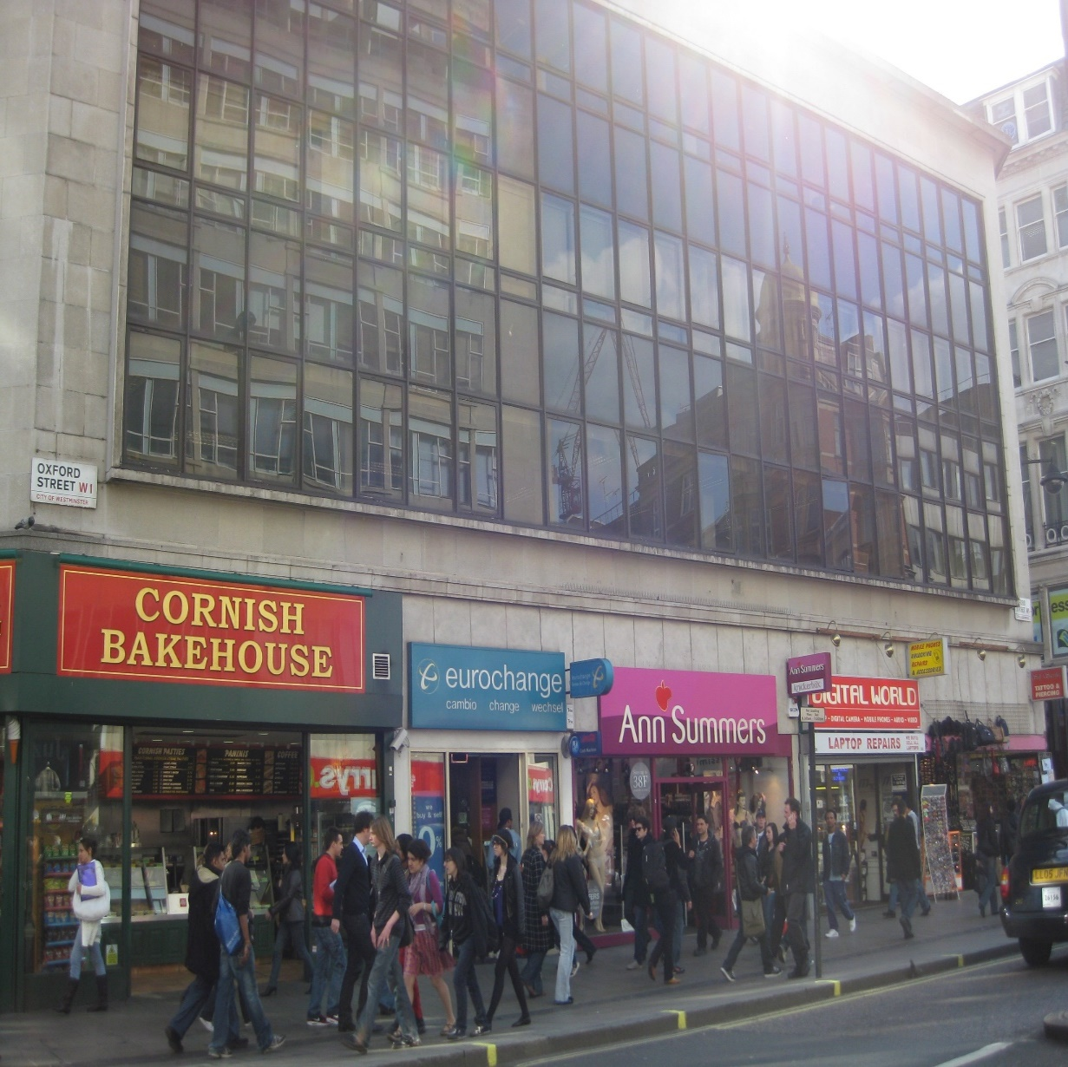
91-101 Oxford Street, London – Aviva Investors

Slide 19
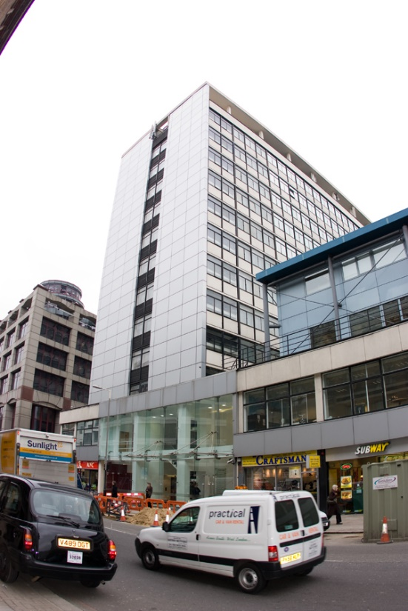
Cardinal Tower, Farringdon, London
– Cardinal Lysander

Slide 20
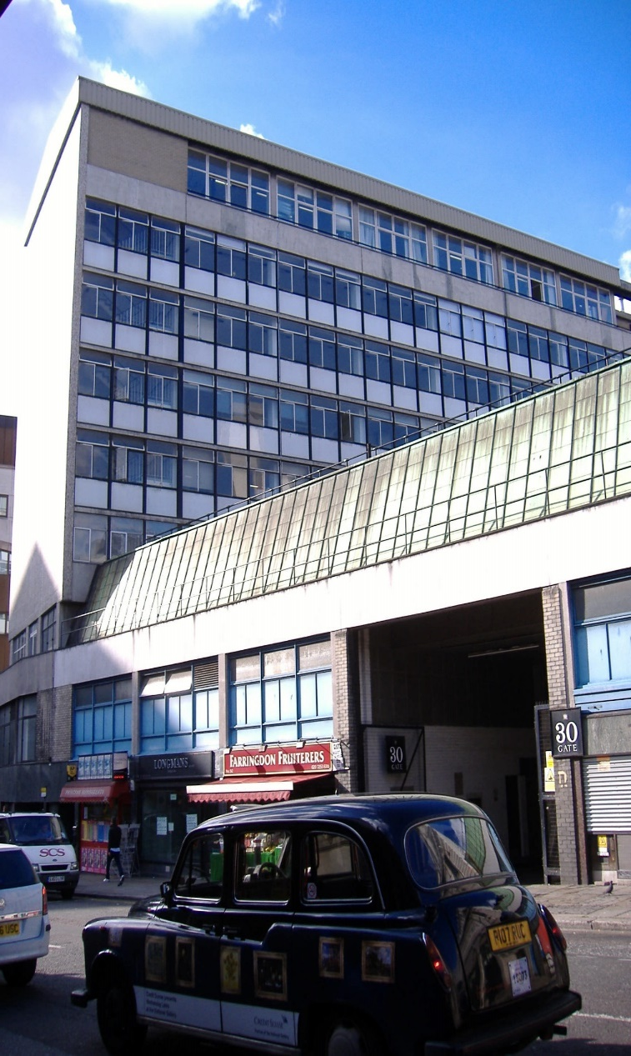
Caxton House - Henderson

Slide 21
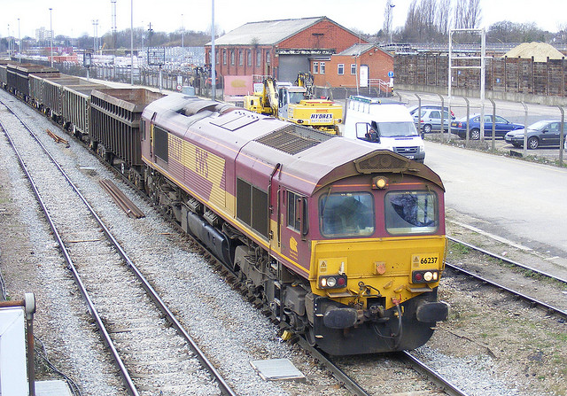
Rail Depot –
DB Schenker Rail (UK) Ltd

Slide 22
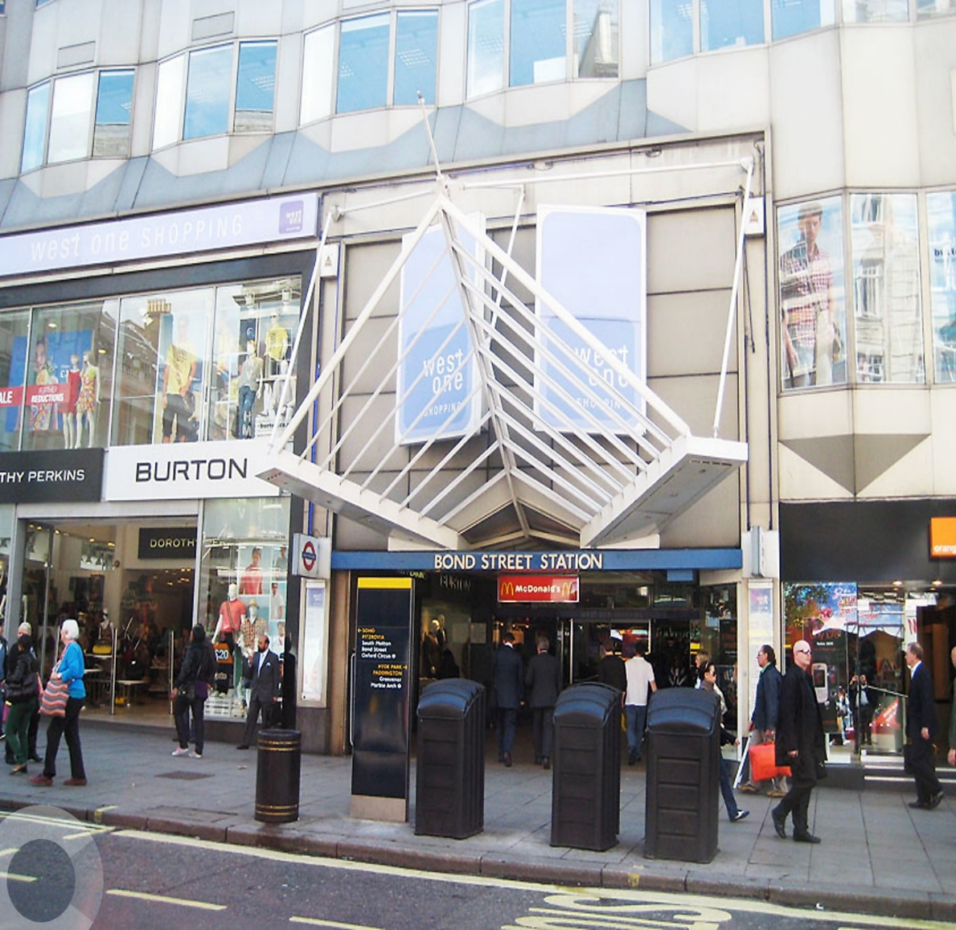
West One Shopping Centre, London
- Grosvenor Estate

Slide 23
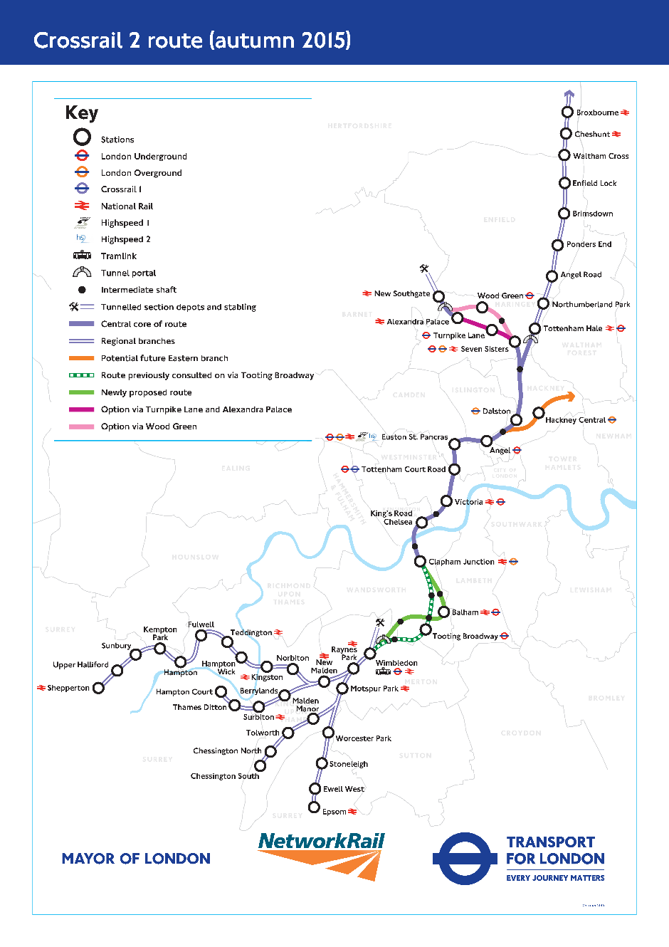
Crossrail 2 Route Map

Slide 24
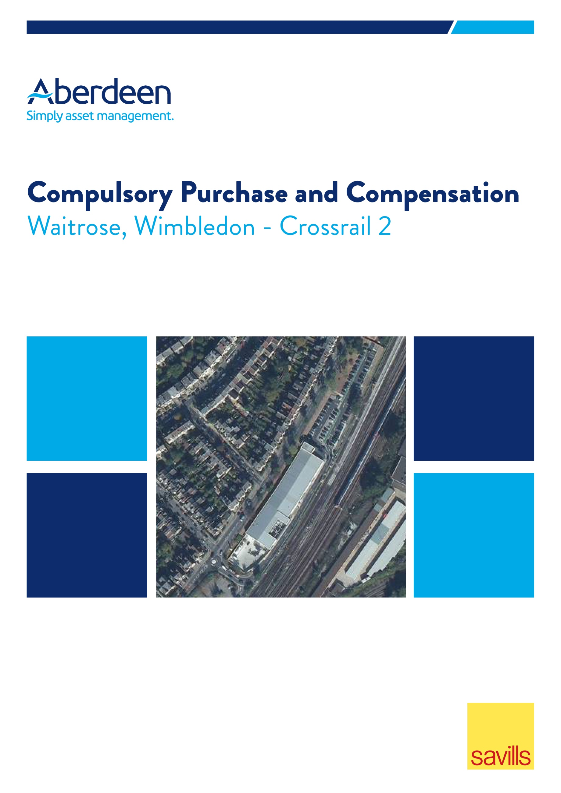
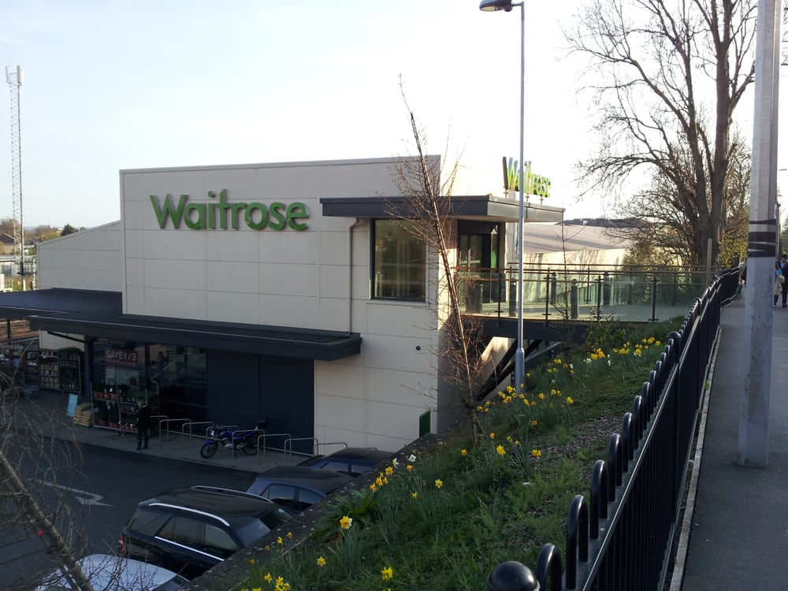
Waitrose Wimbledon –
Aberdeen Asset Management

Slide 25
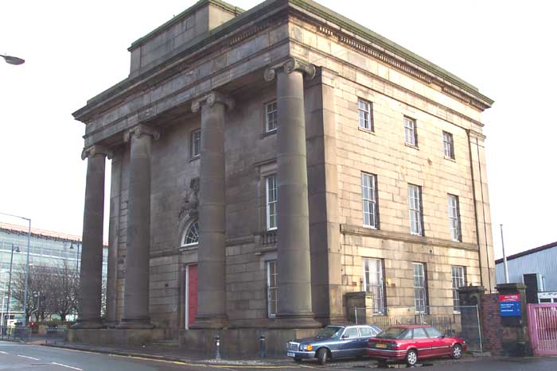
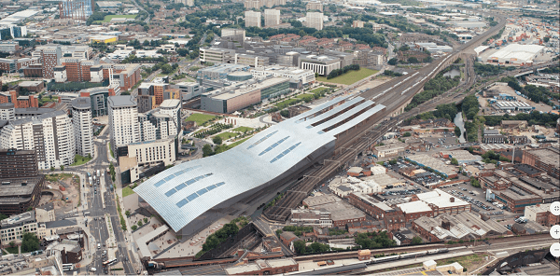
HS2 – Curzon Street Stations
– Old and New

Slide 26
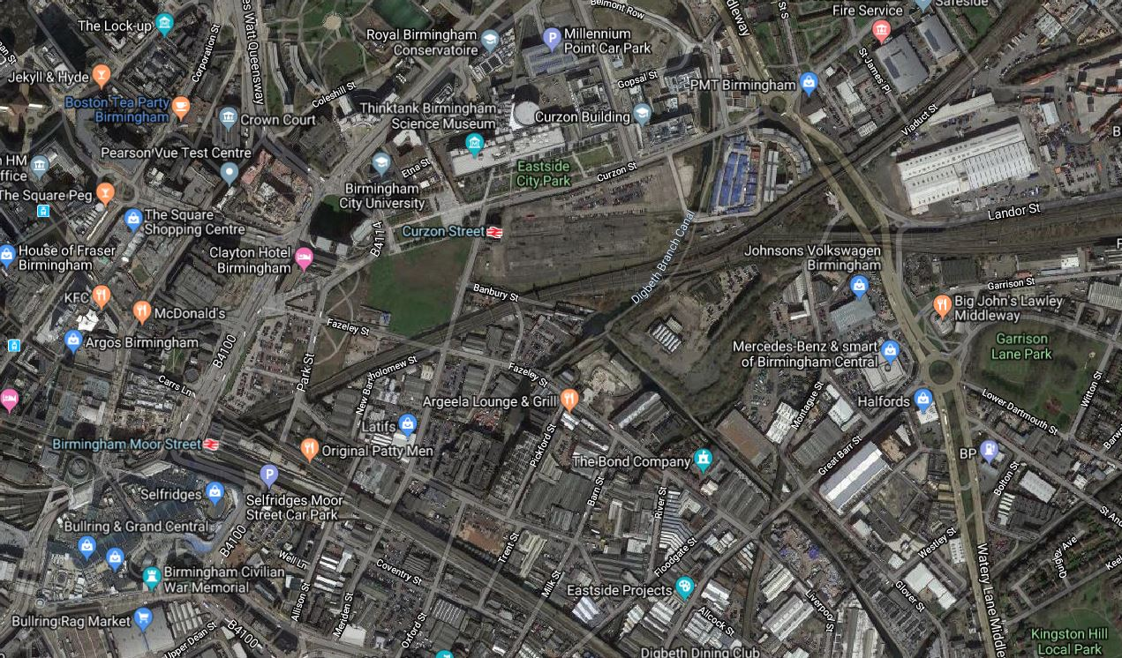
Birmingham Sites
Eastside Partnership
U&I Granger
BCU
Quintain

Slide 27


Thank you
Any comments?
rasher@savills.com

Slide 28
Recent Infrastructure Projects and Proposals in the UK
Meyric Lewis
Barrister
Francis Taylor Building
Temple, London, UK

Slide 29

The UK today

Slide 30


Slide 31
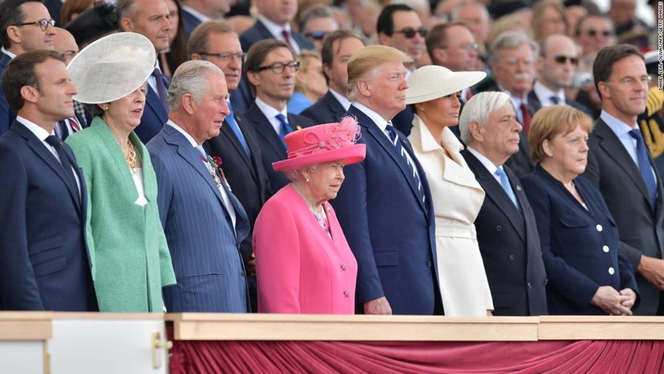

Slide 32
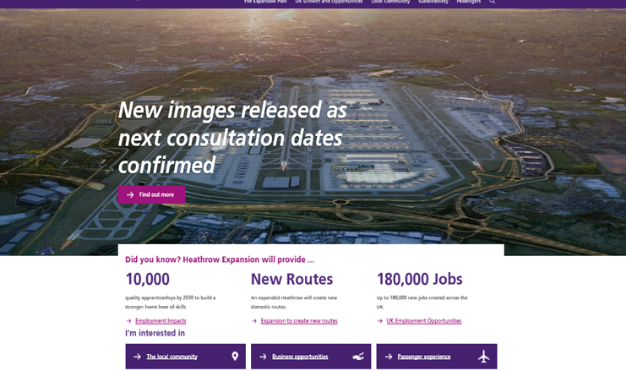
Heathrow expansion – construction of 3rd runway

Slide 33
5 challenges in the High Court
Heard over two weeks
Substantial public access (like for Princess Diana inquest)
Claimants included Mayor of London and local planning authorities, local residents and Friends of the Earth

Slide 34
Allegations of
• Inadequate consultation
• Predetermination
• Impact on surface access ie road/rail
• Impact on air quality
• Impact on ecological habitats
• Friends of the Earth and Plan B Earth took the lead on climate change

Slide 35
Court acknowledged (after 188 page judgment)
Claims involved underlying issues on which the parties, and many members of the public, held strong and sincere views
But emphasised that the hearing had been concerned only with the legality, and not the merits, of the Airports National Policy Statement
BUT none of the judicial review claims succeeded

Slide 36
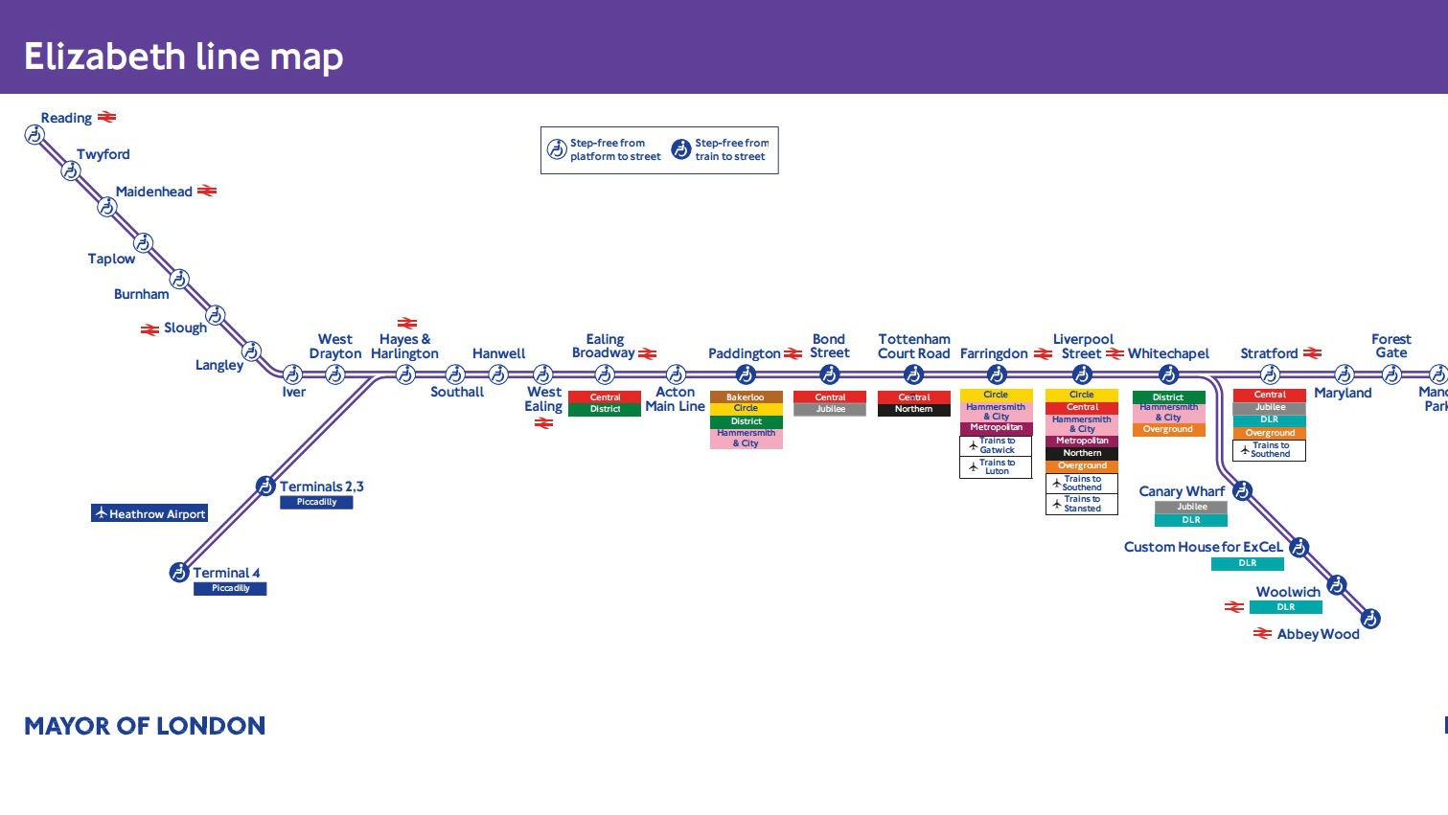
Less controversial? Crossrail/the Elizabeth line A new underground line for London
Opening "late 2018” (!?); project cost $19bn USD

Slide 37
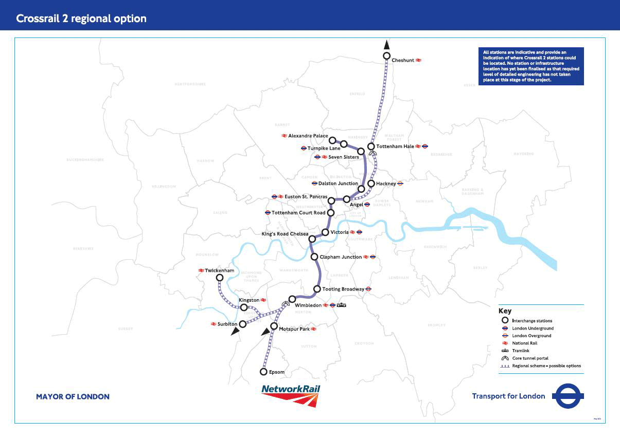
To be followed by Crossrail 2 (new north-south line; opening 2030s?; project cost $38bn USD)

Slide 38
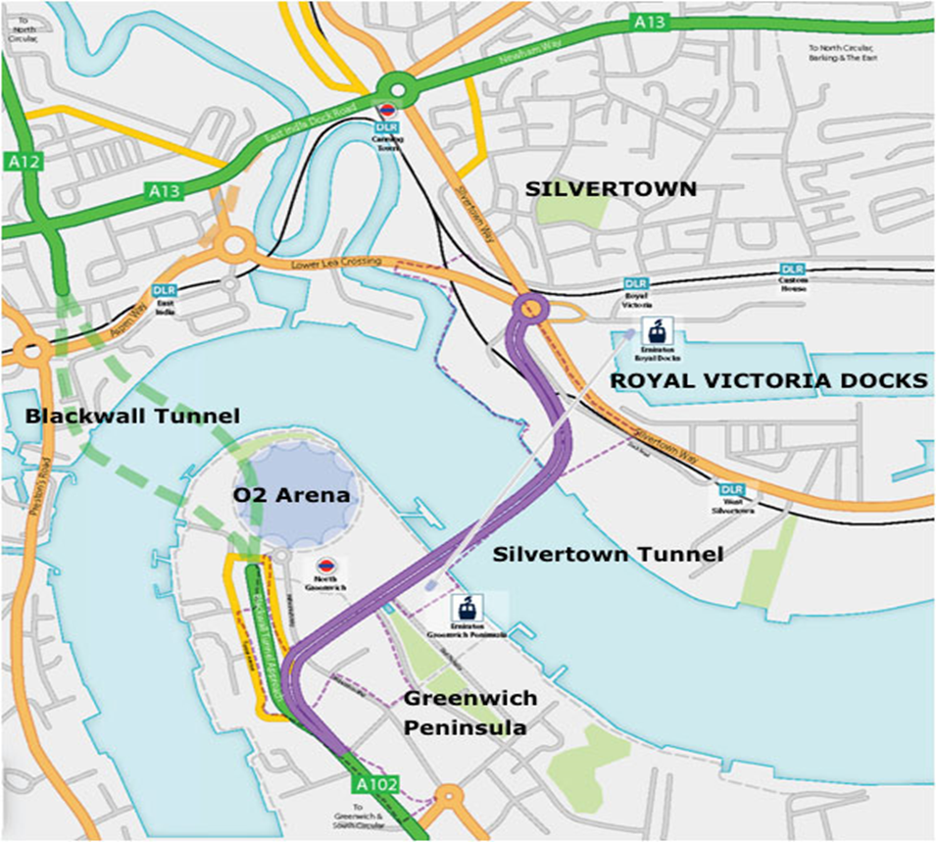
Silvertown tunnel – construction from 2019 or 2020; opening from 2025; cost 1.3bn USD

Slide 39
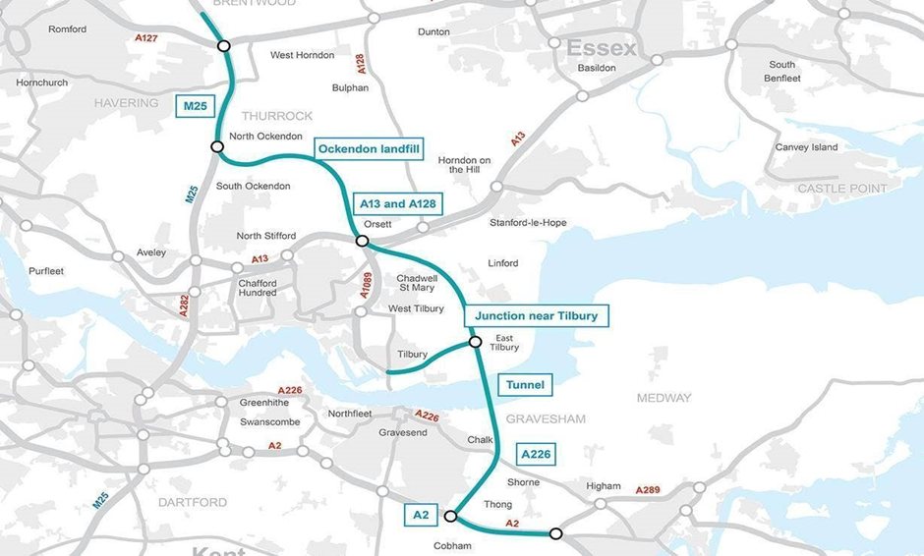
Lower Thames Crossing – approval process about to commence; opening 2027; cost up to $8.7bn USD

Slide 40
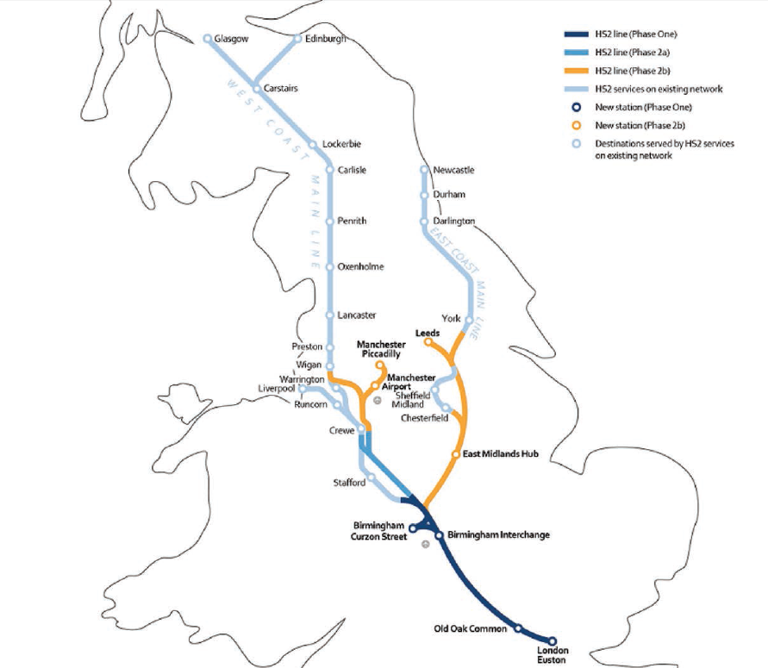
High Speed rail link London to Birmingham (then Manchester and Leeds) cost $71bn USD

Slide 41
HS2 – Latest debate:
“robbing Peter to pay Paul” – ie taking neighbours’ land to compensate for facilities lost to construction of railway (eg County Showground/Golf Club)
SUMMARY OF ARGUMENTS
1. HS2 accepts that taking someone’s land by compulsion when that is not directly for the purpose of a public body’s undertaking but to accommodate the impact of that undertaking on another party is a “very serious thing”, is “exceptional” and requires “the most clear cut and convincing justification”.
2. No such justification has been advanced (or exists) in this case.

Slide 42
3. In particular, the landtake of 23.84 acres for “replacement car parking” is clearly excessive, not least because agreement is under discussion for a private sale of a lesser area.
4. In any event, in terms of Government policy on the use of compulsory purchase powers, compulsory purchase can only be justified as a matter of “last resort” after reasonable steps have been taken to purchase the land needed by agreement.
5. Therefore, given that such an agreement will shortly be concluded there is no justification (let alone an “exceptional” one) for taking your petitioners land by compulsion at all.
6. Your petitioners therefore respectfully request that the “replacement car parking” land should be removed from HS2 Additional Provision 2.
MEYRIC LEWIS

Slide 43
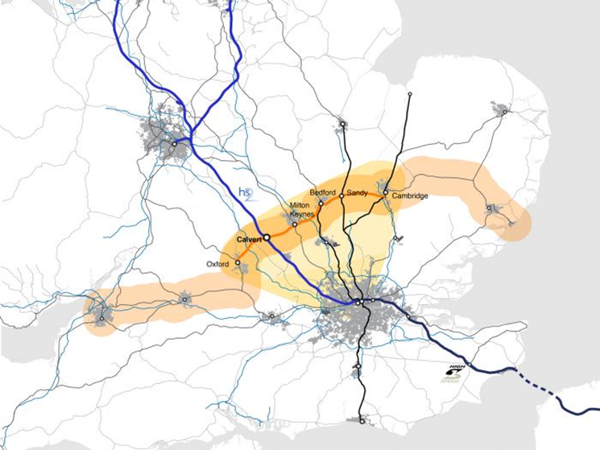
Oxford Cambridge Arc – housing, commercial development, road and rail links

Slide 44
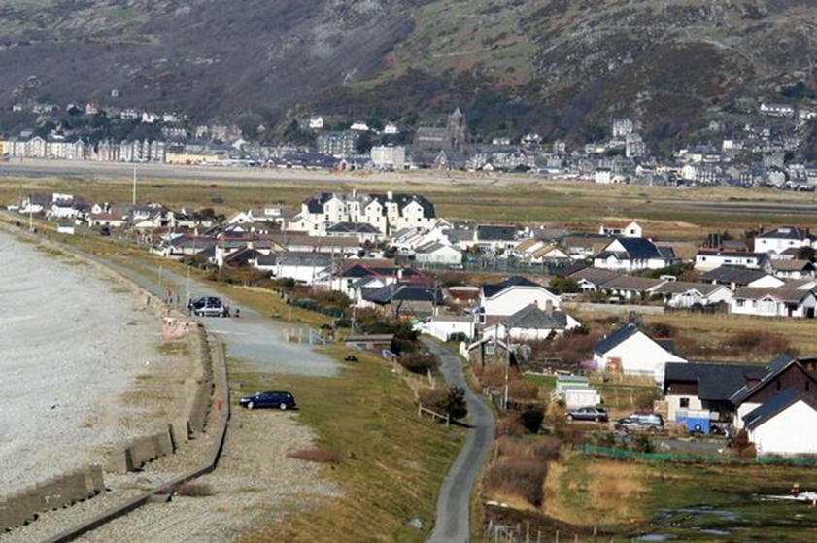
Fairbourne, Wales – too expensive to rebuild sea defences. Village will be flooded by Irish Sea within 20-40 years

Slide 45

Youth of today

Slide 46
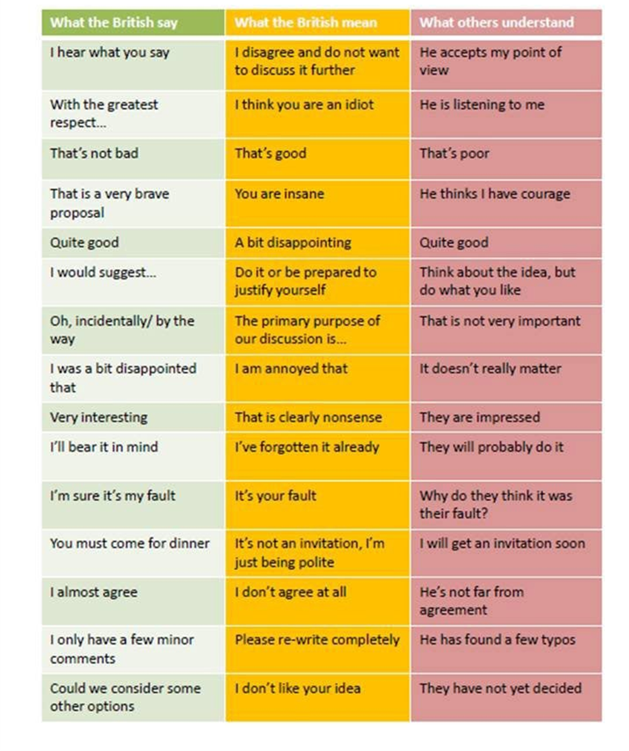
London 2020 – useful words and phrases

Slide 47

Just time for another picture of the happy couple
(plus 1)

Slide 48
Recent Infrastructure Projects and Proposals in the UK
Meyric Lewis
Barrister
Francis Taylor Building
Temple, London, UK

Slide 49
International Summit 2020 –
How to book
Website is live now and
international delegates can book and will have a free cancel period of 100 days so they can co-ordinate flights and hotels at preferential rates
No payments will be sought until Dec 2019
www.landassemblysummit.org

