Slide 2
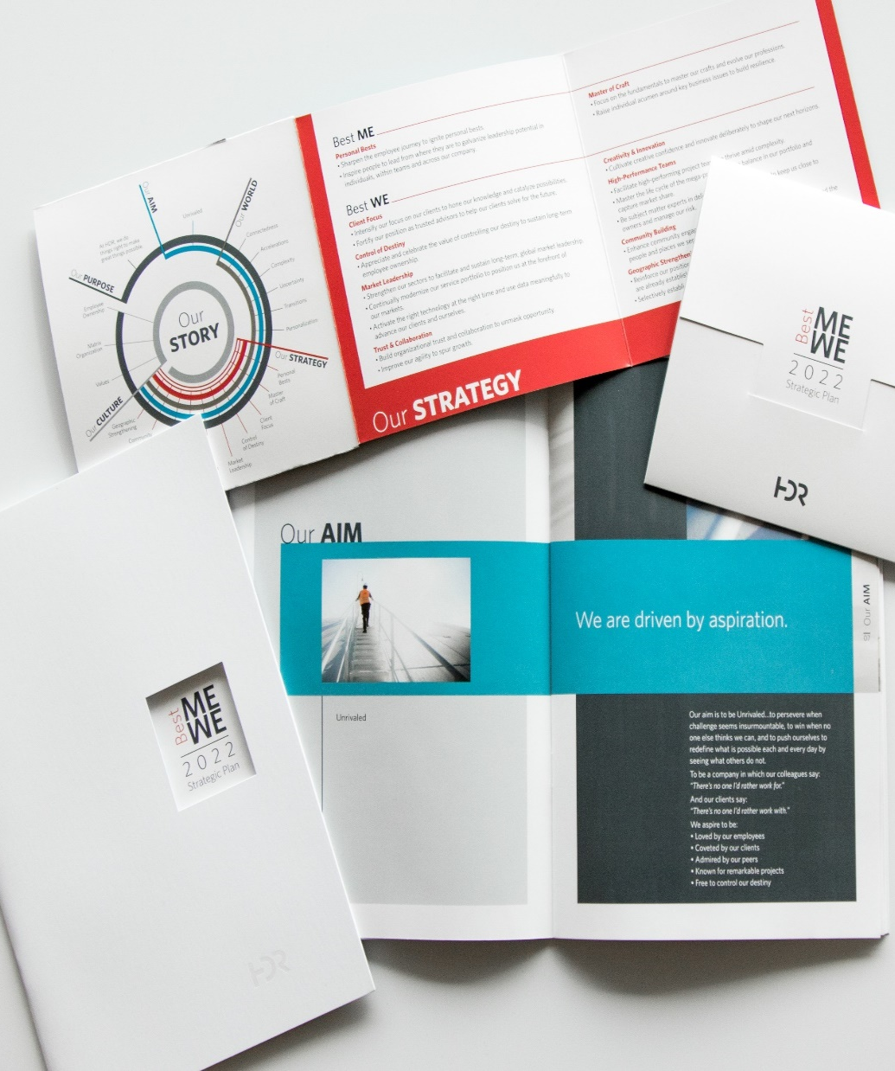
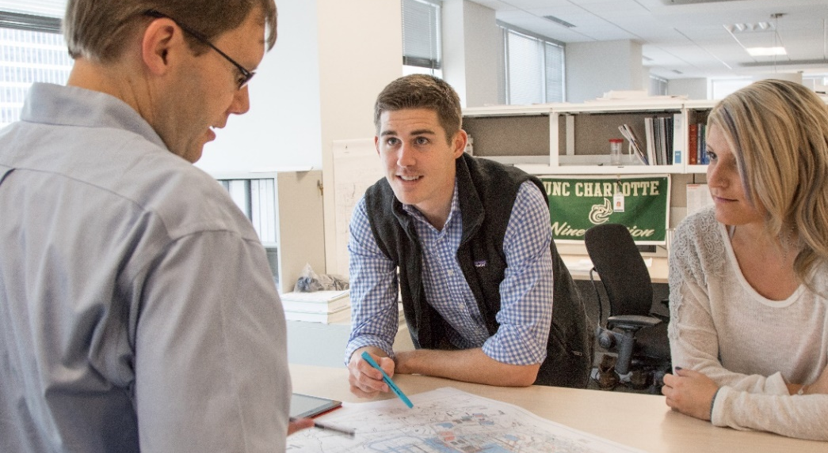

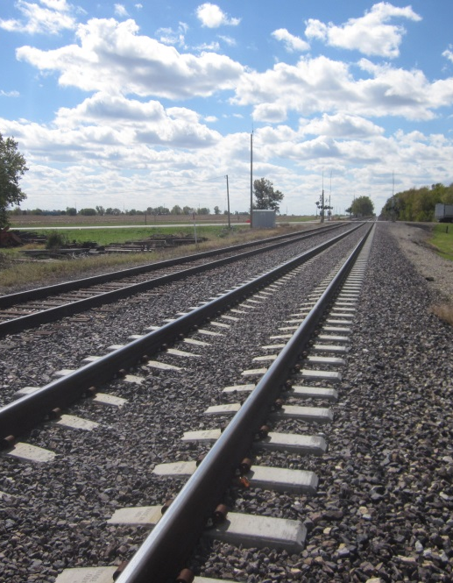
Real Estate/Right-of-Way
“Talent Development”
Carol Bellinger, SR/WA
Associate Vice President
Transportation Pre-Alignment Meeting | May 1, 2019

Slide 3
Together

Slide 4
We believe that the way we work adds meaning and value
to the world.
Together,
anything is possible.

Slide 5

2022 Strategic Plan
Loved by Employees
Coveted by Clients
Respected by our Peers
Known for Remarkable Projects
Free to Control our Destiny

Slide 6
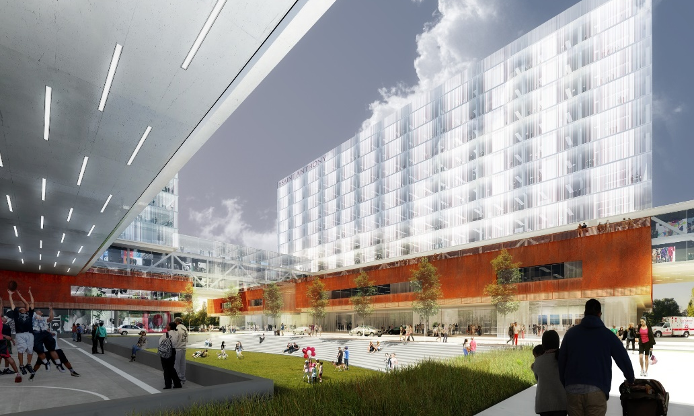
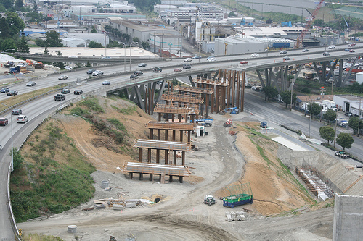

We Must Live Our Brand Promise:
“At HDR we do things right to make great things possible”
We specialize in engineering, architecture, environmental, right-of-way, and construction services.
Our employees, working in more than 200 locations around the world, push open the doors to what’s possible each and every day

Slide 7
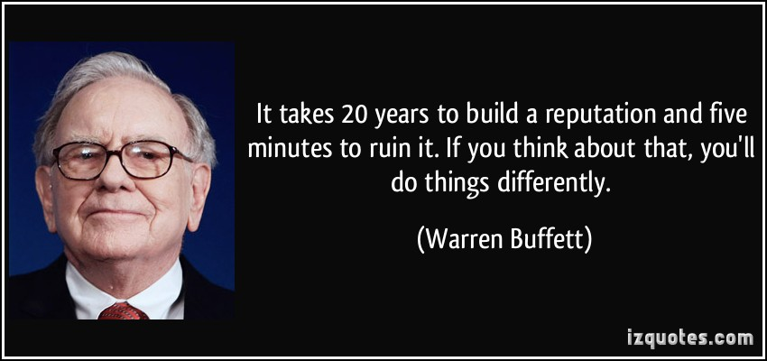

Slide 8
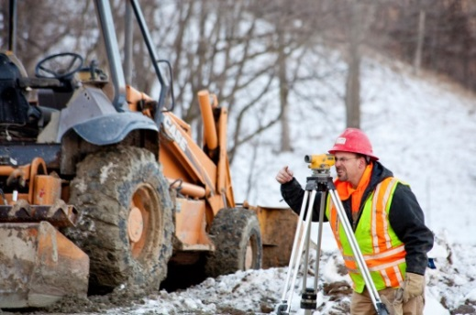
We're always looking for great talent to join our global teams
April we hired 314
May we hired 294
We have approximately 1,400 open requisitions
As with many of our clients we are feeling the impacts of a retiring generation

Slide 9
Talent Growth and Development Plan
Alleviate existing and future staffing challenges
Strengthen HDR’s ROW technical expertise
Diversity and inclusion tool
Existing staff clearly see paths to desired career levels
Succession planning
Notes:
The pool of trained and experienced individuals is shrinking creating hiring challenges
The demand for trained ROW professionals is very high and very little supply

Slide 10
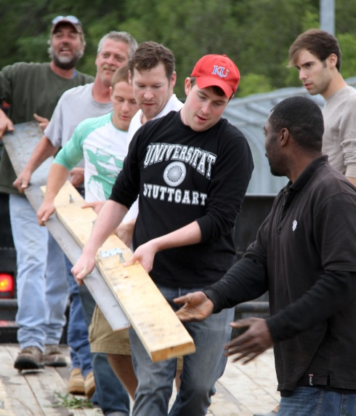

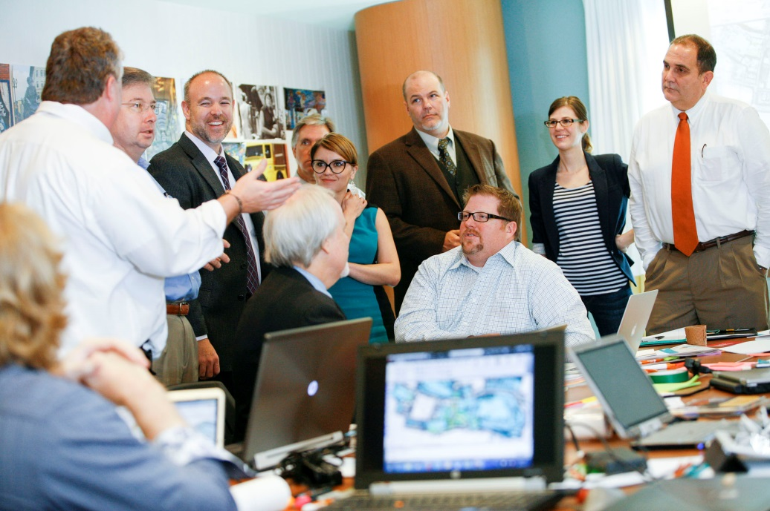
10,000 employees
Learning and Organizational Development
HDR University
International Right of Way Association
On the Job Training
Notes:
Providing professional and technical training for ROW personnel improves public service
Grow towards 2022 strategic plan
Diversity & inclusion
Build ROW team to support Highway and Roads Market Sector in targeted areas

Slide 11
WE STARTED BY CROSS TRAINING EXISITNG STAFF
  Administrative Assistants
  Receptionist
  CADD Operators
  Environmental Specialists
  Engineers
  Surveyors
  Construction Inspectors
Notes:
A method for strengthening the industry
Provides an orderly progression and advancement to a higher proficiency level

Slide 12

RECRUITING AND TRAINING ENTRY LEVEL
High schools
Trade Schools
Colleges
Local pool of licensed realtors
LIVE THE NETWORK

Slide 13
Initial screening
  Potential candidates screened for certain characteristics
    Aptitude, interest & ability, drive for achievement
  Started with best 2 candidates out of 5 potential
  Narrowed focus to small group in one area
  Identified the project work and mentors
  Determined time requirement for mentors and obtain committments
Notes:
Provided a breakeven chart

Slide 14

Mentors and Trainee
  Identified key individuals to mentor
  Trainees given a series of goals to meet including specific courses and tasks
  Assigned a mentor to assist trainee in achieving goals
  Mentor and trainee determined which area of ROW best fit the trainees skill set
Notes:
During or at the end of this initial training a determination will be made by the mentor if the trainee is a good fit for the ROW profession.
Mentor and trainee determining which area of ROW best fit the trainees skill set.

Slide 15
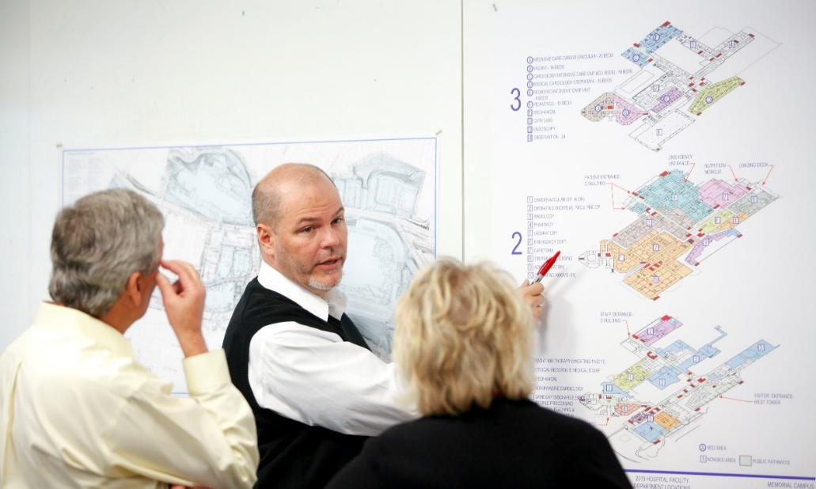
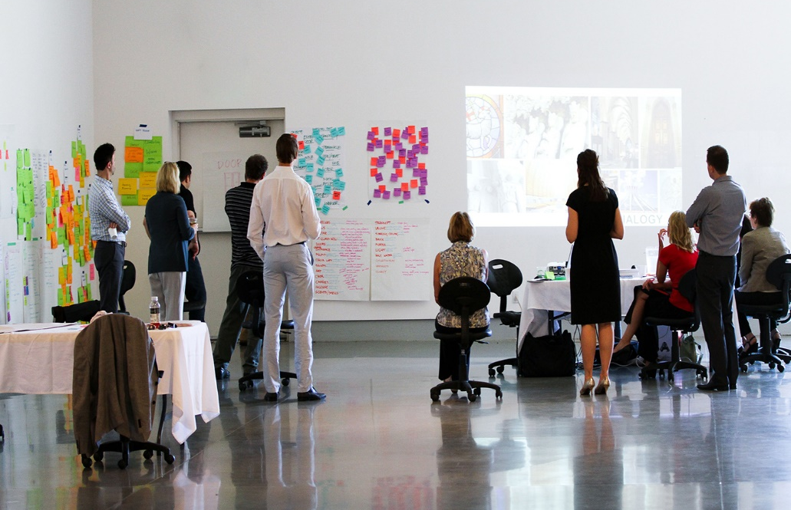
SUPPLEMENTAL TRAINING
  Work Shops
    Day or day and half
  Internal Webinars
    webinars are 1.5 hours to 2 hours
    covers areas such as relocation, cost estimating, eREMS
  Brown Bag Lunches
Notes:
Learning in the workplace helps ensure that trainees are applying the knowledge and skills they pick up. These courses are also key to retention. Providing professional and technical training for ROW personnel allows our staff to clearly see paths to their desired career levels

Slide 16

HDR Programs
Bonus for SR/WA and R/W-RAC
Referral awards
Pathfinder-, companywide recognitions
Robust onboarding program
Mark work anniversaries
College tuition reimbursement
Yearly fellowships awarded

Slide 17

“Working together to make great things possible”

