Slide 1

Developing the Next Generation of ROW Professionals
65th Annual International Education Conference

Slide 2
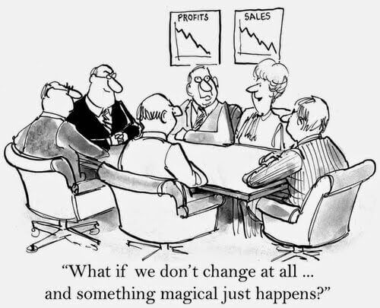
Developing the Next Generation of ROW Professionals
Notes:
How many of you work in this kind of an environment?
We are here today to help you and your organization move from this to proactively planning for your future and the future of your organization.
Just about a year ago, the Engineering Division within the Montana DOT put together a succession planning work group of 12 employees from all levels within the Engineering Division.
The goal of this group was to identify tools that could be implemented that better prepared us for the future.

Slide 3
Succession Planning
Succession Planning a not a proactive methodology to identify talented employees with high potential for promotion and/or management, and to train and equip them to replace an aging workforce that is eligible or nearly eligible for retirement.
Notes:
One of the key issues was making sure that staff knew this was not management pre-selecting the next round of managers or HR telling managers who to hire.
The group started by defining succession planning.

Slide 4
Succession Planning
Succession Planning is a future-focused process that identifies and documents knowledge; shares that knowledge through the development of individuals; and positions MDT and its employees to be prepared for inevitable change.
Notes:
This is what they came up with.

Slide 5
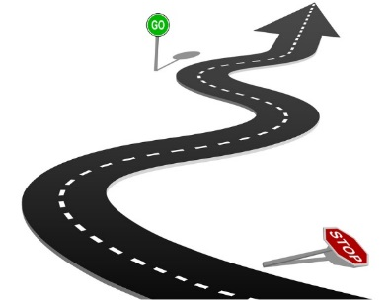
Succession Planning
MDT’s Future Focus
Sharing Knowledge
Cultivating Talent
Embracing Change
Notes:
Breaking down the definition even further and you get three key areas:
Sharing knowledge
Cultivating staff, and
Embracing change.
From here, we evaluated and prioritized 19 different tools.

Slide 6
Succession Planning Tools
Desk Manuals
Communities of Practice
Manager Roundtables
Document Repositories
Internships
On-the-Job Training
Mentoring
Knowledge Fairs
Best Practice Meeting & Studies
Knowledge Maps
Position Specific Worksheets
Wiki
Expert Interviews
Job Shadowing
Short-term Double Fill
Incident Reviews
Job Rotations
Boot Camp
Cross-Training
Notes:
Here are the 19 tools that the team drilled into.
From this list, came two separate lists, one list of the tools that were already being used in one capacity or another, and a list of tools the team felt needed to be implemented immediately.

Slide 7
Succession Planning Tools
Desk Manuals
Manager Roundtables
Internships
Mentoring
Position Specific Worksheets
Expert Interviews
Short-term Double Fill
Job Rotations
Notes:
Here are those two lists.
The first four tools listed on the left side of the screen are tools the Department has been using in some capacity.
The four tools listed on the right side of the screen are the new priority tools that the Engineering Division has started implementing.
I will go through each of these tools briefly to let you know how we are using them how they tie into Developing the Next Generation of ROW Professionals.

Slide 8
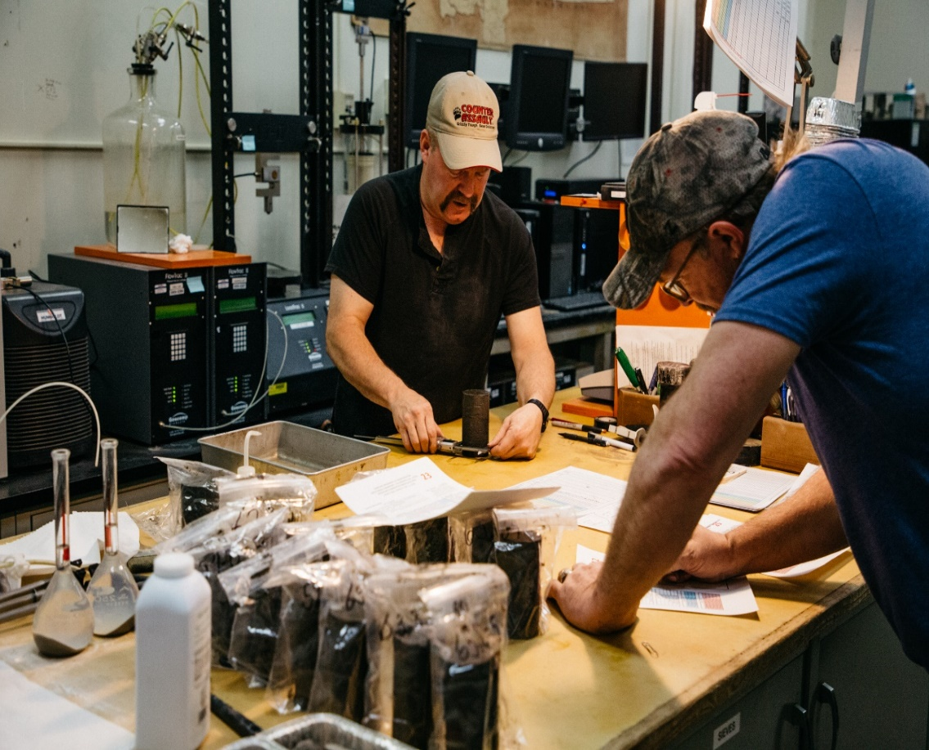
Desk Manuals
Notes:
This is documentation of a job duty that is technical in nature.
This is real a how to do manual.
This is very effective for lower level, technical positions where an employee can learn how to perform a task without needing someone to show them.

Slide 9
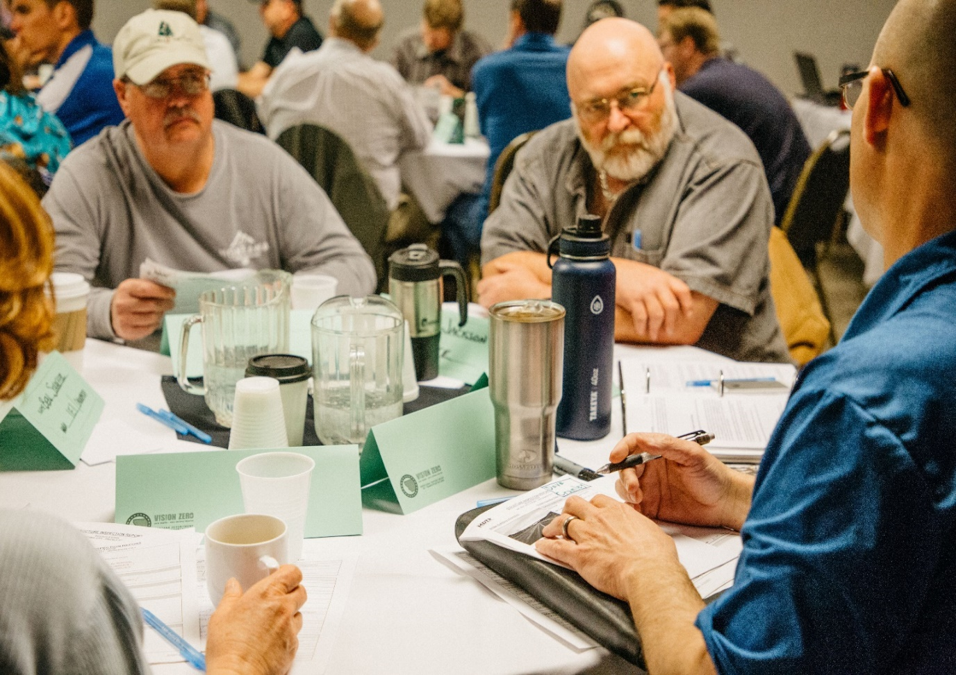
Manager Roundtables
Notes:
This is a peer workgroup where the Bureau Chiefs within the Engineering Division tackle issues such as:
How do you do your budget projections?
Are you looking to do any re-orgs within your bureau?
How is your workload?
How are you dealing with it?
How do you use Interns?
How are you planning for your bureau’s future, Strategic Planning?
This has been an opportunity to look outside our silos and help each other.
It has helped us learn what each other does, broken down silos and has led to sharing resources
We started out with only the Engineering Bureau Chiefs and plan to add Bureau Chiefs from other Divisions
1st Year: Engineering Bureau Chiefs
2nd Year: Add Planning Bureau Chiefs
3rd Year: Add all Bureau Chiefs

Slide 10
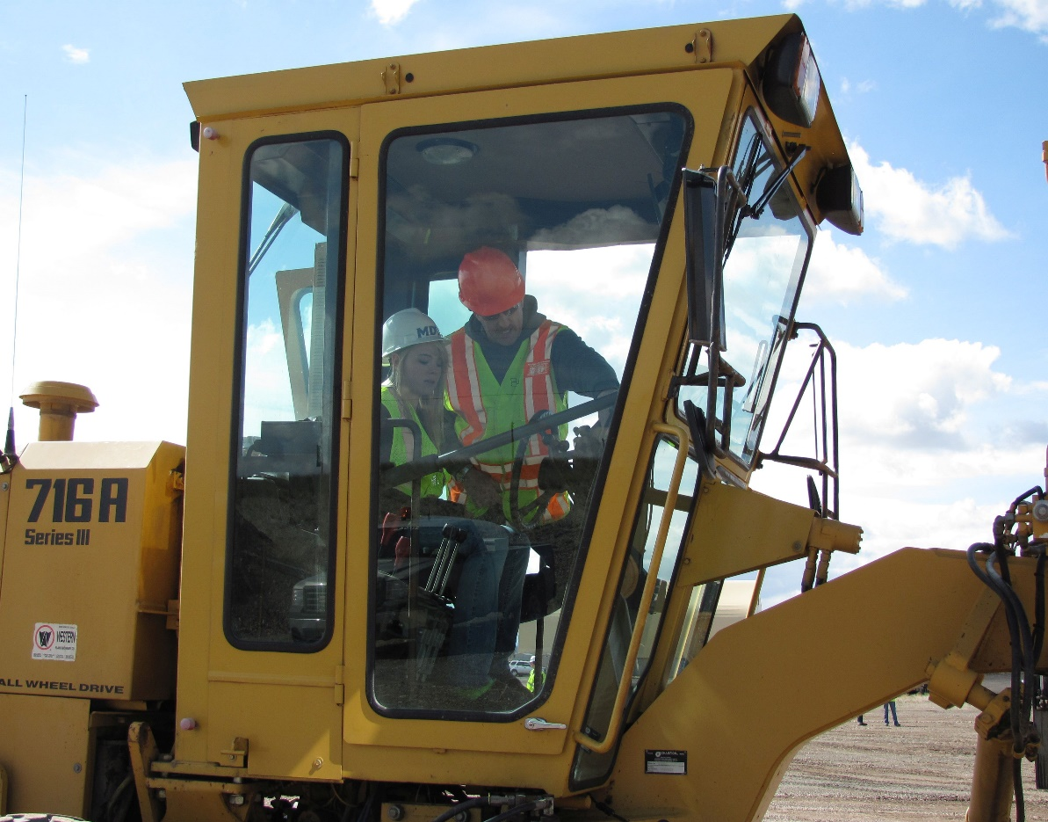
Internships
Notes:
This is just what it sounds like, probably very similar to what each of you do in your departments.
Our hurdle with Interns was having an opportunity to hire the intern at the end of their internship.
This has been a struggle because we don't have vacant positions that we hold.
If you leave a position vacant for any length of time, you risk the legislature taking the position away.
Because of this, most areas try to fill vacant positions as soon as possible after it is vacated.
We are attempting to interview and hire interns in advance of their graduation.
We have been doing this about a year and have seen good results so far.

Slide 11
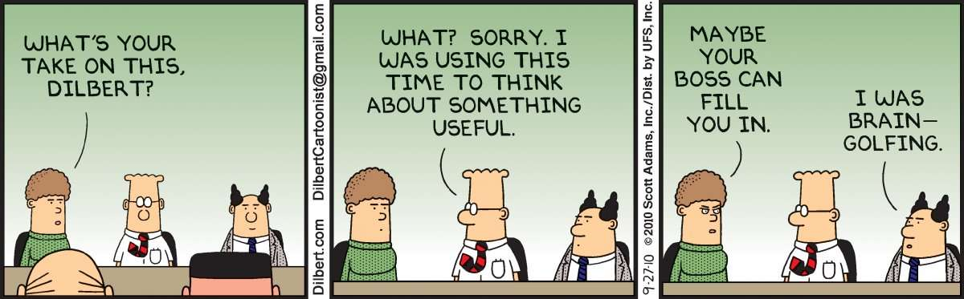
Mentoring
Notes:
We have started a somewhat formalized mentoring program.
First, we reached out to key supervisors and technical experts to see if they had interest in being a mentor to other staff.
Once we had a list of potential mentors, we put a memo out to staff letting them know that there was a group of staff available to provide mentoring services to other staff.
Mentoring could be for specific technical help or it could be for more softskills or management assistance.
One of the department's trainers, who has had experience with this kind of program, who talk with staff requesting a mentor and pair them with someone they felt would be a good fit for the employee requesting a mentor.
The mentoring can last a couple of weeks or multiple months.
This is really up to the mentor and mentee.

Slide 12
Position Specific Worksheets
Category/Sub-category | Description | Frequency | Effort required (hrs/month) | Mission critical duty? (Y/N)
Committees, Boards, and Meetings
Division | Engineering Division Staff Meetings | weekly | 4-6 | N
Bureau | R/W Staff Meeting | weekly | 6 | N
District | District Check-In Meetings | weekly | 10 | N
Division | Overrun & Inactive Projects | monthly | 1-2 | N
Division | Project Status Meeting | monthly | 3-4 | N
Division | Obligation/Apportionment Meeting | monthly | 1-2 | N
Department | Labor Management Committee | monthly | 2-3 | N
Legal | Pre-Project Status Legal Meeting | monthly | 1-2 | N
Division | Succession Planning Committee | monthly | 5-10 | N
Division | Engineering Bureau Chiefs Meeting | quarterly | 1 | N
Division | Preconstruction/Construction Cuss & Discuss | semi-annual | 2-3 | N
Bureau | Acquisition Supervisors Meeting | semi-annual | 5-6 | Y
Bureau | Design/Acquisition Supervisors Meeting | semi-annual | 5-6 | Y
Division | Design Coordination Meeting | semi-annual | 2-3 | N
Department | Tentative Construction Plan (TCP) Meeting | annually | 3-4 | N
Bureau | Right-of-Way TCP Meeting | annually | 2-3 | Y
Bureau | AASHTO CRUO Sub-Committee | annually | 30-40 | N
Bureau | AASHTO CRUO Conference | annually | 40-50 | N
Bureau | Consultant Selection Board | as needed | 1 | N
Department | Succession Planning Task Force | as needed | 1 | N
Department | Knowledge Management Subcommittee | as needed | 1 | N
Notes:
This is a snapshot of part a position Specific Worksheet.
This worksheet, if completed, will provide a roadmap for a new employee.
They may not know what their role is in the Engineering Division Staff Meeting, but they know they need to attend on a weekly basis.
If you were able to scroll to the right, you would see additional columns that list Adequate & current guidance available, authorized backup, and details and comments.
With this worksheet, we have asked staff to complete them as accurate as possible to reflect their actual duties and responsibilities.
This is a living document, so staff are encouraged to continually review their worksheet and update as necessary.

Slide 13
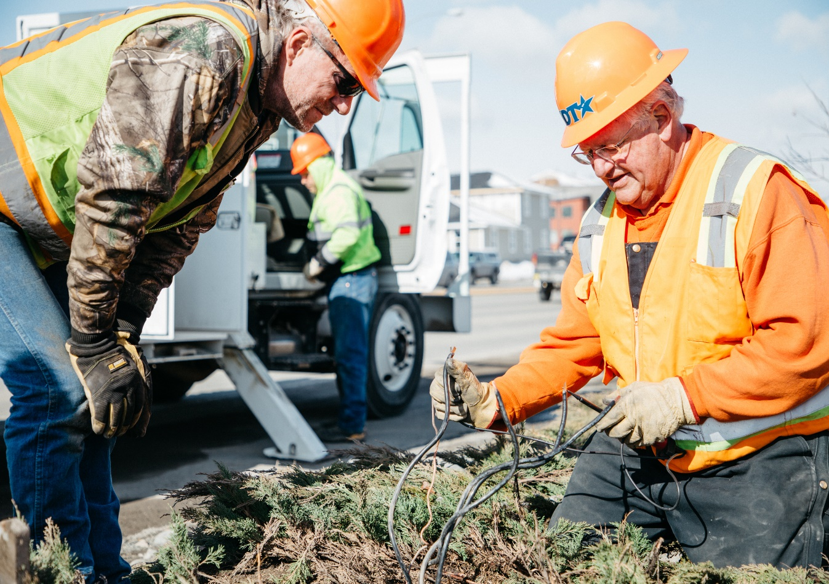
Expert Interviews
Notes:
Identify stand-alone or siloed positions
Identify person or persons to perform the interview
This can be supervisor, a different supervisor, or other staff that may be successful in pulling critical information from the current employee in the position
We are in the process of developing a list of interview questions to give direction to the interviewer.
This tool works best when paired with the Position Specific Worksheet.

Slide 14
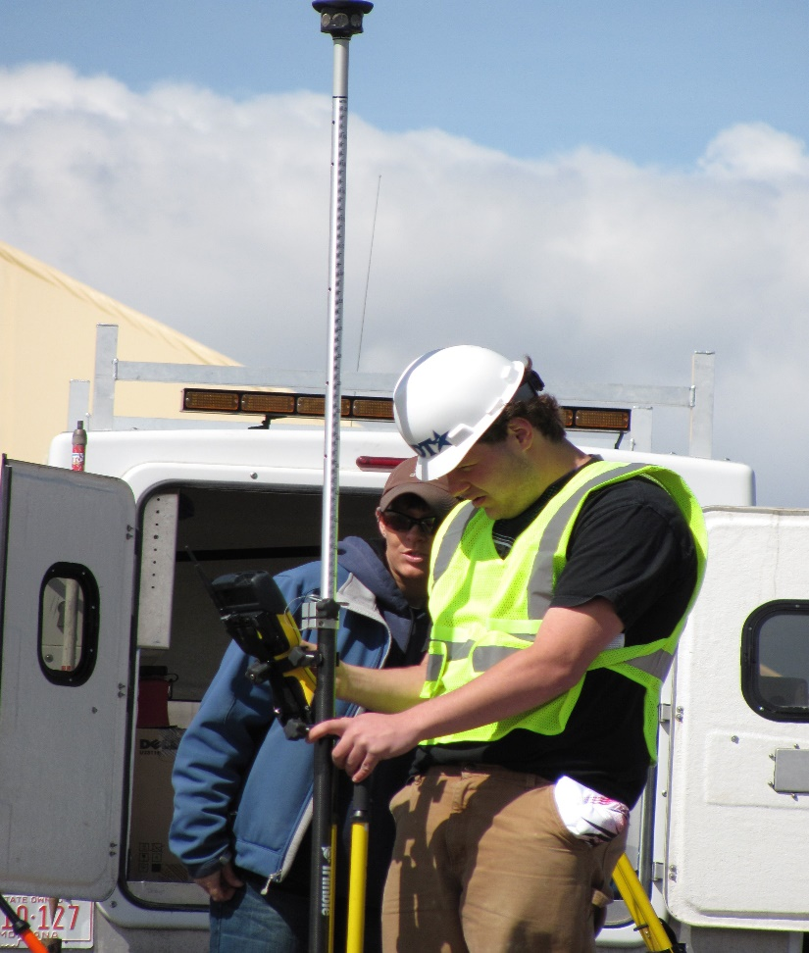
Short-Term Double Fill
Notes:
Two employees fill the same position
Short period of time, typically 2-4 weeks.
Allows incoming employee to receive first-hand knowledge and training from the departing employee.
Not practical for every vacancy.
Works best for siloed positions, where there is a lack of redundancy.
Some things to consider before using this tool are:
Do you have enough notice from the departing employee to be able to make this happen?
Do you have enough room in the budget to allow for two employees to be in the same position?
And is the departing employee the one you want training the new employee?

Slide 15
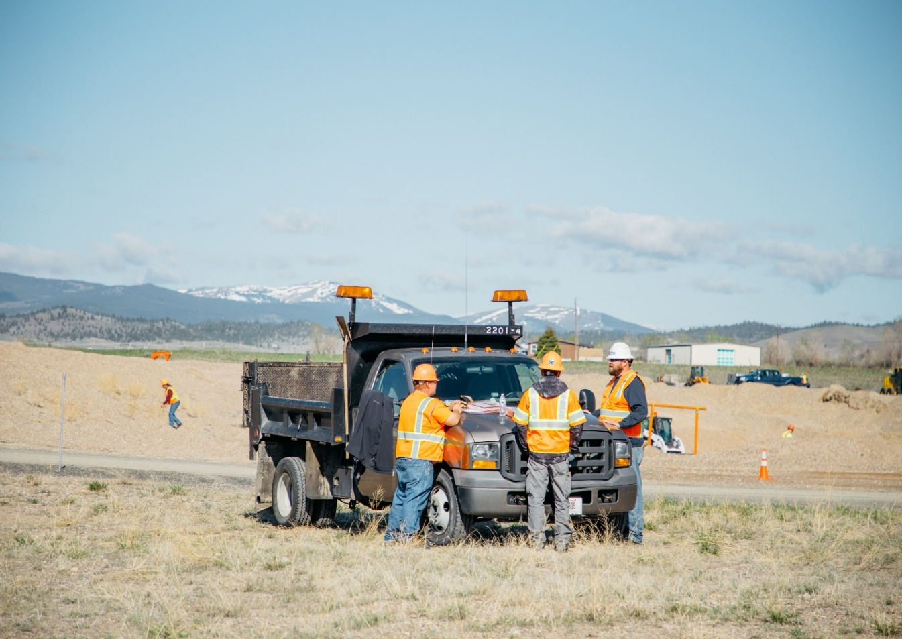
Job Rotations
Notes:
We have had a program for entry level engineers to enter the engineer rotation program.
These engineers would identify 3-5 different engineering areas at MDT and would spend a specific amount of time in each of those areas.
We have had great success with our engineers going through this program and gaining a broader knowledge of engineering within MDT.
We are now looking at implementing a rotation program for other areas within the Engineering Division.
The first area being considered is our Designers.
We have design units within Road Design, Traffic and Safety, and R/W.

Slide 16
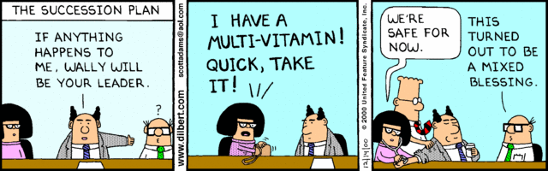
Effective Succession Planning

