Slide 1
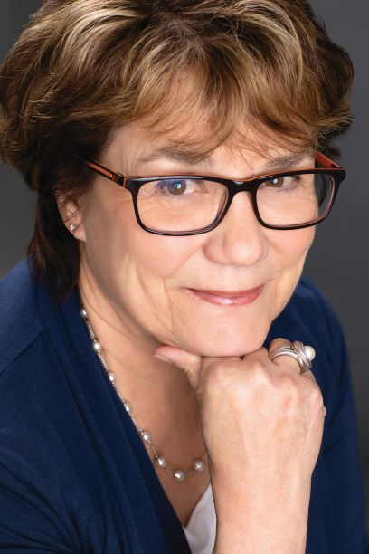
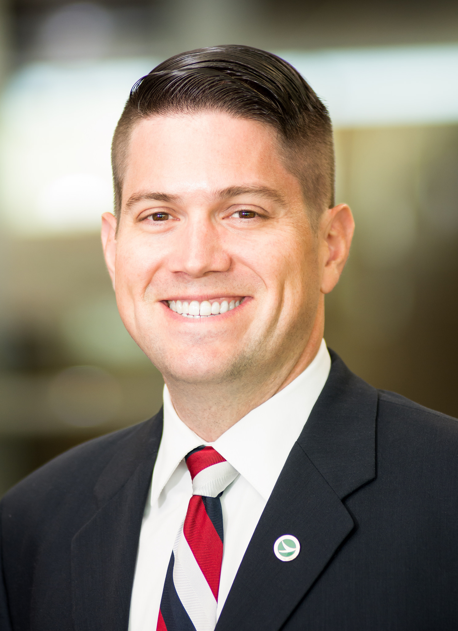
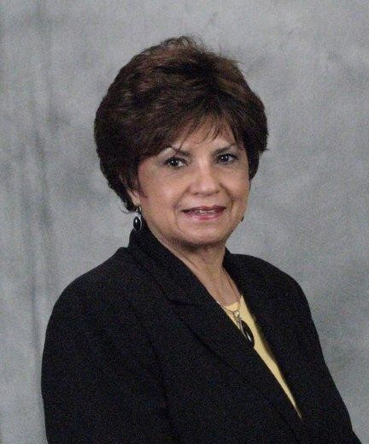
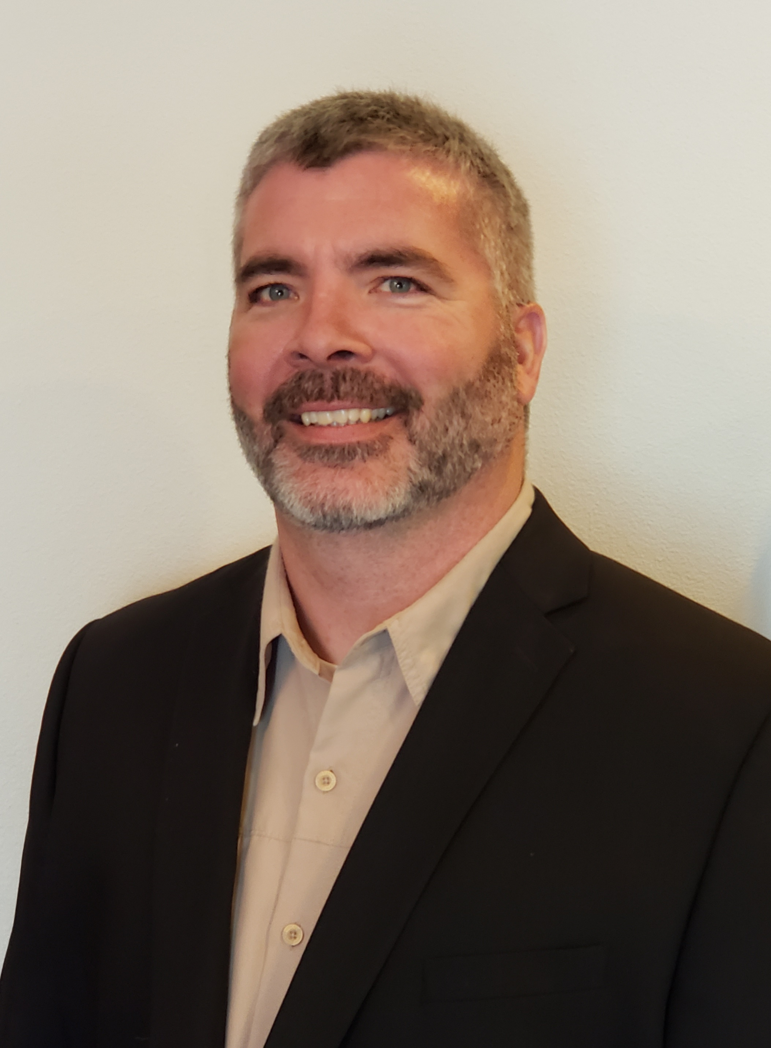
Developing the Next Generation of ROW Professionals
Catherine Muth, CEO - ORC
Drew Gilmore – Administrator of the ODOT Office of Real Estate
Rob Stapley – Right of Way Bureau Chief, Montana DOT
Carol Bellinger, Associate VP and National Transportation Services Real Estate Director - HDR

Slide 2
Demographics: Mathematical Certainty
74 million Baby Boomers
  retiring at the rate of 10,000 / day
65 million Gen X
“There will be winners and losers in this ‘War for Talent’”
      Quote from Chris Czarnik in his book Winning the War for Talent

Slide 3
ORC QA/QC
PROMISE Program
Quality does not happen by mistake
Quality is an integral part of ORC’s Corporate Business Principles. These Principles guide us in delivering compliant and preferred products and services. At ORC, Quality is built into our culture through the ORC WayTM and the Quality PROMISE Program.
Evaluate
Support
Key Performance Indicators (KPIs)/Metrics
Inspect
Best Practices & Process Improvement
Maintain
Oversight
Management Of Change (MOC)
Quality Control (QC)
Review
Plan
Internal Audit and Governance
Lessons Learned and Risk Management
Project Readiness
Notes:
Complying with relevant laws and regulations as well as internal requirements;
• Fostering a quality mind-set with the objective of developing and providing trusted, Client-preferred, defect-free products and services;
• Continuously challenging ourselves to improve the quality management system to guarantee our focus on safety;
• Demonstrating continuous improvement through sharing lessons learned to prevent quality incidents and eliminate defects;
• Encouraging participation and promotion of quality responsibilities among all employees and third parties through applying standards, education, training and coaching, supervision, and effective communication;
• Ensuring that our process identifies, assesses, quantifies, and mitigates our operational risk.

Slide 4

ORC Licensing Agreement for online training courses – 2015 to present
6 courses to date

Slide 5

IRWA Online University Courses by ORC
Course 411 – Appraisal Concepts for the Negotiator
Course 503 – Mobile Home Relocation
Course 507 – Specialized Nonresidential Payments
Course 520 – Special Topics in Replacement Housing
Course 521 – Nonresidential Fixed Payments
Course 530 – The Business Move Process
Pending – The 1, 2, 3’s of Right of Way Project Management

Slide 6
Jr. Agent Training Program (since 2005)
3 year curriculum
Assigned Mentor
One week Introductory Overview Course & Map Reading
IRWA, Appraisal Institute and internal courses
Combination of Classroom Instruction, Field Mentoring and completing a list of tasks with oversight
On Overhead first 6 months, then billable
Path to Management

Slide 7
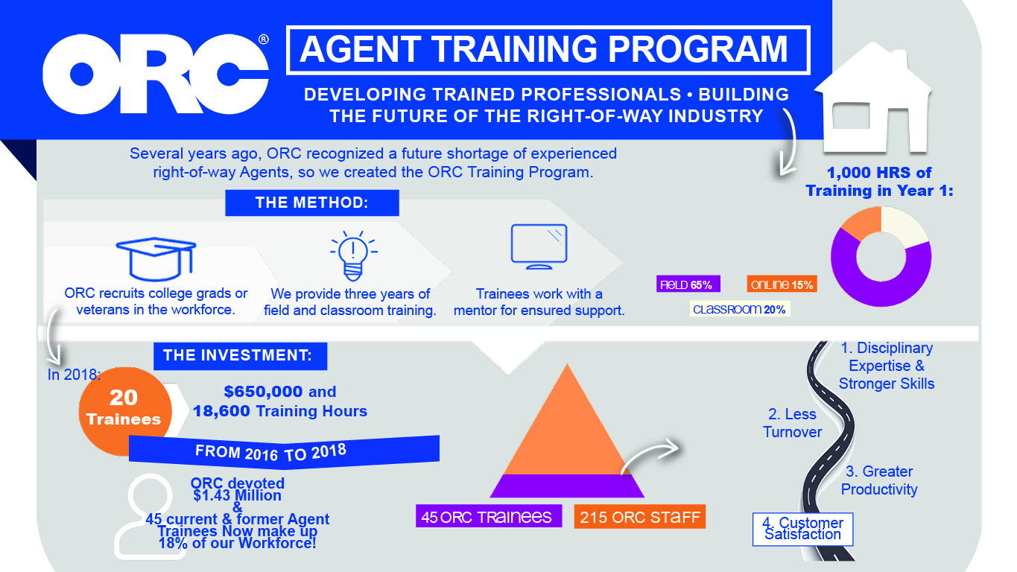

Slide 8
Internship Program
College Juniors and Seniors
Receive College Credits
Paid $10 - $12 / hour
SKILLS
DEVELOPMENT
TRAINING
PERSONAL GROWTH

Slide 9



2018 / 2019 Jr. Agents and Interns
2018 2019
Jr. Agents Hired 14 9
Interns Hired 2 5
Total Employees 230 260

Slide 10

Next Phase: 2nd Career Gap Training
Big 5 Personality Profile
  What behaviors make a good Agent? Manager?
Learning Development Specialist hired 2019
Assignment: design “gap training” for the 2nd career employee
Customize to the employee

Slide 11

1969 - 2019

Slide 12

Questions?
Comments?

